Slide 1
Mindful Coding
DEMO

Slide 2

Before going further, read the pages about Marking the Text and Mindful Coding in the handbook.
Welcome to the Mindful Coding DEMO.
As part of Layered Reading, this is a powerful DURING strategy for deep learning.

Slide 3
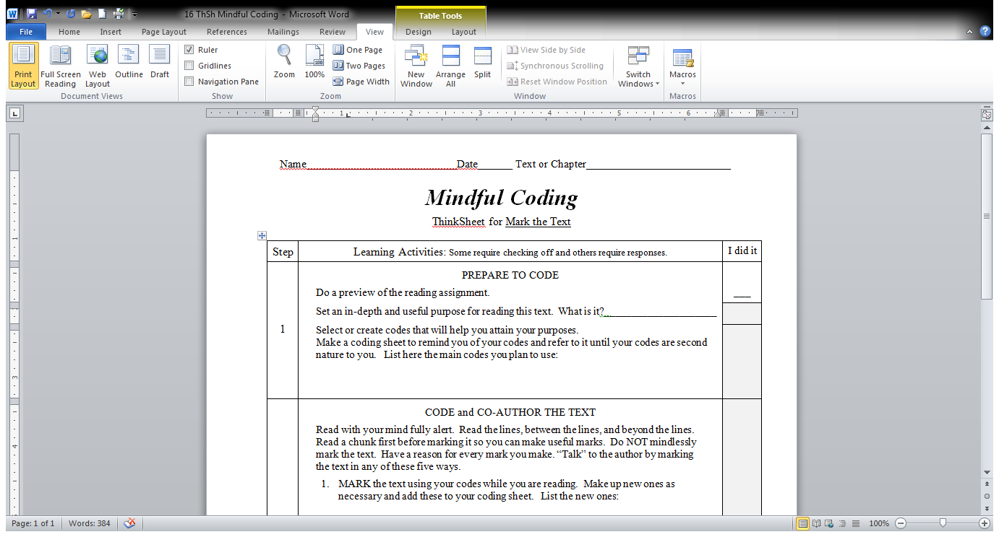


Now let’s go to the ThinkSheet for this Strategy.
I do T.H.I.E.V.V.E.S. with Snatches to preview the text and check it.

Slide 4

How was the periodic table developed?
What is the purpose of the periodic table?
Why are the parts arranged as they are?
I set three purposes for reading this text—I choose the question format.
From the preview, I think I know what I want to learn. I set my purpose—I do Launch.

Slide 5

Here are the codes I plan to use.
I will be marking this text.
P = my Prediction or guess of the answer to my question
T-S = connection between the Text and mySelf
T-W = connection between the Text and the World
T-TT = connection between the Text and This Text
T-S = connection between the Text and mySelf
? = my Question
OC = my Opinion or my Comment
= An important point I want to remember
= An important point I want to remember
= Key words

Slide 6
P = my Prediction or guess of the answer to my question
T-S = connection between the Text and mySelf
T-W = connection between the Text and the World
T-TT = connection between the Text and This Text
T-S = connection between the Text and mySelf
? = my Question
OC = my Opinion or my Comment
= An important point I want to remember
= An important point I want to remember
= Key words

Slide 7
P = my Prediction or guess of the answer to my question
T-S = connection between the Text and mySelf
T-W = connection between the Text and the World
T-TT = connection between the Text and This Text
T-S = connection between the Text and mySelf
? = my Question
OC = my Opinion or my Comment
= An important point I want to remember
= An important point I want to remember
= Key words

Slide 8
P = my Prediction or guess of the answer to my question
T-S = connection between the Text and mySelf
T-W = connection between the Text and the World
T-TT = connection between the Text and This Text
T-S = connection between the Text and mySelf
? = my Question
OC = my Opinion or my Comment
= An important point I want to remember
= An important point I want to remember
= Key words

Slide 9
P = my Prediction or guess of the answer to my question
T-S = connection between the Text and mySelf
T-W = connection between the Text and the World
T-TT = connection between the Text and This Text
T-S = connection between the Text and mySelf
? = my Question
OC = my Opinion or my Comment
= An important point I want to remember
= An important point I want to remember
= Key words

Slide 10
P = my Prediction or guess of the answer to my question
T-S = connection between the Text and mySelf
T-W = connection between the Text and the World
T-TT = connection between the Text and This Text
T-S = connection between the Text and mySelf
? = my Question
OC = my Opinion or my Comment
= An important point I want to remember
= An important point I want to remember
= Key words

Slide 11
P = my Prediction or guess of the answer to my question
T-S = connection between the Text and mySelf
T-W = connection between the Text and the World
T-TT = connection between the Text and This Text
T-S = connection between the Text and mySelf
? = my Question
OC = my Opinion or my Comment
= An important point I want to remember
= An important point I want to remember
= Key words

Slide 12
P = my Prediction or guess of the answer to my question
T-S = connection between the Text and mySelf
T-W = connection between the Text and the World
T-TT = connection between the Text and This Text
T-S = connection between the Text and mySelf
? = my Question
OC = my Opinion or my Comment
= An important point I want to remember
= An important point I want to remember
= Key words
Text word or phrase
Remind myself what circled part means

Slide 13
P = my Prediction or guess of the answer to my question
T-S = connection between the Text and mySelf
T-W = connection between the Text and the World
T-TT = connection between the Text and This Text
T-S = connection between the Text and mySelf
? = my Question
OC = my Opinion or my Comment
= An important point I want to remember
= An important point I want to remember
= Key words
Text word or phrase
Remind myself what circled part means
*

Slide 14
P = my Prediction or guess of the answer to my question
T-S = connection between the Text and mySelf
T-W = connection between the Text and the World
T-TT = connection between the Text and This Text
T-S = connection between the Text and mySelf
? = my Question
OC = my Opinion or my Comment
= An important point I want to remember
= A good summary
= Key words
Text word or phrase
Remind myself what circled part means
*
[ ]

Slide 15
P = my Prediction or guess of the answer to my question
T-S = connection between the Text and mySelf
T-W = connection between the Text and the World
T-TT = connection between the Text and This Text
T-S = connection between the Text and mySelf
? = my Question
OC = my Opinion or my Comment
= An important point I want to remember
= A good summary
= Key words
Text word or phrase
Remind myself what circled part means
*
[ ]
Word
= Key words

Slide 16
P = my Prediction or guess of the answer to my question
T-S = connection between the Text and mySelf
T-W = connection between the Text and the World
T-TT = connection between the Text and This Text
T-S = connection between the Text and mySelf
? = my Question
OC = my Opinion or my Comment
= An important point I want to remember
= A good summary
= Key words
Text word or phrase
Remind myself what circled part means
*
[ ]
Word

Slide 17
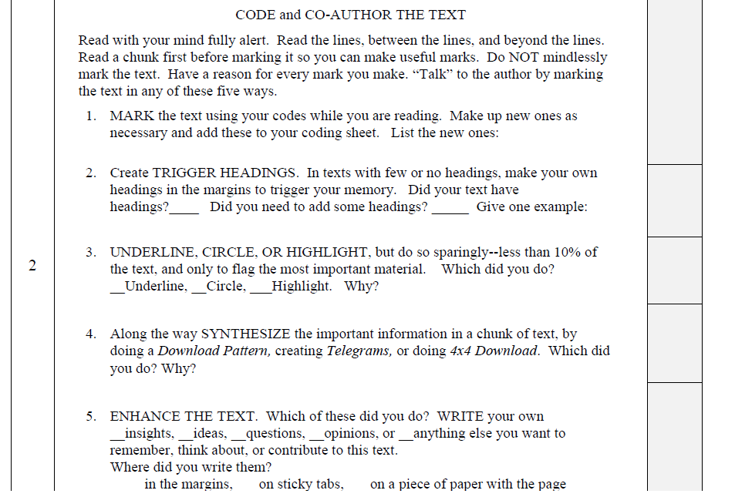

Watch me mark the text while I am reading.
I have a reason for every mark I make. I am NOT marking mindlessly!
Read the instructions for Coding and Co-Authoring the Text

Slide 18
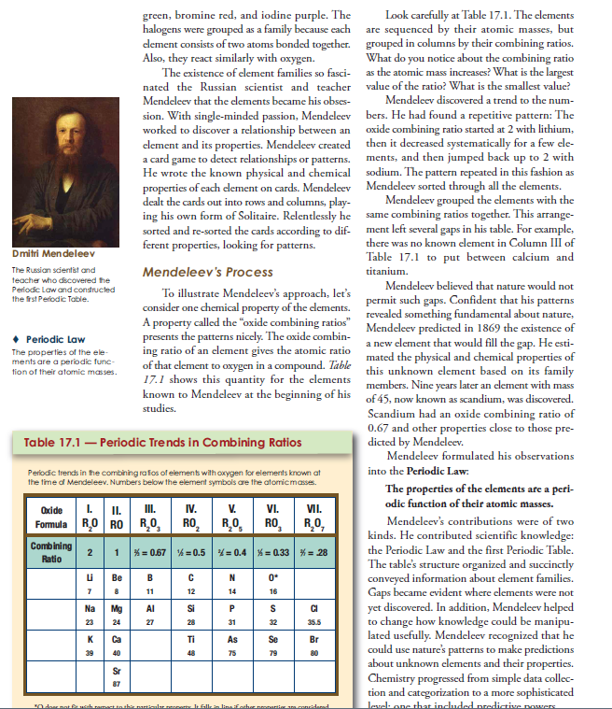
?
Like what I do with skeleton
T-TT –
See Fig. 17.7
TS– I need to be relentless as I read and learn
OC – “created” ?

Slide 19
?
Like what I do with skeleton
T-TT –
See Fig. 17.7
TS– I’m relentless as I read and learn
OC – “created”
T-S –
I can imagine his thrill in discovering these patterns
* The so what of the table!

Slide 20

While reading, I noticed that key moments occurred when important knowledge was added to the development of the Periodic Table.
Here is my new code, tailor made for this text:
+ Know = Added Knowledge
So, I am going to add an additional code that goes along with this purpose How was the periodic table developed?

Slide 21
Now I’ll add that to my code sheet
P = my Prediction or guess of the answer to my question
T-S = connection between the Text and mySelf
T-W = connection between the Text and the World
T-TT = connection between the Text and This Text
T-S = connection between the Text and mySelf
? = my Question
OC = my Opinion or my Comment
= An important point I want to remember
= A good summary
= Key words
Text
Remind myself what circled part means
*
[ ]
Word
+ Know = Added Knowledge

Slide 22
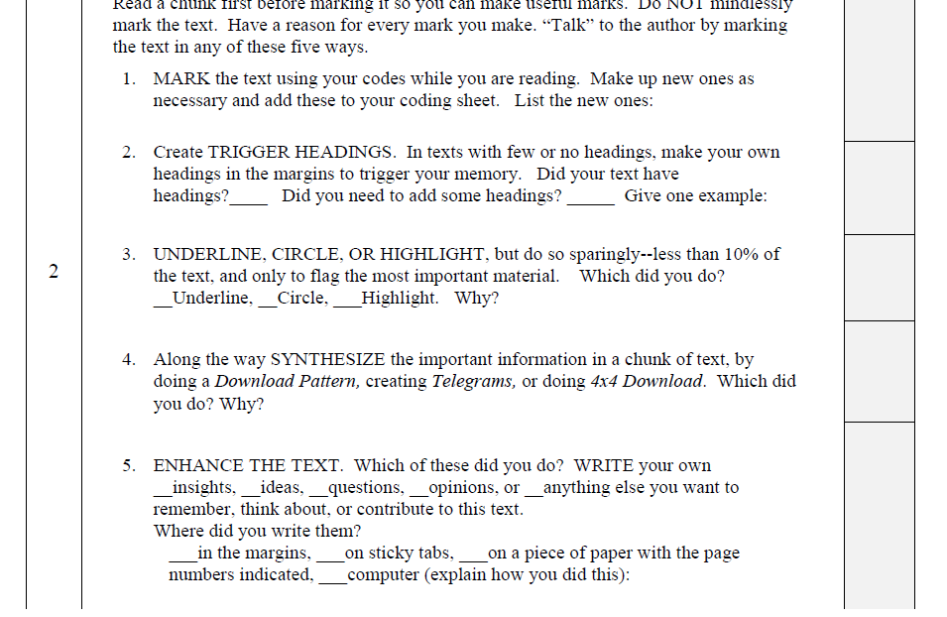
Watch me complete the ThinkSheet.
I keep reading, thinking, and marking the text—the parts that are most important for me,
based on my purpose.
Yes
Yes
When some sections were too long and had too much information, I added a heading. For example: “Periods defined” “Electrons role on the Periodlc Table”

Slide 23

I do not like to read highlighted books, including my highlighting. I much prefer underlining; I only underline key phrases and a complete sentence but only if it states the essence of a section in a remarkable way. I circle key words or names I MUST know well.
Not
Applicable

Slide 24
I defined “the important information” as the pieces that answered any of my three purpose-setting questions. I did Download Patterns and Telegram, with the Telegram as the main point in each Download Pattern. Why? I definitely needed to know the main point (Telegram), but I also wanted to capture the details and how they related to each other (Download Patterns).

Slide 25
Not
Applicable
I tried to answer my questions—usually when I came back after reading a little farther into the text.
When I could not figure out the answers to my questions, I wrote them on a list to ask someone later.

Slide 26
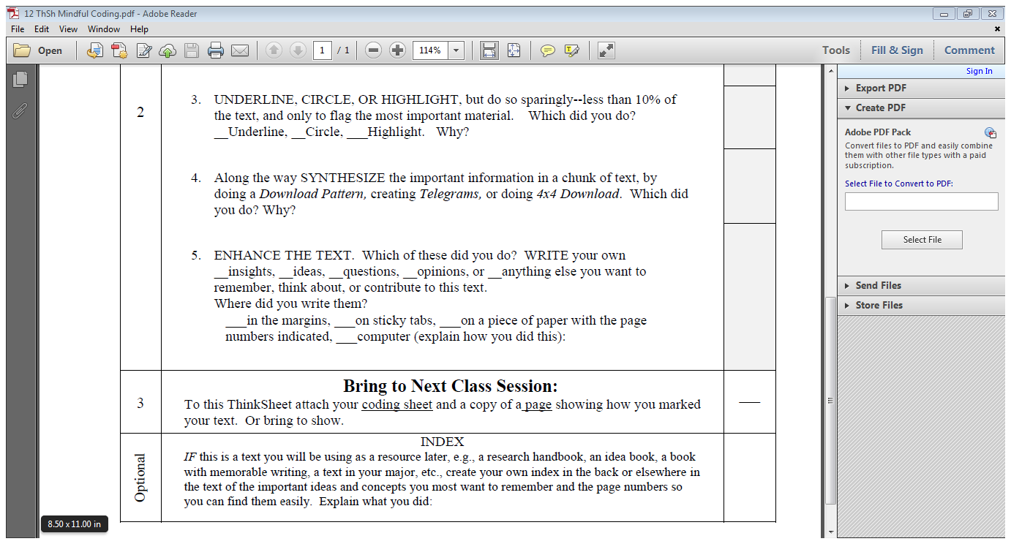

P = my Prediction or guess of the answer to my question
T-S = connection between the Text and mySelf
T-W = connection between the Text and the World
T-TT = connection between the Text and This Text
T-S = connection between the Text and mySelf
? = my Question
OC = my Opinion or my Comment
= An important point I want to remember
= An important point I want to remember
= Key words
Remember to bring this to class
Got it!
Text
Remind myself what circled part means
*
[ ]
Word
+ Know = Added Knowledge

Slide 27
My indexes are usually about issues or aspects of the text that may or may not be found in the book’s index—things I definitely want to think about and find easily, those things I find myself needing to refer to over and over, or that I want to use in a paper or presentation.
This optional step is very useful and a time-saver for those important texts I want to keep.
Here is a sample that I placed in the back of my text.

Slide 28

My Personal Index
Scientific Method, used naturally
Newton, 18-19
Cavendish, 34
Ben Franklin, 42
Thomson, 169
Rutherford, 170-171
Mendeleev, 208-209
Orbitals
Orbitals defined
Orbitals quantum mechanics, 196 waves, 195-197
Orbital energies, 195
Ions
ion defined
kinds of ions
ionic energy
ionic conductors, 152
Notice that sometimes I list topics I want to find in the text, but have not yet—maybe I will in a later chapter.
. . . that require mastery at a high level, or . . .
. . . for those texts I will reference heavily in the future.
Remember, putting together a personal index,
. . . is only for those texts,

Slide 29
To be completely honest,
I have to say,
. . . that at first this is a slow process.
The Secrets?
Keep your purposes for reading firmly in mind.
Have a good reason for everything you mark.
Use the same codes from text to text whenever feasible and include a few unique codes specific to that text, if necessary.
It is worth it!
And a time-saver later.
That’s because I usually can’t remember all of my codes as I start reading. Plus at first I was not quite sure what to mark.
Mindfully marking the text takes conscious practice of the steps at first, but it will become natural and will help you learn well while reading. Plus, you produce a great tool for reviewing the text later.
Best of luck practicing MINDFUL CODING on your text!

