Slide 1
Professor’s Questions & My Questions
DEMO

Slide 2
Welcome to a DEMO of Professor’s Questions
and
My Questions.
Both are primarily DURING strategies in Layered Reading.
These strategies demand perhaps the most important mental action of a scholar—
Asking Questions.

Slide 3
Right now, before going on, study the pages in the Handbook about the principle Ask Questions and the strategies
Prof’s Questions and
My Questions
We will break this demonstration up into two parts:
Professor Questions and
(2) My Questions

Slide 4
Let’s take a look at the text we’ll be working with in this demo.

Slide 5
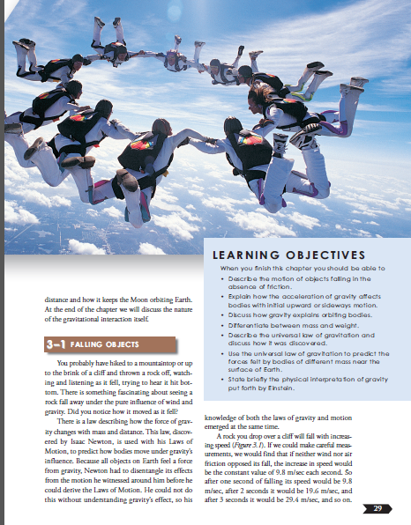
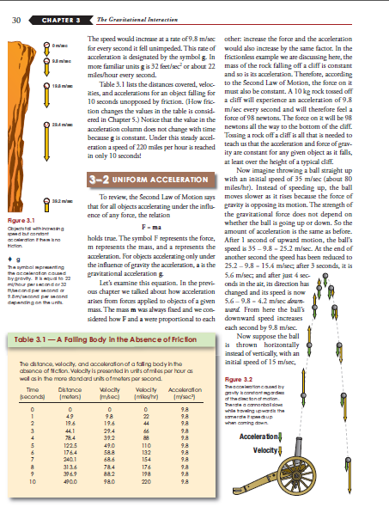
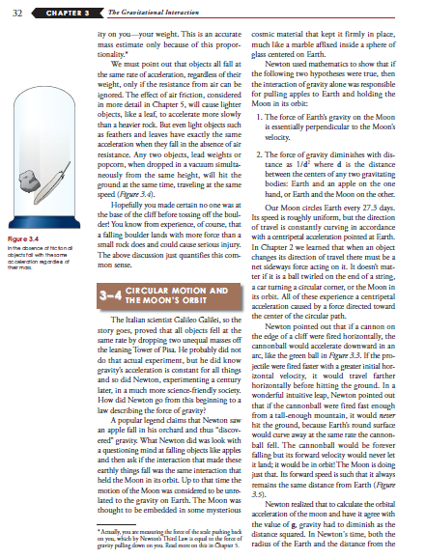
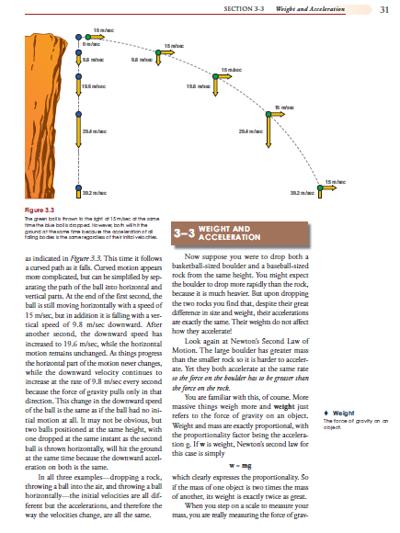
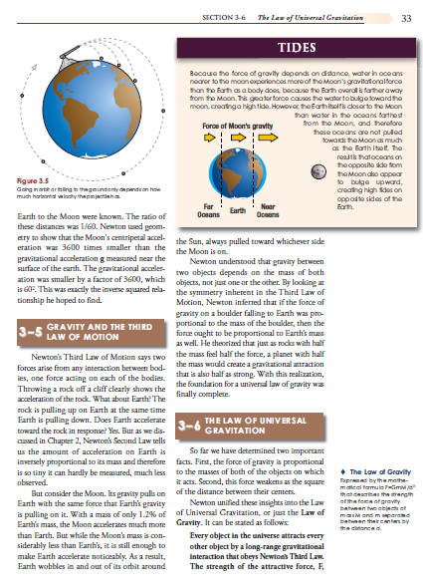
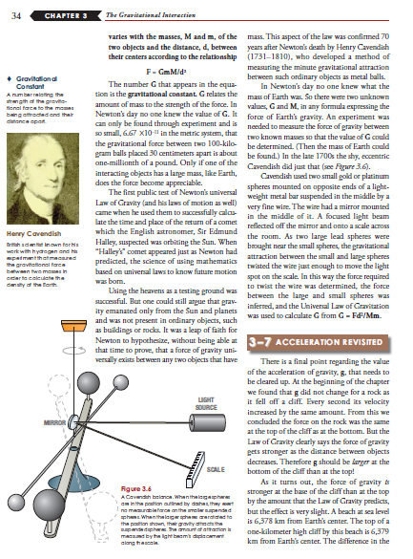
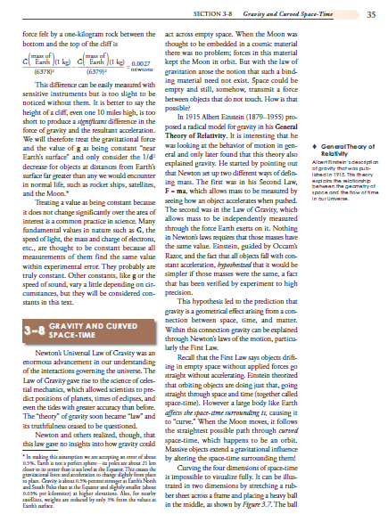
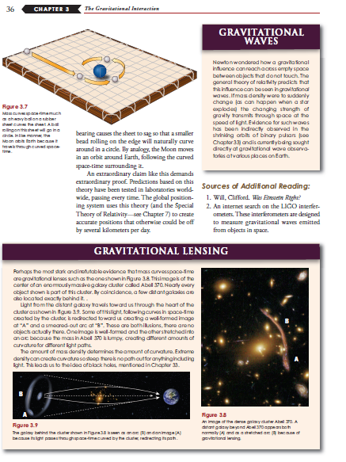
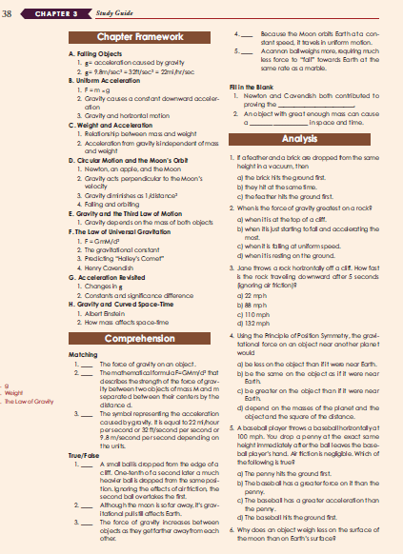
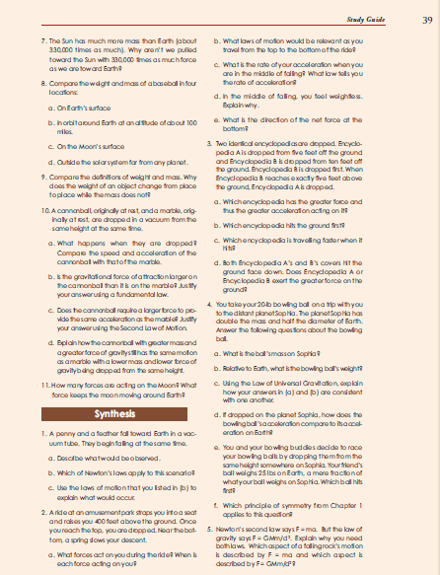
This is a science text.
We’ll focus on the chapter entitled:
“The Gravitational Interaction”

Slide 6
Now let’s take a tour of the ThinkSheet.

Slide 7
The backside lists the suggestions for how to do the ThinkSheet.

Slide 8
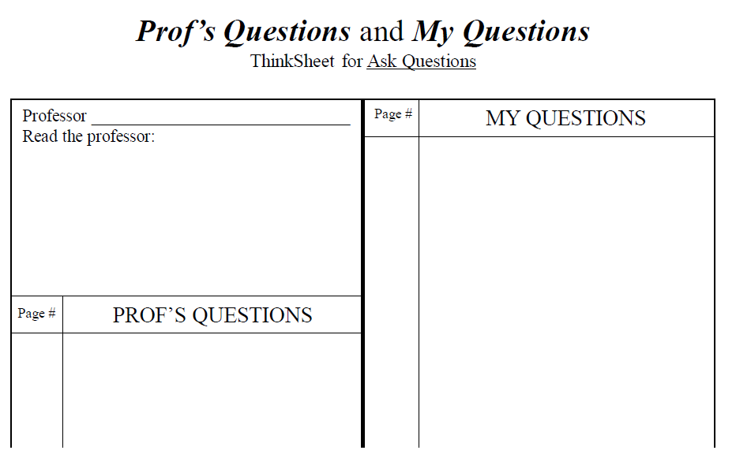
Let’s begin with Read the Professor
As you can see there are three sections to this ThinkSheet

Slide 9
Go to class ready to learn.
Use the notes; Use the questions the professor gives
. . . the G.U.E.S.S. acronym
You will remember from your reading in the Course Handbook . . .

Slide 10
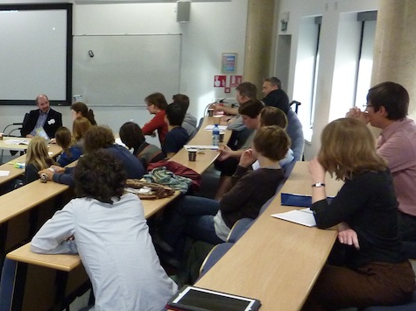
Where the professor puts heavy emphasis in lectures, discussion, and reference to the textbook
Where the professor puts heavy emphasis in lectures, discussion, and reference to the textbook
Where the professor puts heavy emphasis in lectures,ook
Examine:

Slide 11
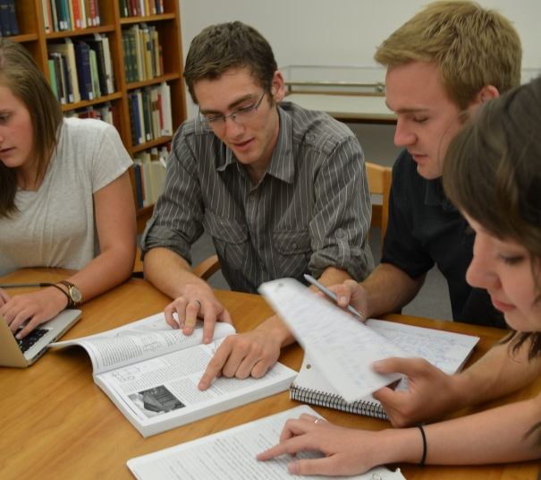
Survey former students;
aSk the Professor;
Start a study group and pool ideas about questions.

Slide 12
I will let a student take it from here.
G.U.E.S.S

Slide 13
So, in by Physical Science class, here is what I have learned about my
Professor’s emphasis so far.

Slide 14
She wants us to speculate the “Why” behind everything.
She gives lots of examples that connect to the content and also asks for our examples.
She expects us to know the basic facts that she presents and that are in the chapter.
She demands understanding underlying those facts and wants us to think about their implications.
She becomes excited when we show curiosity & imagination.

Slide 15
Now, I will put those observations on my ThinkSheet.
Speculate the “Why” behind everything.
Give examples.
know the basic facts from lecture & from chapter.
Understand those facts and think about implications.
Be curious and imagine possibilities.

Slide 16
Now Read Your Professor in this same box on your ThinkSheet.

Slide 17
Pause for Practice

Slide 18
I set my purpose for reading, which is . . .
Based on these observations and after doing THIEVVES with Snatches,

Slide 19
List questions I think the Professor will ask: Prof’s Questions
(Because I have read the professor, these will be why questions, examples, understanding of the facts, speculations about implications.)
List questions about what I don’t understand or want to know more about: My Questions
(I will go to class ready to ask these in such a way that she knows I have thought deeply about this chapter. Also this stimulates my curiosity which my professor hopes to see in me.)
Try to answer the questions.
(Use the text and my background knowledge. Go to outside sources as prodded by curiosity, time permitting.)

Slide 20
List questions I think the Professor will ask.
List questions about what I don’t understand.
Try to answer all of the questions about gravity from these two sources.at
Address each of the author’s objectives listed on page 29 in the text. (I think I can gain a solid understanding of the important facts if I can do these activities)
Notes:
Put in Page 29

Slide 21
As I read, here are the
Prof Questions, I came up with.
p. 29
What is the explanation for the fact that an object increases speed as it falls and does so at a constant rate?
Why
p. 30-31
What are some examples of how acceleration of gravity affects bodies thrown upward or thrown horizontally?
Examples
. . . read each entry to see how they address the four aspects of “reading this professor.”
p. 31
Why does weight NOT affect acceleration of a dropped object? w = mg
Why
p. 32-33
If the moon is falling at the constant acceleration (g) because of the earth’s gravity, why does it stay in orbit and not fall to the earth?
Is gravity actually holding the moon in orbit? How so? How so?
Factual
Implications
I write questions all the way to the end of the chapter. Usually I need extra paper OR I list the questions in the margins instead of on the ThinkSheet.
For this demonstration, I’ll stop here.
p. 33
What is the symmetry inherent in the Third Law of Motion?
Facts
p. 33
Explain the Law of Gravity – every part of it – its formula, how measured & examples showing how it works.
Facts and Examples
Notes:
Normally – you would do this in the margins of the text

Slide 22
Using your knowledge of your own professor, take time now to read a paragraph or two of your text and list on your ThinkSheet the “Prof Questions” you guess your professor will ask from this part of the text.

Slide 23
Pause for Practice

Slide 24
As you know from the Handbook, My Questions is the scholar’s primary strategy for learning from a text.
You will now see the student demonstrate
My Questions
using the same text.
Now watch her ask probing questions. Note:
She is full of curiosity and desire to understand.
She asks “What if” questions, thinking of implications and applications.
She is being a scholar here.

Slide 25
p. 29
Is Newton the one to derive the g constant?
How did he come up with It?
How did he measurement that?
Author talks of Newton’s Second Law of Motion, but what is the first? Did I miss something? (Ah, See p. 18!)
p. 30
p. 30
What is a newton? Predict – came from Sir Isaac Newton.
(Not in glossary nor in index)
Here are My Questions.
Note that the page number is RARELY where the answer it, but it is where I was when the question came to me.
p. 32
Even though a heavy object travels at the same rate falling as does a much lighter object (lead weight & popcorn), it lands with much more force. How could I explain this phenomena?
p. 32
What is “centripetal acceleration”?
And how does this explain the orbiting of the moon around the earth?
p. 33
I don’t understand: What is the effect of mass on gravitational attraction when it has no affect on acceleration in falling?
What if there were not gravity?
Are there places in space without gravity?
What was the point in the movie Interstellar about gravity?
Explain these statements:
“The force of gravity on a boulder falling to Earth is proportional to the mass of the boulder.”
Predict: falls at the same rate of acceleration but lands with a force proportional to its mass.
“With a mass of only, 1.2% of Earth’s mass, the moon accelerates much more than the Earth.”
(Ah! Is this what they meant earlier by this “In the absence of friction, all objects fall with the same acceleration regardless of mass”? (p. 32a)

Slide 26
For demonstration purposes, I will classify my questions based on the categories on the charts in the Course Handbook (Question Starters Chart and Bloom’s Taxonomy)

Slide 27
p. 29
Is Newton the one to derive the g constant?
How did he come up with It?
How did he measurement that?
Factual
p. 30
Author talks of Newton’s Second Law of Motion, but what is the first? Did I miss something? (Ah, See p. 18!)
Factual
p. 30
What is a newton? Predict – came from Sir Isaac Newton. (Not in glossary nor in index)
Analyze
p. 32
Even though a heavy object travels at the same rate falling as does a much lighter object (lead weight & popcorn), it lands with much more force. Explain this phenomena.
Comprehend
p. 32
What is “centripetal acceleration”?
And how does this explain the orbiting of the moon around the earth?
Probing
I don’t understand the effect of mass on gravitational attraction when it has no affect on acceleration in falling.
Explain these statements:
“The force of gravity on a boulder falling to Earth is proportional to the mass of the boulder.” (I predict: falls at the same rate of acceleration but lands with a force proportional to its mass.)
“With a mass of only, 1.2% of Earth’s mass, the moon accelerates much more than the Earth.” (Ah! Is this what they meant earlier by this “In the absence of friction, all objects fall with the same acceleration regardless of mass”? (p. 32a)
p. 33
Analyze
Comprehend
Analyze
Analyze

Slide 28
The student will now go back to the text, and elsewhere if she wants to learn beyond the text (The More You Know strategy) and will try to answer her questions or
drill deeper.
It is your turn to practice. Use the ThinkSheet
on the text using both Professor Questions and My Questions.
HAVE FUN!

