Slide 1
Telegram & Make an Abstract
Demo

Slide 2
Welcome to the DEMO for Telegram and Make an Abstract.
Both cause you to synthesize, an essential principle for learning well from academic texts. In the scope of Layered Reading,
Telegram is in the DURING layer.
Make an Abstract is in the AFTER layer.
Before going on, go to the Handbook and learn all you can about Synthesize Along the Way and Telegram for the DURING READING layer, plus all you can from the pages about Synthesize—Parts to Whole and Make an Abstract for AFTER READING.
We will begin with Telegram.

Slide 3

We will work through a chapter in an American Heritage Text

Slide 4
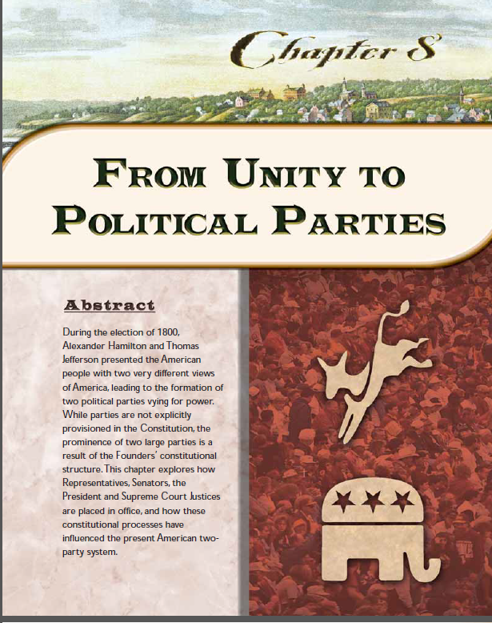
Specifically, Chapter 8, entitled:

Slide 5
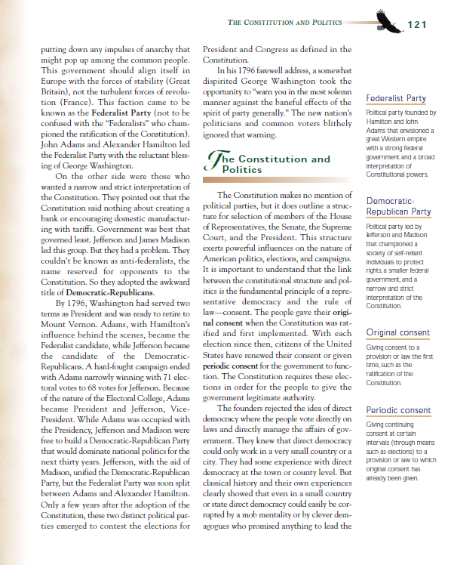
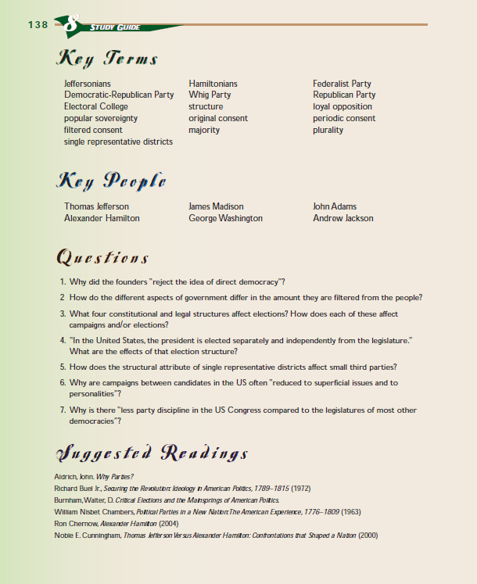
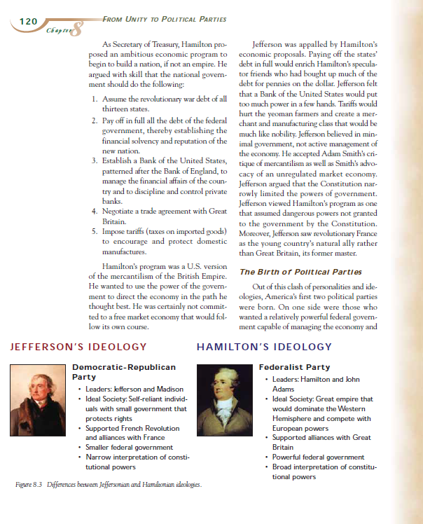
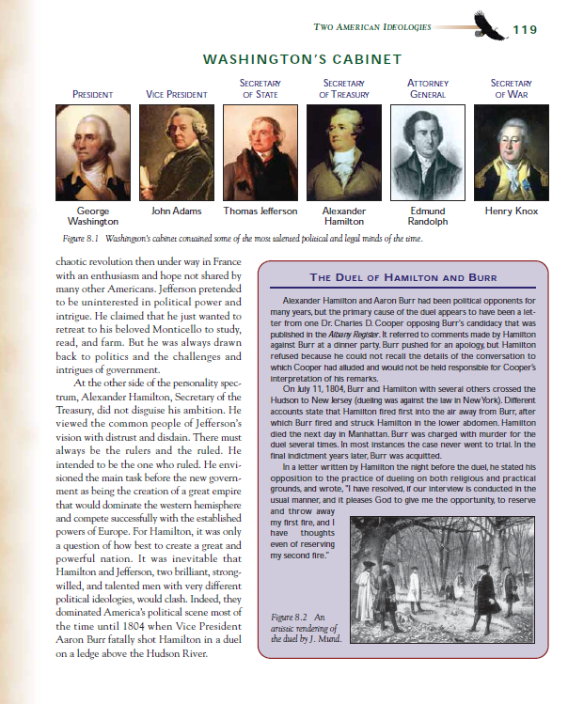
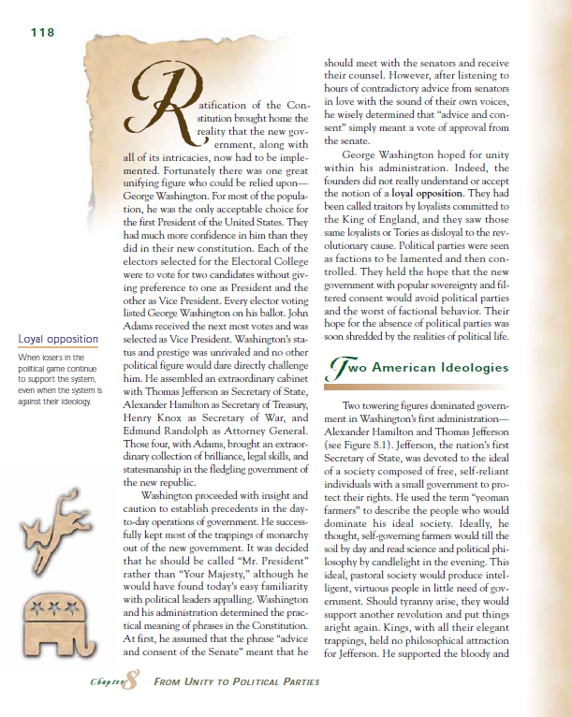
So I did three BEFORE strategies for this text:
(1) a Skeleton of the chapter to remind me of the chapter’s structure,
(2) T.H.I.E.V.V.E.S. with Snatches to see what I will be learning and to build my anticipation, and
(3) Launch to form my purpose for what I want to learn before leaving this text.

Slide 6
Based on these pre-reading strategies, I have formed these purposes:
Describe the views that led to the formation of two political parties.
Explain how elections are to occur according to the Constitution for the House of Representatives, the Senate, the President, and the Supreme Court Justices.

Slide 7
From the Handbook, I learned the value of synthesizing along the way.
I now need to decide where to pause to download. Many of the ideas in this chapter are familiar to me, so I will probably pause only at the end of sections.
However, for the parts that are new to me and harder to understand, I will stop more often, perhaps at the end of a couple of paragraphs or even a single paragraph.
In some parts of texts that are really hard for me, I have stopped to synthesize at the end of a single sentence!
With Telegram, I demand of myself that I understand and can state what I just read IF this section helps me meet my purpose for reading.
To do a Telegram, I pull all the parts of what I just read into a single abbreviated statement, its overall message for me. Sometimes circling key words along the way helps me do this.
The Telegram can be a quick phrase. If I do a good job, everything in that part points to and enhances my phrase, and later, I can look at the phrase to trigger my memory of the details, examples, whatever I want to remember, in that part of the text.
Notes:
I can write myYou will see later why I used sticky tabs.
However, there will be times when you will want to just write in the margins.

Slide 8
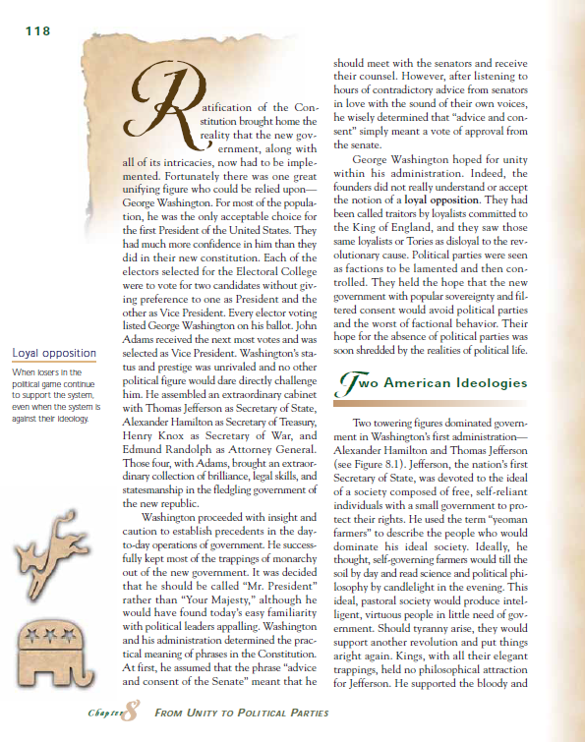
Watch me do Telegram.
I have already decided to synthesize at the end of each section, though this may change to shorter segments if needed.
Notice that I place the sticky tabs smack dab in the middle of the last line—to remind me to stop.

Slide 9
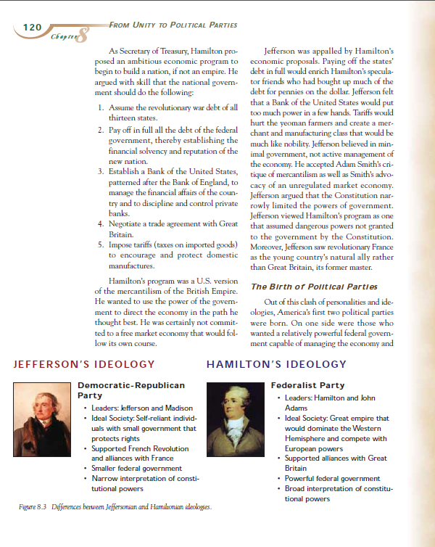

Slide 10
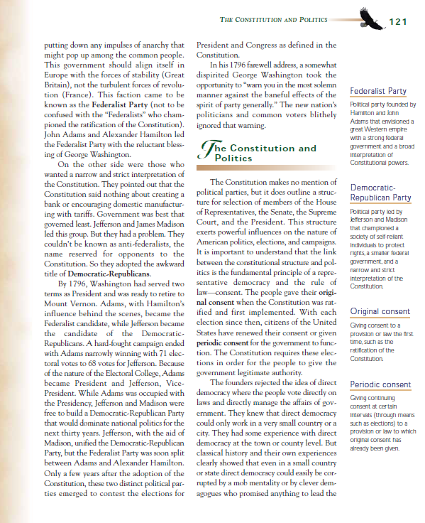

Slide 11
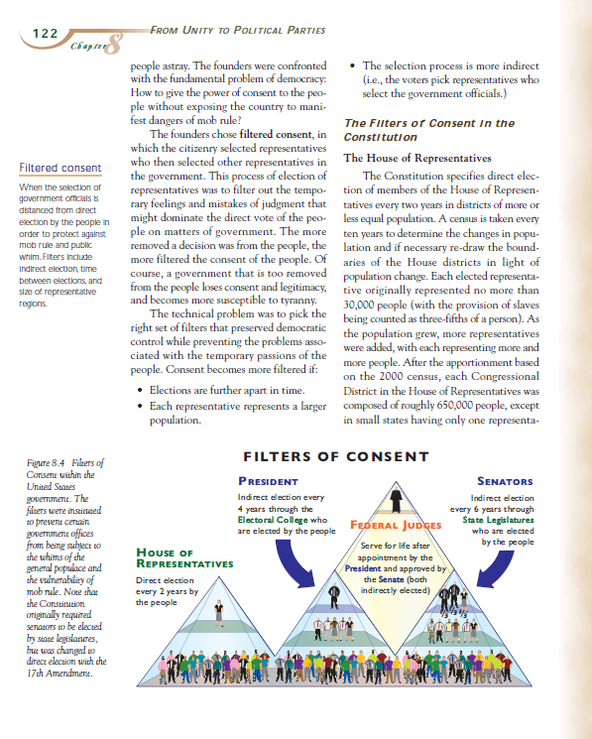

Slide 12
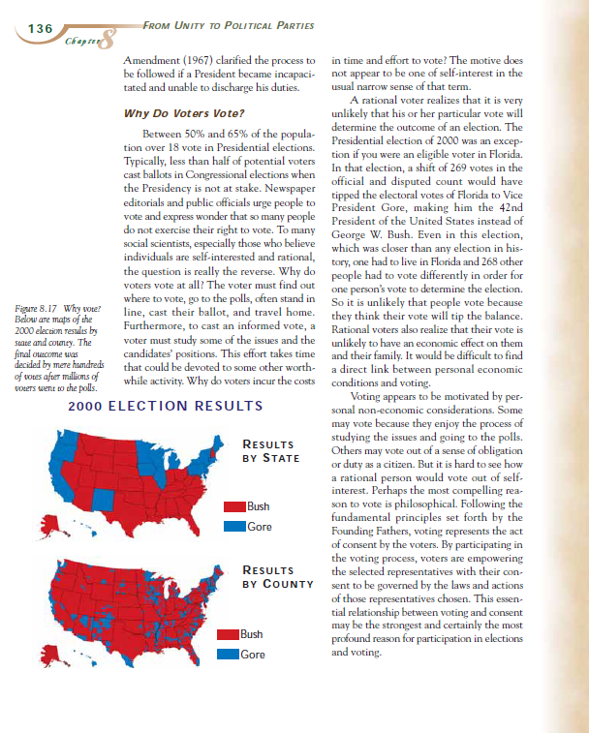

Slide 13
If the book is mine, I usually write in the margins at the end of the segment.
If it is not, I write on the sticky notes.
Also, if my AFTER strategy will be Make an Abstract, I do write on the sticky tabs. That is what I will do for this demonstration, write Telegrams on the sticky notes.

Slide 14
Notice how the Telegrams are written.
They may not make sense to you, but they do to me. Warning: They must make sense to me weeks from now also, or they lose their usefulness.
Here we go!

Slide 15
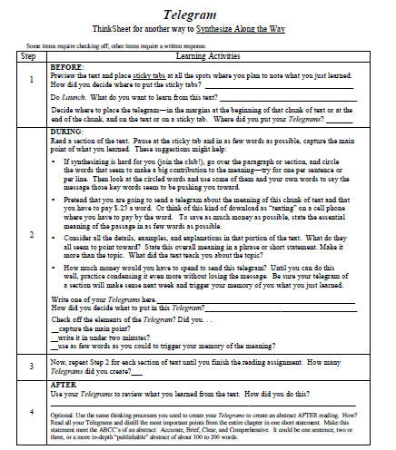
The ThinkSheet can guide you through the process.

Slide 16
Of course, I write them by hand, not type them! Quick and easy is the rule.
I always put the page number in case the sticky notes come loose.
P. 118
Washington’s Adjustments – hoped for Unity (Not!)
Notes:
118

Slide 17
Let me show you how I came up with that Telegram.

Slide 18
As I read, I consciously identify ideas that trigger the meaning of that part. I either circle or underline key words that seem to represent these ideas.
As I make these decisions, I start to see where this section is headed.
P. 118
Washington’s popularity, precedents, adjustments
hoped for Unity (Not!)
Notes:
118

Slide 19
Later, as I become good at identifying the messages of sentences, paragraphs, and visuals, and holding them in my head to the end of the section, I won’t need to mark these key words and phrases—just use them to formulate the overall meaning of the section.
P. 118
Washington’s popularity, precedents, adjustments
hoped for Unity (Not!)
Notes:
118

Slide 20
P. 118
Washington’s popularity, precedents, his adjustments
hoped for Unity (Not!)
Notes:
118

Slide 21
P. 118
Washington’s popularity, precedents, his adjustments – hoped for Unity (Not!)
Notes:
118

Slide 22
Notice how I could have written a Telegram for each paragraph (and were the text harder for me, indeed, I would have), but instead I waited to the end of the section and synthesized all the parts into just eight words! --a Telegram of that entire section.
Then as I read the Telegram, it triggers in my mind the details I left out.
USEFUL!
QUICK!
MEMORABLE!
I hope you get the idea for how to do a Telegram and realize its value. Our research showed it to be the MOST popular During Strategy of our students.
  The ThinkSheet asks me to check the elements of my Telegrams. This is good to do until Telegram is automatic:
  Did I capture the main point?
  Did I create it in under two minutes?
  Did I use as few words as necessary to trigger my memory of the meaning and the details?
Let’s continue looking at examples of Telegrams in this text.

Slide 23
P. 120
Role of Govt.
Jeffers - Hamilton
Small - Powerful

Slide 24
P. 121
2 Parties started
Demo-Repub-Fed
(Small) (Strong)
pp. 118- 121
Major Section 1
The two strongest ideologies =
2 Political Parties
Pres
VP
Depending how the chapter is structured, I like to take a moment and write an even broader Telegram synthesizing all the sub-sections within a major section. It is still short but brings to mind all that I have learned.

Slide 25
pp. 122
3 Reasons for NOT direct democracy.
But keep consent of the people – filtered content
pp. 122-123
Filtered Consent
H. Of Rep
Directly elected –
2 yrs. Based on population 1 per # of people

Slide 26
For the sake of time, this demo skips to the end, but know that I made a Telegram on every sticky tab along the way.
Major Section 6 p. 134-136
changes in election
process
Elections & individuals – not much difference
We vote to give consent

Slide 27
Telegram is a powerful During strategy because you demand understanding and have a useful product to show for your effort.
Let’s now move to an equally useful After strategy, Make an Abstract.
You need to know that IF the book is mine, I prefer to write the Telegrams in the margins rather than on sticky notes.
But I like to use sticky notes, too, especially when I want to Make an Abstract.
P. 120
Role of Govt.
Jeffers - Hamilton
Small - Powerful
Notes:
But I like to use sticky notes, too, especially when I want to Make an Abstract.

Slide 28
An easy and effective way to synthesize the entire chapter is to look at all the Telegrams and synthesize from them. To do this, I first gather all the sticky notes into one location so I can easily refer to them.
I use the same thinking processes of SYNTHESIZING when I Make an Abstract as I do for Telegram. The difference? One I do DURING reading for each segment of text as I come to it; the other I do AFTER reading the entire text.
Another difference involves the ABCC’s of a good abstract:
An Abstract is
Accurate, Brief, Clear, and Comprehensive.
Let’s use the ThinkSheet for this purpose. Here is the ThinkSheet.

Slide 29
Name________________________Date_____Section___Text or Chapter______________
Purpose(s) for reading this text:________________________________________________________
Make a Telegram for each important chunk of text. Write them here with page numbers or on a sticky tab next to the chunk of text. Then place the tabs on this ThinkSheet.
An effective way to Make an Abstract is to read and synthesize your telegrams.
Telegram and Make an Abstract
ThinkSheet for Synthesizing Along the Way and Synthesizing After—Parts to Whole
Telegram
Abstract
What kind of NAPE abstract did you write? _________

Slide 30
Name________________________Date_____Section___Text or Chapter______________
Purpose(s) for reading this text:________________________________________________________
Make a Telegram for each important chunk of text. Write them here with page numbers or on a sticky tab next to the chunk of text. Then place the tabs on this ThinkSheet.
An effective way to Make an Abstract is to read and synthesize your telegrams.
Telegram and Make an Abstract
ThinkSheet for Synthesizing Along the Way and Synthesizing After—Parts to Whole
Telegram
P. 118
Washington’s popularity, precedents, his adjustments – hoped for Unity (Not!)
P. 121
2 Parties started
Demo-Repub-Fed
(Small) (Strong)
pp. 118- 121
Section 1
The two strongest ideologies =
2 Political Parties
pp. 122
3 Reasons for NOT direct democracy.
But keep consent of the people – filtered content
pp. 122
Filtered Consent
H. Of Rep
Directly elected –
2 yrs. Based on population 1 per # of people
P. 118
Washington’s popularity, precedents, his adjustments – hoped for Unity (Not!)
P. 120
Role of Govt.
Jeffers - Hamilton
Small - Powerful
Abstract
What kind of NAPE abstract did you write? _________
Here comes an abstract!
As you read it, notice the ways it is unlike Telegram: Instead, it is written in complete sentences to make sense to other people who have not read the chapter.—and it will make sense to me, also, weeks from now.
pp. 123
Filtered Consent
Senate
For 6 yrs – 2 per state
Before 1913 elected by state legislature
pp. 124
Filtered Consent
President
# of Senators plus # of H. of Rep = Electl Col
4 yrs – not popular vote
Section 6 p. 134-136
changes in election
process
Elections & individuals – not much difference
We vote to give consent
pp. 124
Filtered Consent
Supreme Court
Nominated by Pres. Consent of Senate
for life
Section 5 p 130-134
Characteristics of contemporary elections.
*Continuous campaigns
*Primaries- extremes
*General elect – middle
*Increased partisanship
Section 4 P. 127-130
1-The conditions when 3rd parties have impact
2-How candidates must position themselves to win
pp. 125-127
Section 3
Contrasting US system of elections (winner take all) with Parliament (proportional)
Note – I did Telegrams for five sub-sections for Section 3, three of4, four for 5, and three for 6 (none shown here)
pp. 121-124
Section 2
The meaning of “filtered” consent in the Constitution
pp. 124
Removal from Office
*Voted out
*Congress – by mbers
*Pres – impeach by the H of Rep, Trial by Senate

Slide 31
Telegram and Make an Abstract
ThinkSheet for Synthesizing Along the Way and Synthesizing After—Parts to Whole
p 118
p 120
p 121
p 118-121
p 122
p 123
Telegram
P. 118
Washington’s popularity, precedents, his adjustments – hoped for Unity (Not!)
P. 120
Role of Govt.
Jeffers - Hamilton
Small - Powerful
P. 121
2 Parties started
Demo-Repub-Fed
(Small) (Strong)
pp. 118- 121
Section 1
The two strongest ideologies =
2 Political Parties
pp. 122
3 Reasons for NOT direct democracy.
But keep consent of the people – filtered content
pp. 122
Filtered Consent
H. Of Rep
Directly elected –
2 yrs. Based on population 1 per # of people
Washington’s Adjust-ments – hoped for Unity (Not!)
Role of Govt.
Jefferson - - - Hamilton
(Small) (Powerful)
2 Parties Started
Demo-Repub - - - - Fed
(Small) (Strong)
Section 1
The two strongest ideologies
=
Two Political Parties
3 Reasons for NOT direct democracy
But keep consent of the people – filtered consent
Filtered Consent
H. of Rep.
Directly elected – 2 yrs based on population
1 rep per # of people
How did I do it?
I read through my Telegrams and synthesized them into this abstract that captures the main points for the entire chapter.
Let’s look at some more examples.
p 123
Abstract
pp. 123
Filtered Consent
Senate
For 6 yrs – 2 per state
Before 1913 elected by state legislature
Filtered Consent
Senate
For 6 yrs – 2 per state
Before 1913 elected by state legislature
This chapter “From Unity to Political Parties” outlines the processes and changes in U.S. history concerning how elections of national government occur. The Constitution supports but doesn’t specifically create political parties; however two main parties have existed throughout, though additional parties have had more or less subtle influences on elections. This chapter explains the essential characteristics of “filtered consent,” of “Winner takes all,” and of the state of contemporary elections. The chapter ends with a philosophical discussion of why people vote.
p 124
pp. 124
Filtered Consent
President
# of Senators plus # of H. of Rep = Electl Col
4 yrs – not popular vote
Filtered Consent
President
# of Senators plus # of H. of Rep = Electoral College
4 yrs – not popular vote
Section 6 p. 134-136
changes in election
process
Elections & individuals – not much difference
We vote to give consent
p 124
pp. 124
Filtered Consent
Supreme Court
Nominated by Pres. Consent of Senate
for life
Filtered Consent
Supreme Court
Nominated by Pres. Consent of Senate
for life
Section 4 P. 127-130
1-The conditions when 3rd parties have impact
2-How candidates must position themselves to win
p 121-124
p 121-124
p 124
Section 5 p 130-134
Characteristics of contemporary elections.
*Continuous campaigns
*Primaries- extremes
*General elect – middle
*Increased partisanship
pp. 125-127
Section 3
Contrasting US system of elections (winner take all) with Parliament (proportional)
Note – I did Telegrams for five sub-sections for Section 3, three of4, four for 5, and three for 6 (none shown here)
pp. 121-124
Section 2
The meaning of “filtered” consent
pp. 124
Removal from Office
*Voted out
*Congress – by mbers
*Pres – impeach by the H of Rep, Trial by Senate
Section 3
pp. 125-127 Contrasting US system of elections (winner take all) with Parliament (proportional)
Section 2
The meaning of “filtered” consent
Removal from Office
*Voted out
*Congress – by members
*Pres – impeach by the
H of Rep, Trial by Senate

Slide 32
Telegram and Make an Abstract
ThinkSheet for Synthesizing Along the Way and Synthesizing After—Parts to Whole
p 118
p 120
p 121
p 118-121
p 122
p 123
Telegram
P. 118
Washington’s Adjustments – hoped for Unity (Not!)
P. 120
Role of Govt.
Jeffers - Hamilton
Small - Powerful
P. 121
2 Parties started
Demo-Repub-Fed
(Small) (Strong)
pp. 118- 121
Section 1
The two strongest ideologies =
2 Political Parties
pp. 122
3 Reasons for NOT direct democracy.
But keep consent of the people – filtered content
pp. 122
Filtered Consent
H. Of Rep
Directly elected –
2 yrs. Based on population 1 per # of people
Washington’s Adjust-ments – hoped for Unity (Not!)
Role of Govt.
Jefferson - - - Hamilton
(Small) (Powerful)
2 Parties Started
Demo-Repub - - - - Fed
(Small) (Strong)
Section 1
The two strongest ideologies
=
Two Political Parties
3 Reasons for NOT direct democracy
But keep consent of the people – filtered consent
Filtered Consent
H. of Rep.
Directly elected – 2 yrs based on population
1 rep per # of people
Abstract
p 123
Here is a News Release example.
pp. 123
Filtered Consent
Senate
For 6 yrs – 2 per state
Before 1913 elected by state legislature
Filtered Consent
Senate
For 6 yrs – 2 per state
Before 1913 elected by state legislature
p 124
pp. 124
Filtered Consent
President
# of Senators plus # of H. of Rep = Electl Col
4 yrs – not popular vote
Filtered Consent
President
# of Senators plus # of H. of Rep = Electoral College
4 yrs – not popular vote
Section 6 p. 134-136
changes in election
process
Elections & individuals – not much difference
We vote to give consent
p 124
pp. 124
Filtered Consent
Supreme Court
Nominated by Pres. Consent of Senate
for life
Filtered Consent
Supreme Court
Nominated by Pres. Consent of Senate
for life
Section 4 P. 127-130
1-The conditions when 3rd parties have impact
2-How candidates must position themselves to win
p 121-124
p 121-124
p 124
Section 5 p 130-134
Characteristics of contemporary elections.
*Continuous campaigns
*Primaries- extremes
*General elect – middle
*Increased partisanship
pp. 125-127
Section 3
Contrasting US system of elections (winner take all) with Parliament (proportional)
Note – I did Telegrams for five sub-sections for Section 3, three of4, four for 5, and three for 6 (none shown here)
pp. 121-124
Section 2
The meaning of “filtered” consent
pp. 124
Removal from Office
*Voted out
*Congress – by mbers
*Pres – impeach by the H of Rep, Trial by Senate
Section 3
pp. 125-127 Contrasting US system of elections (winner take all) with Parliament (proportional)
Section 2
The meaning of “filtered” consent
Removal from Office
*Voted out
*Congress – by members
*Pres – impeach by the
H of Rep, Trial by Senate

Slide 33
Telegram and Make an Abstract
ThinkSheet for Synthesizing Along the Way and Synthesizing After—Parts to Whole
p 118
p 120
p 121
p 118-121
p 122
p 123
Telegram
P. 118
Washington’s Adjustments – hoped for Unity (Not!)
P. 120
Role of Govt.
Jeffers - Hamilton
Small - Powerful
P. 121
2 Parties started
Demo-Repub-Fed
(Small) (Strong)
pp. 118- 121
Section 1
The two strongest ideologies =
2 Political Parties
pp. 122
3 Reasons for NOT direct democracy.
But keep consent of the people – filtered content
pp. 122
Filtered Consent
H. Of Rep
Directly elected –
2 yrs. Based on population 1 per # of people
Washington’s Adjust-ments – hoped for Unity (Not!)
Role of Govt.
Jefferson - - - Hamilton
(Small) (Powerful)
2 Parties Started
Demo-Repub - - - - Fed
(Small) (Strong)
Section 1
The two strongest ideologies
=
Two Political Parties
3 Reasons for NOT direct democracy
But keep consent of the people – filtered consent
Filtered Consent
H. of Rep.
Directly elected – 2 yrs based on population
1 rep per # of people
Abstract
p 123
A news release focuses on the who, what, when, where, why, how, and you state it in one sentence, like the lead sentence in a news article.
pp. 123
Filtered Consent
Senate
For 6 yrs – 2 per state
Before 1913 elected by state legislature
Filtered Consent
Senate
For 6 yrs – 2 per state
Before 1913 elected by state legislature
p 124
pp. 124
Filtered Consent
President
# of Senators plus # of H. of Rep = Electl Col
4 yrs – not popular vote
Filtered Consent
President
# of Senators plus # of H. of Rep = Electoral College
4 yrs – not popular vote
p 130-134
Section 5
Characteristics of contemporary elections.
Continuous campaigns
Primaries- extremes
General elect – middle
Increased partisanship
p 124
Section 6 p. 134-136
changes in election
process
Elections & individuals – not much difference
We vote to give consent
pp. 124
Filtered Consent
Supreme Court
Nominated by Pres. Consent of Senate
for life
Filtered Consent
Supreme Court
Nominated by Pres. Consent of Senate
for life
P127-130
p 121-124
p 121-124
p 124
Section 4
The conditions when 3rd parties have impact
How candidates must position themselves to win
Section 4 P. 127-130
1-The conditions when 3rd parties have impact
2-How candidates must position themselves to win
pp. 125-127
Section 3
Contrasting US system of elections (winner take all) with Parliament (proportional)
pp. 121-124
Section 2
The meaning of “filtered” consent
Section 5 p 130-134
Characteristics of contemporary elections.
*Continuous campaigns
*Primaries- extremes
*General elect – middle
*Increased partisanship
Section 3
pp. 125-127 Contrasting US system of elections (winner take all) with Parliament (proportional)
Note – I did Telegrams for five sub-sections for Section 3, three of4, four for 5, and three for 6 (none shown here)
pp. 124
Removal from Office
*Voted out
*Congress – by mbers
*Pres – impeach by the H of Rep, Trial by Senate
Note – I did three subsections for Section 4 (not shown here)
Note – I did five subsections for Section 3 (not shown here)
Section 2
The meaning of “filtered” consent
Removal from Office
*Voted out
*Congress – by members
*Pres – impeach by the
H of Rep, Trial by Senate

Slide 34
One sentence
Telegram and Make an Abstract
ThinkSheet for Synthesizing Along the Way and Synthesizing After—Parts to Whole
Notice:
p 118
p 121
p 118-121
p 122
p 123
Telegram
P. 118
Washington’s Adjustments – hoped for Unity (Not!)
P. 120
Role of Govt.
Jeffers - Hamilton
Small - Powerful
P. 121
2 Parties started
Demo-Repub-Fed
(Small) (Strong)
pp. 118- 121
Section 1
The two strongest ideologies =
2 Political Parties
pp. 122
3 Reasons for NOT direct democracy.
But keep consent of the people – filtered content
pp. 122
Filtered Consent
H. Of Rep
Directly elected –
2 yrs. Based on population 1 per # of people
Washington’s Adjust-ments – hoped for Unity (Not!)
Role of Govt.
Jefferson - - - Hamilton
(Small) (Powerful)
2 Parties Started
Demo-Repub - - - - Fed
(Small) (Strong)
Section 1
The two strongest ideologies
=
Two Political Parties
3 Reasons for NOT direct democracy
But keep consent of the people – filtered consent
Filtered Consent
H. of Rep.
Directly elected – 2 yrs based on population
1 rep per # of people
Abstract
News Release
p 123
pp. 123
Filtered Consent
Senate
For 6 yrs – 2 per state
Before 1913 elected by state legislature
Filtered Consent
Senate
For 6 yrs – 2 per state
Before 1913 elected by state legislature
Who
When
From 1780 to the present, the selection of our national leaders has involved popular elections and appointments, both based on the “filtered consent” of the people to form a practical govern-ment that represents the majority vote.
What
Section 6 p. 134-136
changes in election
process
Elections & individuals – not much difference
We vote to give consent
Section 6
changes in election
process
Elections & individuals – not much difference
We vote to give consent
p 124
p 134-136
pp. 124
Filtered Consent
President
# of Senators plus # of H. of Rep = Electl Col
4 yrs – not popular vote
Filtered Consent
President
# of Senators plus # of H. of Rep = Electoral College
4 yrs – not popular vote
p 130-134
Section 5
Characteristics of contemporary elections.
Continuous campaigns
Primaries- extremes
General elect – middle
Increased partisanship
p 124
Section 5 p 130-134
Characteristics of contemporary elections.
*Continuous campaigns
*Primaries- extremes
*General elect – middle
*Increased partisanship
pp. 124
Filtered Consent
Supreme Court
Nominated by Pres. Consent of Senate
for life
Filtered Consent
Supreme Court
Nominated by Pres. Consent of Senate
for life
Why
P127-130
How
p 121-124
p 121-124
p 124
Section 4
The conditions when 3rd parties have impact
How candidates must position themselves to win
Note – I did three subsections for Section 4 (not shown here)
pp. 125-127
Section 3
Contrasting US system of elections (winner take all) with Parliament (proportional)
Note – I did five subsections for Section 3 (not shown here)
Section 4 P. 127-130
1-The conditions when 3rd parties have impact
2-How candidates must position themselves to win
pp. 121-124
Section 2
The meaning of “filtered” consent
pp. 124
Removal from Office
*Voted out
*Congress – by mbers
*Pres – impeach by the H of Rep, Trial by Senate
Note – I did three subsections for Section 4 (not shown here)
Section 3
pp. 125-127 Contrasting US system of elections (winner take all) with Parliament (proportional)
Note – I did five subsections for Section 3 (not shown here)
Section 2
The meaning of “filtered” consent
Removal from Office
*Voted out
*Congress – by members
*Pres – impeach by the
H of Rep, Trial by Senate

Slide 35
Telegram and Make an Abstract
ThinkSheet for Synthesizing Along the Way and Synthesizing After—Parts to Whole
p 118
p 120
p 121
p 118-121
p 122
p 123
Telegram
P. 118
Washington’s Adjustments – hoped for Unity (Not!)
P. 120
Role of Govt.
Jeffers - Hamilton
Small - Powerful
P. 121
2 Parties started
Demo-Repub-Fed
(Small) (Strong)
pp. 118- 121
Section 1
The two strongest ideologies =
2 Political Parties
pp. 122
3 Reasons for NOT direct democracy.
But keep consent of the people – filtered content
pp. 122
Filtered Consent
H. Of Rep
Directly elected –
2 yrs. Based on population 1 per # of people
Washington’s Adjust-ments – hoped for Unity (Not!)
Role of Govt.
Jefferson - - - Hamilton
(Small) (Powerful)
2 Parties Started
Demo-Repub - - - - Fed
(Small) (Strong)
Section 1
The two strongest ideologies
=
Two Political Parties
3 Reasons for NOT direct democracy
But keep consent of the people – filtered consent
Filtered Consent
H. of Rep.
Directly elected – 2 yrs based on population
1 rep per # of people
Abstract
p 123
An Annotation Abstract example is next.
pp. 123
Filtered Consent
Senate
For 6 yrs – 2 per state
Before 1913 elected by state legislature
Filtered Consent
Senate
For 6 yrs – 2 per state
Before 1913 elected by state legislature
p 124
pp. 124
Filtered Consent
President
# of Senators plus # of H. of Rep = Electl Col
4 yrs – not popular vote
Filtered Consent
President
# of Senators plus # of H. of Rep = Electoral College
4 yrs – not popular vote
Section 6 p. 134-136
changes in election
process
Elections & individuals – not much difference
We vote to give consent
p 124
pp. 124
Filtered Consent
Supreme Court
Nominated by Pres. Consent of Senate
for life
Filtered Consent
Supreme Court
Nominated by Pres. Consent of Senate
for life
Section 4 P. 127-130
1-The conditions when 3rd parties have impact
2-How candidates must position themselves to win
p 121-124
p 121-124
p 124
Section 5 p 130-134
Characteristics of contemporary elections.
*Continuous campaigns
*Primaries- extremes
*General elect – middle
*Increased partisanship
pp. 125-127
Section 3
Contrasting US system of elections (winner take all) with Parliament (proportional)
Note – I did Telegrams for five sub-sections for Section 3, three of4, four for 5, and three for 6 (none shown here)
pp. 121-124
Section 2
The meaning of “filtered” consent
pp. 124
Removal from Office
*Voted out
*Congress – by mbers
*Pres – impeach by the H of Rep, Trial by Senate
Section 3
pp. 125-127 Contrasting US system of elections (winner take all) with Parliament (proportional)
Section 2
The meaning of “filtered” consent
Removal from Office
*Voted out
*Congress – by members
*Pres – impeach by the
H of Rep, Trial by Senate

Slide 36
Telegram and Make an Abstract
ThinkSheet for Synthesizing Along the Way and Synthesizing After—Parts to Whole
p 118
p 120
p 121
p 118-121
p 122
p 123
Telegram
P. 118
Washington’s Adjustments – hoped for Unity (Not!)
P. 120
Role of Govt.
Jeffers - Hamilton
Small - Powerful
P. 121
2 Parties started
Demo-Repub-Fed
(Small) (Strong)
pp. 118- 121
Section 1
The two strongest ideologies =
2 Political Parties
pp. 122
3 Reasons for NOT direct democracy.
But keep consent of the people – filtered content
pp. 122
Filtered Consent
H. Of Rep
Directly elected –
2 yrs. Based on population 1 per # of people
Washington’s Adjust-ments – hoped for Unity (Not!)
Role of Govt.
Jefferson - - - Hamilton
(Small) (Powerful)
2 Parties Started
Demo-Repub - - - - Fed
(Small) (Strong)
Section 1
The two strongest ideologies
=
Two Political Parties
3 Reasons for NOT direct democracy
But keep consent of the people – filtered consent
Filtered Consent
H. of Rep.
Directly elected – 2 yrs based on population
1 rep per # of people
Abstract
p 123
An Annotation – Abstract consists of 2 to 3 sentences as for an annotated bibliography.
pp. 123
Filtered Consent
Senate
For 6 yrs – 2 per state
Before 1913 elected by state legislature
Filtered Consent
Senate
For 6 yrs – 2 per state
Before 1913 elected by state legislature
p 124
pp. 124
Filtered Consent
President
# of Senators plus # of H. of Rep = Electl Col
4 yrs – not popular vote
Filtered Consent
President
# of Senators plus # of H. of Rep = Electoral College
4 yrs – not popular vote
Section 6 p. 134-136
changes in election
process
Elections & individuals – not much difference
We vote to give consent
p 124
pp. 124
Filtered Consent
Supreme Court
Nominated by Pres. Consent of Senate
for life
Filtered Consent
Supreme Court
Nominated by Pres. Consent of Senate
for life
P127-130
p 121-124
p 121-124
p 124
Section 4
The conditions when 3rd parties have impact
How candidates must position themselves to win
pp. 125-127
Section 3
Contrasting US system of elections (winner take all) with Parliament (proportional)
Section 5 p 130-134
Characteristics of contemporary elections.
*Continuous campaigns
*Primaries- extremes
*General elect – middle
*Increased partisanship
Section 4 P. 127-130
1-The conditions when 3rd parties have impact
2-How candidates must position themselves to win
Note – I did Telegrams for five sub-sections for Section 3, three of4, four for 5, and three for 6 (none shown here)
pp. 121-124
Section 2
The meaning of “filtered” consent
pp. 124
Removal from Office
*Voted out
*Congress – by mbers
*Pres – impeach by the H of Rep, Trial by Senate
Note – I did three subsections for Section 4 (not shown here)
Section 3
pp. 125-127 Contrasting US system of elections (winner take all) with Parliament (proportional)
Section 2
The meaning of “filtered” consent
Removal from Office
*Voted out
*Congress – by members
*Pres – impeach by the
H of Rep, Trial by Senate

Slide 37
Telegram and Make an Abstract
ThinkSheet for Synthesizing Along the Way and Synthesizing After—Parts to Whole
p 118
p 120
p 121
p 118-121
p 122
p 123
Telegram
P. 118
Washington’s Adjustments – hoped for Unity (Not!)
P. 120
Role of Govt.
Jeffers - Hamilton
Small - Powerful
P. 121
2 Parties started
Demo-Repub-Fed
(Small) (Strong)
pp. 118- 121
Section 1
The two strongest ideologies =
2 Political Parties
pp. 122
3 Reasons for NOT direct democracy.
But keep consent of the people – filtered content
pp. 122
Filtered Consent
H. Of Rep
Directly elected –
2 yrs. Based on population 1 per # of people
Washington’s Adjust-ments – hoped for Unity (Not!)
Role of Govt.
Jefferson - - - Hamilton
(Small) (Powerful)
2 Parties Started
Demo-Repub - - - - Fed
(Small) (Strong)
Section 1
The two strongest ideologies
=
Two Political Parties
3 Reasons for NOT direct democracy
But keep consent of the people – filtered consent
Filtered Consent
H. of Rep.
Directly elected – 2 yrs based on population
1 rep per # of people
Annotation Abstract
p 123
pp. 123
Filtered Consent
Senate
For 6 yrs – 2 per state
Before 1913 elected by state legislature
From the Founders to the present, elections have assured that the government runs by the consent of the people. Political parties present various positions – move to the extreme in Primaries and more Centrist in the General Elections. Also dealt with are the influence of third parties, why we have “winner take all,” and why “filtered consent” is essential to our form of democracy.
Filtered Consent
Senate
For 6 yrs – 2 per state
Before 1913 elected by state legislature
p 124
pp. 124
Filtered Consent
President
# of Senators plus # of H. of Rep = Electl Col
4 yrs – not popular vote
Filtered Consent
President
# of Senators plus # of H. of Rep = Electoral College
4 yrs – not popular vote
p 130-134
Section 5
Characteristics of contemporary elections.
Continuous campaigns
Primaries- extremes
General elect – middle
Increased partisanship
p 124
Section 6 p. 134-136
changes in election
process
Elections & individuals – not much difference
We vote to give consent
pp. 124
Filtered Consent
Supreme Court
Nominated by Pres. Consent of Senate
for life
Filtered Consent
Supreme Court
Nominated by Pres. Consent of Senate
for life
P127-130
p 121-124
p 121-124
p 124
Section 4
The conditions when 3rd parties have impact
How candidates must position themselves to win
pp. 125-127
Section 3
Contrasting US system of elections (winner take all) with Parliament (proportional)
pp. 121-124
Section 2
The meaning of “filtered” consent
Section 5 p 130-134
Characteristics of contemporary elections.
*Continuous campaigns
*Primaries- extremes
*General elect – middle
*Increased partisanship
Section 4 P. 127-130
1-The conditions when 3rd parties have impact
2-How candidates must position themselves to win
Section 3
pp. 125-127 Contrasting US system of elections (winner take all) with Parliament (proportional)
Note – I did Telegrams for five sub-sections for Section 3, three of4, four for 5, and three for 6 (none shown here)
pp. 124
Removal from Office
*Voted out
*Congress – by mbers
*Pres – impeach by the H of Rep, Trial by Senate
Note – I did three subsections for Section 4 (not shown here)
Note – I did five subsections for Section 3 (not shown here)
Section 2
The meaning of “filtered” consent
Removal from Office
*Voted out
*Congress – by members
*Pres – impeach by the
H of Rep, Trial by Senate

Slide 38
Telegram and Make an Abstract
ThinkSheet for Synthesizing Along the Way and Synthesizing After—Parts to Whole
p 118
p 120
p 121
p 118-121
p 122
p 123
Telegram
P. 118
Washington’s Adjustments – hoped for Unity (Not!)
P. 120
Role of Govt.
Jeffers - Hamilton
Small - Powerful
P. 121
2 Parties started
Demo-Repub-Fed
(Small) (Strong)
pp. 118- 121
Section 1
The two strongest ideologies =
2 Political Parties
pp. 122
3 Reasons for NOT direct democracy.
But keep consent of the people – filtered content
pp. 122
Filtered Consent
H. Of Rep
Directly elected –
2 yrs. Based on population 1 per # of people
Washington’s Adjust-ments – hoped for Unity (Not!)
Role of Govt.
Jefferson - - - Hamilton
(Small) (Powerful)
2 Parties Started
Demo-Repub - - - - Fed
(Small) (Strong)
Section 1
The two strongest ideologies
=
Two Political Parties
3 Reasons for NOT direct democracy
But keep consent of the people – filtered consent
Filtered Consent
H. of Rep.
Directly elected – 2 yrs based on population
1 rep per # of people
Abstract
p 123
Now for a Publishable Abstract.
pp. 123
Filtered Consent
Senate
For 6 yrs – 2 per state
Before 1913 elected by state legislature
Filtered Consent
Senate
For 6 yrs – 2 per state
Before 1913 elected by state legislature
p 124
pp. 124
Filtered Consent
President
# of Senators plus # of H. of Rep = Electl Col
4 yrs – not popular vote
Filtered Consent
President
# of Senators plus # of H. of Rep = Electoral College
4 yrs – not popular vote
Section 6 p. 134-136
changes in election
process
Elections & individuals – not much difference
We vote to give consent
p 130-134
Section 5
Characteristics of contemporary elections.
Continuous campaigns
Primaries- extremes
General elect – middle
Increased partisanship
p 124
pp. 124
Filtered Consent
Supreme Court
Nominated by Pres. Consent of Senate
for life
Filtered Consent
Supreme Court
Nominated by Pres. Consent of Senate
for life
P127-130
Section 4 P. 127-130
1-The conditions when 3rd parties have impact
2-How candidates must position themselves to win
p 121-124
p 121-124
p 124
Section 4
The conditions when 3rd parties have impact
How candidates must position themselves to win
pp. 125-127
Section 3
Contrasting US system of elections (winner take all) with Parliament (proportional)
pp. 121-124
Section 2
The meaning of “filtered” consent
Section 5 p 130-134
Characteristics of contemporary elections.
*Continuous campaigns
*Primaries- extremes
*General elect – middle
*Increased partisanship
Section 3
pp. 125-127 Contrasting US system of elections (winner take all) with Parliament (proportional)
Note – I did Telegrams for five sub-sections for Section 3, three of4, four for 5, and three for 6 (none shown here)
pp. 124
Removal from Office
*Voted out
*Congress – by mbers
*Pres – impeach by the H of Rep, Trial by Senate
Note – I did three subsections for Section 4 (not shown here)
Note – I did five subsections for Section 3 (not shown here)
Section 2
The meaning of “filtered” consent
Removal from Office
*Voted out
*Congress – by members
*Pres – impeach by the
H of Rep, Trial by Senate

Slide 39
Telegram and Make an Abstract
ThinkSheet for Synthesizing Along the Way and Synthesizing After—Parts to Whole
p 118
p 120
p 121
p 118-121
p 122
p 123
Telegram
P. 118
Washington’s Adjustments – hoped for Unity (Not!)
P. 120
Role of Govt.
Jeffers - Hamilton
Small - Powerful
P. 121
2 Parties started
Demo-Repub-Fed
(Small) (Strong)
pp. 118- 121
Section 1
The two strongest ideologies =
2 Political Parties
pp. 122
3 Reasons for NOT direct democracy.
But keep consent of the people – filtered content
pp. 122
Filtered Consent
H. Of Rep
Directly elected –
2 yrs. Based on population 1 per # of people
Washington’s Adjust-ments – hoped for Unity (Not!)
Role of Govt.
Jefferson - - - Hamilton
(Small) (Powerful)
2 Parties Started
Demo-Repub - - - - Fed
(Small) (Strong)
Section 1
The two strongest ideologies
=
Two Political Parties
3 Reasons for NOT direct democracy
But keep consent of the people – filtered consent
Filtered Consent
H. of Rep.
Directly elected – 2 yrs based on population
1 rep per # of people
I find this type of abstract is very helpful when it comes time to review or use the information later. It takes longer to create, but it is worth it depending on my purpose for reading a text.
Here is another example of a Publishable Abstract for the same chapter.
Abstract
p 123
The first example I gave earlier is a Publishable Abstract—more details, more thorough, longer—100 to 200 words.
pp. 123
Filtered Consent
Senate
For 6 yrs – 2 per state
Before 1913 elected by state legislature
Filtered Consent
Senate
For 6 yrs – 2 per state
Before 1913 elected by state legislature
p 124
pp. 124
Filtered Consent
President
# of Senators plus # of H. of Rep = Electl Col
4 yrs – not popular vote
Filtered Consent
President
# of Senators plus # of H. of Rep = Electoral College
4 yrs – not popular vote
p 130-134
Section 6 p. 134-136
changes in election
process
Elections & individuals – not much difference
We vote to give consent
Section 5
Characteristics of contemporary elections.
Continuous campaigns
Primaries- extremes
General elect – middle
Increased partisanship
p 124
pp. 124
Filtered Consent
Supreme Court
Nominated by Pres. Consent of Senate
for life
Filtered Consent
Supreme Court
Nominated by Pres. Consent of Senate
for life
Section 5 p 130-134
Characteristics of contemporary elections.
*Continuous campaigns
*Primaries- extremes
*General elect – middle
*Increased partisanship
p 121-124
P127-130
p 121-124
p 124
Section 4
The conditions when 3rd parties have impact
How candidates must position themselves to win
Section 4 P. 127-130
1-The conditions when 3rd parties have impact
2-How candidates must position themselves to win
pp. 125-127
Section 3
Contrasting US system of elections (winner take all) with Parliament (proportional)
Note – I did Telegrams for five sub-sections for Section 3, three of4, four for 5, and three for 6 (none shown here)
pp. 121-124
Section 2
The meaning of “filtered” consent
pp. 124
Removal from Office
*Voted out
*Congress – by mbers
*Pres – impeach by the H of Rep, Trial by Senate
Note – I did three subsections for Section 4 (not shown here)
Section 3
pp. 125-127 Contrasting US system of elections (winner take all) with Parliament (proportional)
Note – I did five subsections for Section 3 (not shown here)
Section 2
The meaning of “filtered” consent
Removal from Office
*Voted out
*Congress – by members
*Pres – impeach by the
H of Rep, Trial by Senate

Slide 40
Telegram and Make an Abstract
ThinkSheet for Synthesizing Along the Way and Synthesizing After—Parts to Whole
p 118
p 120
p 121
p 118-121
p 122
p 123
Telegram
P. 118
Washington’s Adjustments – hoped for Unity (Not!)
P. 120
Role of Govt.
Jeffers - Hamilton
Small - Powerful
P. 121
2 Parties started
Demo-Repub-Fed
(Small) (Strong)
pp. 118- 121
Section 1
The two strongest ideologies =
2 Political Parties
pp. 122
3 Reasons for NOT direct democracy.
But keep consent of the people – filtered content
pp. 122
Filtered Consent
H. Of Rep
Directly elected –
2 yrs. Based on population 1 per # of people
Washington’s Adjust-ments – hoped for Unity (Not!)
Role of Govt.
Jefferson - - - Hamilton
(Small) (Powerful)
2 Parties Started
Demo-Repub - - - - Fed
(Small) (Strong)
Section 1
The two strongest ideologies
=
Two Political Parties
3 Reasons for NOT direct democracy
But keep consent of the people – filtered consent
Filtered Consent
H. of Rep.
Directly elected – 2 yrs based on population
1 rep per # of people
p 123
Publishable Abstract
pp. 123
Filtered Consent
Senate
For 6 yrs – 2 per state
Before 1913 elected by state legislature
Elections give people the powers of consent, but with a “filtered consent.” Representatives of the people make the decisions. These representatives have different levels of proximity to voter consent – the House of Representatives being the closest (directly elected every two years by districts supposedly equal in population) to the Supreme Court being the furthest removed (nominated by the President, approved by the senate once for life). Furthermore, “winner takes all” in most elections rather than proportional as is done in parliaments; third parties exist but usually have little influence; winning candidates must move to the extremes during primary elections but to the center in general elections.
Filtered Consent
Senate
For 6 yrs – 2 per state
Before 1913 elected by state legislature
p 124
pp. 124
Filtered Consent
President
# of Senators plus # of H. of Rep = Electl Col
4 yrs – not popular vote
Filtered Consent
President
# of Senators plus # of H. of Rep = Electoral College
4 yrs – not popular vote
p 130-134
p 124
Section 6 p. 134-136
changes in election
process
Elections & individuals – not much difference
We vote to give consent
pp. 124
Filtered Consent
Supreme Court
Nominated by Pres. Consent of Senate
for life
Filtered Consent
Supreme Court
Nominated by Pres. Consent of Senate
for life
p 121-124
p 121-124
p 124
Section 5 p 130-134
Characteristics of contemporary elections.
*Continuous campaigns
*Primaries- extremes
*General elect – middle
*Increased partisanship
Section 4 P. 127-130
1-The conditions when 3rd parties have impact
2-How candidates must position themselves to win
pp. 125-127
Section 3
Contrasting US system of elections (winner take all) with Parliament (proportional)
Note – I did Telegrams for five sub-sections for Section 3, three of4, four for 5, and three for 6 (none shown here)
pp. 121-124
Section 2
The meaning of “filtered” consent
pp. 124
Removal from Office
*Voted out
*Congress – by mbers
*Pres – impeach by the H of Rep, Trial by Senate
Note – I did three subsections for Section 4 (not shown here)
Section 3
pp. 125-127 Contrasting US system of elections (winner take all) with Parliament (proportional)
Note – I did five subsections for Section 3 (not shown here)
Section 2
The meaning of “filtered” consent
Removal from Office
*Voted out
*Congress – by members
*Pres – impeach by the
H of Rep, Trial by Senate

Slide 41
Telegram and Make an Abstract
ThinkSheet for Synthesizing Along the Way and Synthesizing After—Parts to Whole
p 118
p 120
p 121
p 118-121
p 122
p 123
Telegram
P. 118
Washington’s Adjustments – hoped for Unity (Not!)
P. 120
Role of Govt.
Jeffers - Hamilton
Small - Powerful
P. 121
2 Parties started
Demo-Repub-Fed
(Small) (Strong)
pp. 118- 121
Section 1
The two strongest ideologies =
2 Political Parties
pp. 122
3 Reasons for NOT direct democracy.
But keep consent of the people – filtered content
pp. 122
Filtered Consent
H. Of Rep
Directly elected –
2 yrs. Based on population 1 per # of people
Washington’s Adjust-ments – hoped for Unity (Not!)
Role of Govt.
Jefferson - - - Hamilton
(Small) (Powerful)
2 Parties Started
Demo-Repub - - - - Fed
(Small) (Strong)
Section 1
The two strongest ideologies
=
Two Political Parties
3 Reasons for NOT direct democracy
But keep consent of the people – filtered consent
Filtered Consent
H. of Rep.
Directly elected – 2 yrs based on population
1 rep per # of people
It is best used for whole books or multiple texts and can be several pages long. I use it for book reports or a synthesis of a review of the literature on a topic.
Abstract
p 123
Note – an Executive Summary is not applicable with this type of text.
pp. 123
Filtered Consent
Senate
For 6 yrs – 2 per state
Before 1913 elected by state legislature
Filtered Consent
Senate
For 6 yrs – 2 per state
Before 1913 elected by state legislature
p 124
pp. 124
Filtered Consent
President
# of Senators plus # of H. of Rep = Electl Col
4 yrs – not popular vote
Filtered Consent
President
# of Senators plus # of H. of Rep = Electoral College
4 yrs – not popular vote
Section 6 p. 134-136
changes in election
process
Elections & individuals – not much difference
We vote to give consent
p 124
pp. 124
Filtered Consent
Supreme Court
Nominated by Pres. Consent of Senate
for life
Filtered Consent
Supreme Court
Nominated by Pres. Consent of Senate
for life
P127-130
Section 4 P. 127-130
1-The conditions when 3rd parties have impact
2-How candidates must position themselves to win
p 121-124
p 121-124
p 124
Section 4
The conditions when 3rd parties have impact
How candidates must position themselves to win
pp. 125-127
Section 3
Contrasting US system of elections (winner take all) with Parliament (proportional)
Note – I did Telegrams for five sub-sections for Section 3, three of4, four for 5, and three for 6 (none shown here)
pp. 121-124
Section 2
The meaning of “filtered” consent
Section 5 p 130-134
Characteristics of contemporary elections.
*Continuous campaigns
*Primaries- extremes
*General elect – middle
*Increased partisanship
Section 3
pp. 125-127 Contrasting US system of elections (winner take all) with Parliament (proportional)
pp. 124
Removal from Office
*Voted out
*Congress – by mbers
*Pres – impeach by the H of Rep, Trial by Senate
Note – I did three subsections for Section 4 (not shown here)
Note – I did five subsections for Section 3 (not shown here)
Section 2
The meaning of “filtered” consent
Removal from Office
*Voted out
*Congress – by members
*Pres – impeach by the
H of Rep, Trial by Senate

Slide 42
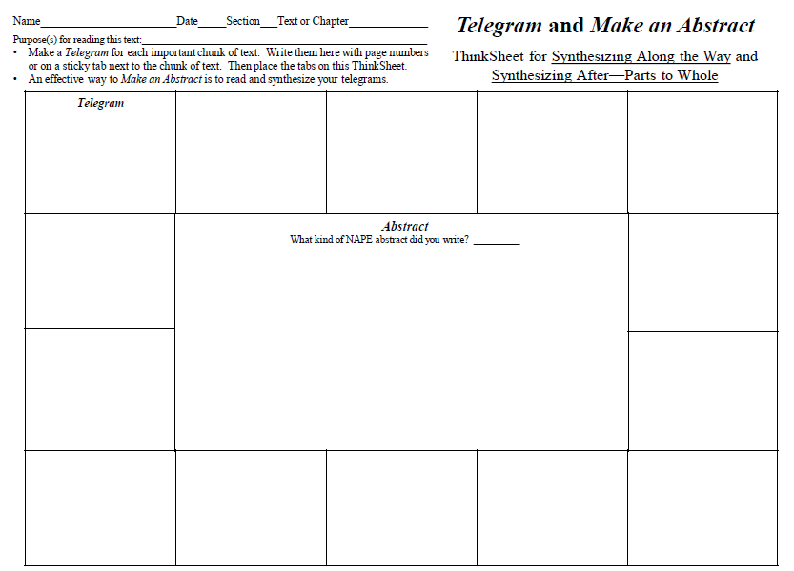
Do use the Synthesizing Thinksheet as part of your first practice.
You can certainly Make an Abstract without using Telegrams, but doing so at first helps you learn to synthesize an entire text because you have already synthesized the important information along the way with your Telegrams.
Good Luck!
For now, practice using these two strategies together on another textbook.

