Slide 1
Download Pattern
Demo

Slide 2

Welcome to the Demo of DOWNLOAD PATTERNS.
In the big picture of Layered Reading, it is a quick and highly effective way to mark the text DURING reading.
Before going on, read the pages in the Handbook explaining Mark the Text and Download Patterns.

Slide 3
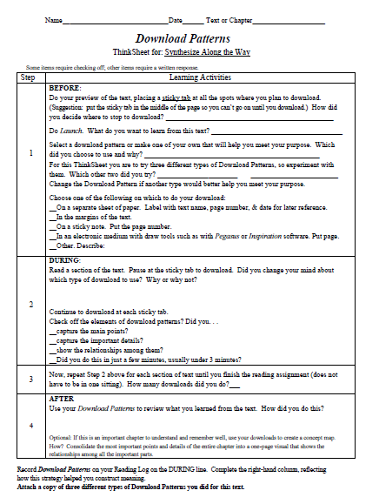
Here is the ThinkSheet to guide us through the process.

Slide 4
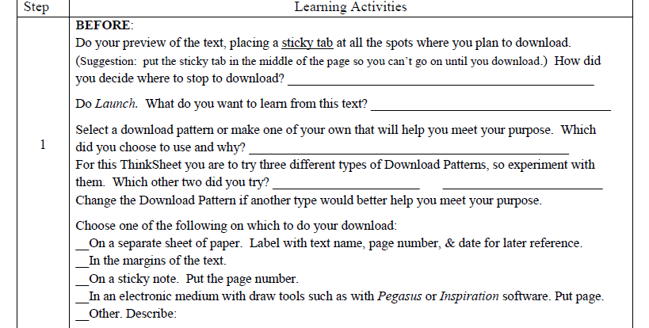
Let’s begin with the BEFORE activities

Slide 6
As I preview using T.H.I.E.V.V.E.S. with Snatches, I place sticky notes in the text where I think I might download, usually at the end of each section.

Slide 7
108
109
I like to place them in the middle of the page to remind me to stop to download.
112
113
116
117

Slide 8
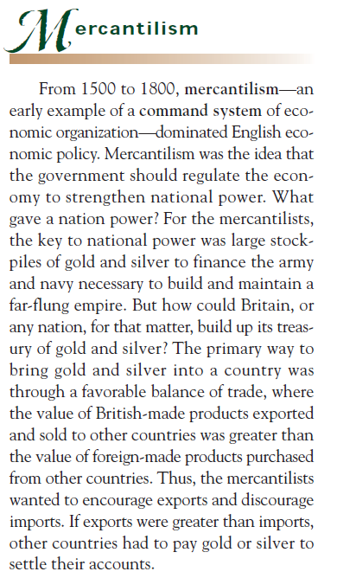
The rule I find useful:
The harder the text is for me, the more often I stop to download.
Where I place the sticky tab depends on my purpose and how difficult the text is for me. As I start reading, I may find I need to download more or less often than previously thought.
Notes:
THE HARRDER THE TEXT, THE NEWER THE INFORMATION – THE SHORTER THE CHUNK
During my preview I decided to stop at the end of every section, because they are short sections – I placed sticky notes. But then when I come to Mercantalism – I decided that I will stop at the end of this paragraph.
I am going to stop here because it is a long paragraph – it is a new concept for me in history and I think it is better to download more often than to wait too long. I might change my mind as I get into it, in that case I would stop at the end of a section instead of a long paragraph.

Slide 9
I answer the question.
I decided to stop at the end of sections because of the amount of reading material I have to do and because I predict I c understand it well enough.

Slide 11
I will always download when the text addresses my purpose. When it does not, I may read the section but choose not download.
I set this purpose: Identify the foundational principles of mercantilism and explain the relationship between them.

Slide 12
Identify the foundational principles of mercantilism and explain the relationship between them.

Slide 13
I’ll use SLASH because it will help me quickly capture main points and supporting details.
Slash will help me meet my purpose:
With it I can show that I have identified a mercantile principle and the details I can use to explain that principle.

Slide 14
LINEAR
PICTORIAL

Slide 15
Important Point!

Slide 16


Slide 17
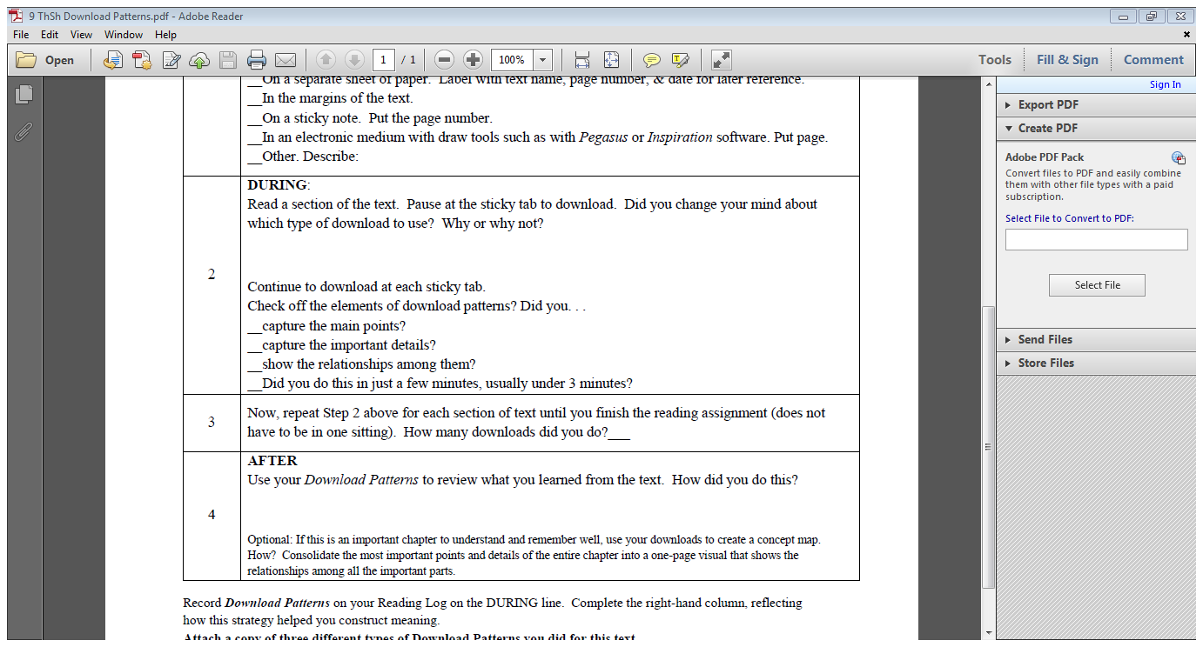
Now we focus on the DURING phase.

Slide 18
Before going on, read this passage.
Notes:
Take out the underlining

Slide 19
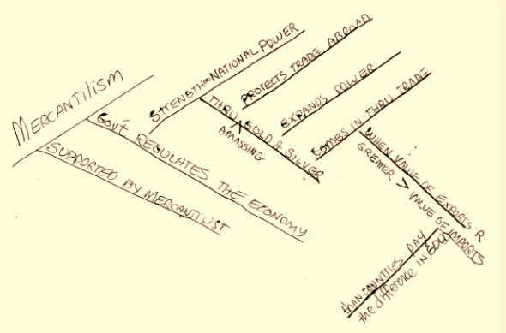
Behold, the Slash pattern.
City on a Hill – p. 48 – Jan 10
Notes:
Change page #s throughout
Take 2013 off each slide

Slide 20
I did not change my mind. Slash helped me do the thinking and remembering I needed to do.

Slide 21

4 min for the one I demonstrated.

Slide 22
Remember, you would normally only use one download pattern per passage.
. . . I will now demonstrate the other Download Patterns.
Just for instructional purposes . . .

Slide 23
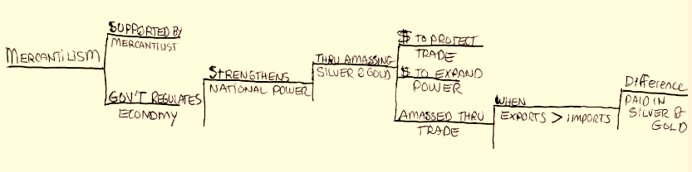
The linear progression can be left to right as shown or can be top down—whichever you prefer.
The Linear Pattern
City on a Hill – p. 65 – Jan 10, 2013
City on a Hill – p. 48 – Jan 10
Notes:
Make sure they do not think they have to do all of the five types each time.

Slide 24
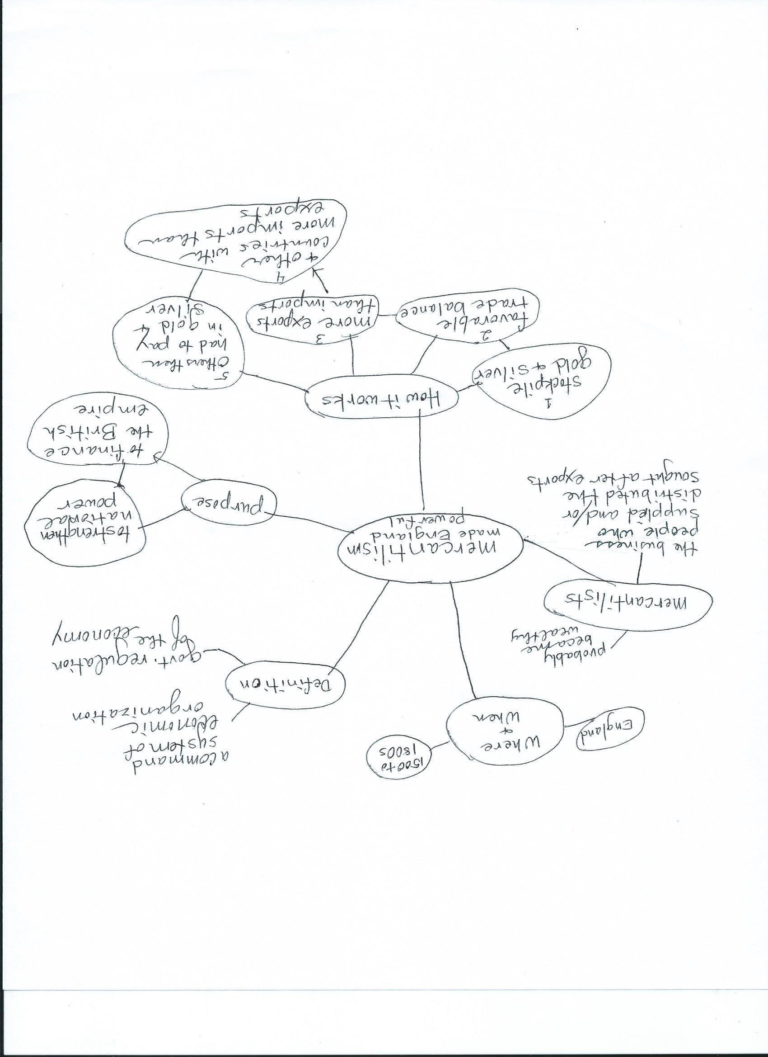
City on a Hill – p. 65 – Jan 10, 2013
The Web pattern
City on a Hill – p. 48 – Jan 10
Notes:
Too linear – needs to look like a web

Slide 25
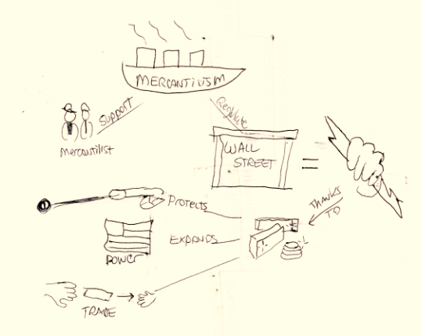
The Pictorial Download could instead have one drawing of the main topic placed in the middle—in this case, the ship with “mercantilism.” Then the details would be written like the Web Download Pattern.
As you read in the handbook, the Pictorial Download is great for you visual learners—just do not spend too much time drawing.
The Pictorial pattern
City on a Hill – p. 48 – Jan 10
City on a Hill – p. 65 – Jan 10, 2013

Slide 26
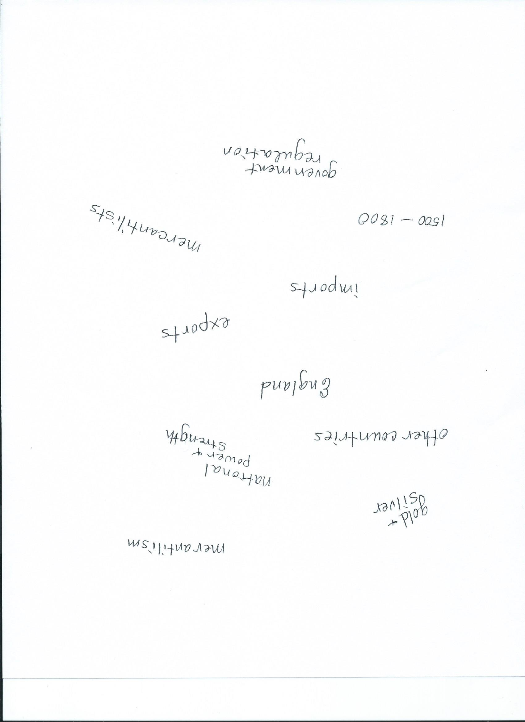
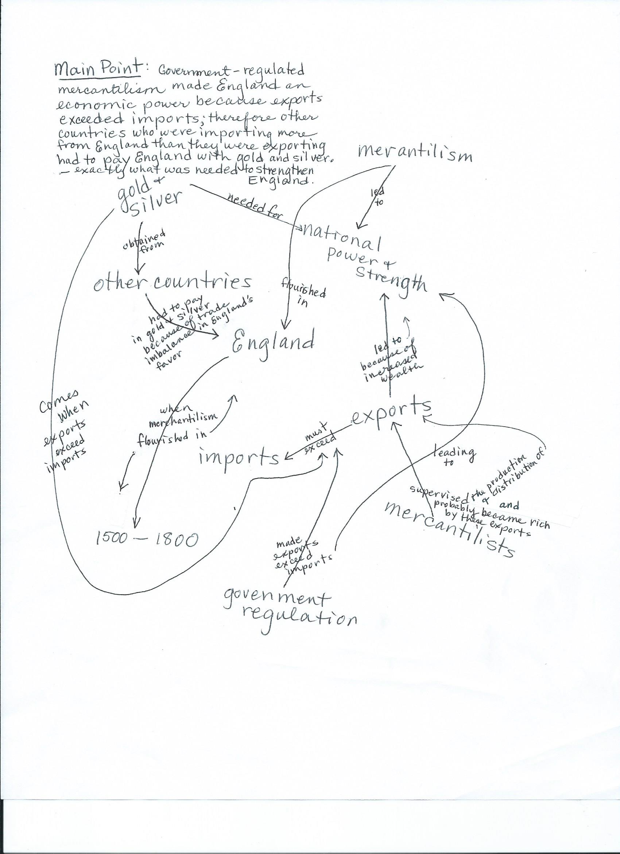
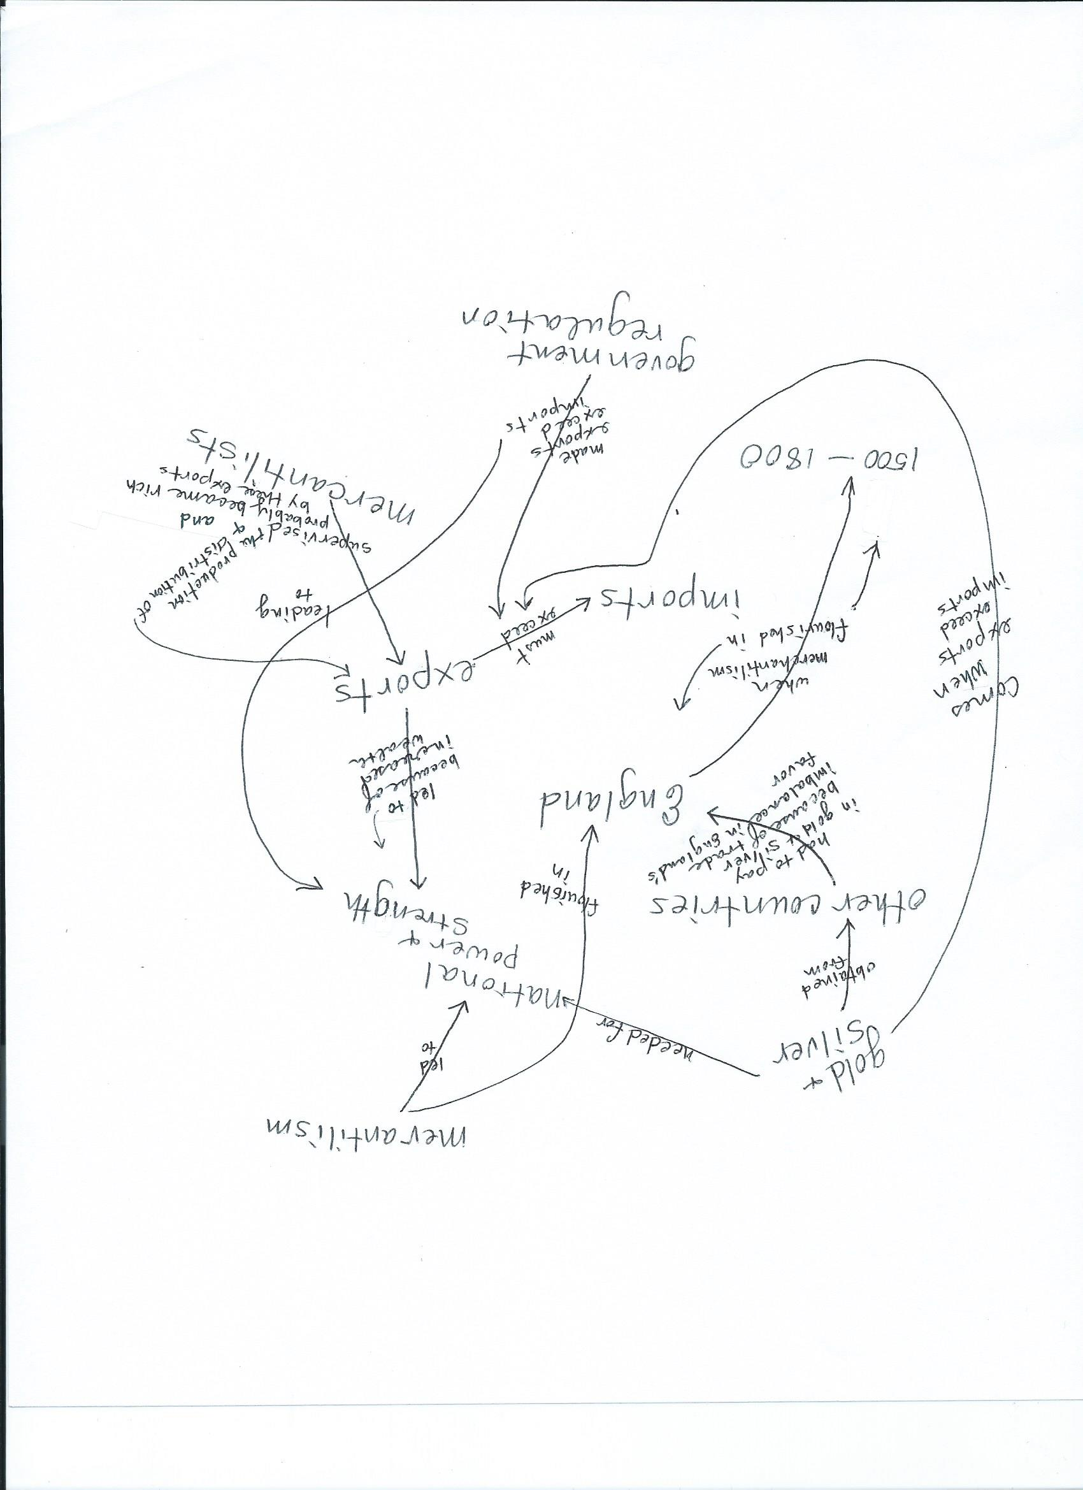
I now can state the main point. I write it last, because it took all the other thinking before I could figure out the main point. I usually try to say it in as few words as possible, but this example is rather lengthy.
I look at the words and begin to see the connections between the concepts. I draw arrows to make the connections and briefly state those connections on the arrows.
Notice that I randomly place words all over the page as I think of them—no order, just pieces of information from memory.
Finally, the Random Download Pattern.
I use this when the main point is not clear to me.
Now for the fun part. . .
City on a Hill – p. 48 – Jan 10

Slide 27
Some downloads go very fast; others take more time but are worth it for what I need to learn.
The level of detail I capture depends on my purpose.
I continue doing downloads along the way
until I finish my reading assignment.
17

Slide 28
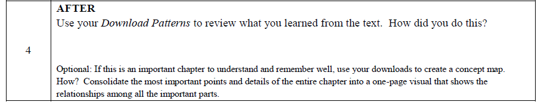
Now we focus on the AFTER phase.
Read my responses.
I looked at each download, talked through the information, explaining the ideas in each and adding more details as triggered by the download. Several times I could not explain the connections and needed to return briefly to the text. After going through all the downloads, I verbally connected the downloads to each other.
I did not do a concept map this time, but in a way I did in my mind when I connected all the downloads and saw the big ideas and picture of the entire text.

Slide 29
Even though I did not create a concept map as an AFTER strategy, here’s an example of what one looked like for my stats book, a part entitled “Effect Size”

Slide 30
The type of download pattern you choose depends on your style, comfort level, and what you need to get out of the text.

Slide 31
Good luck practicing on your own text!

