Slide 1
Launch and Met Purpose?
DEMO

Slide 2

Welcome to the Demo for Launch and Met Purpose?
Think about LAYERED READING. Launch is a BEFORE strategy; Met Purpose? is an AFTER strategy.
Before going on, read the pages in the Handbook about SET PURPOSE and Launch and CHECK PURPOSE and Met Purpose? Be able to answer the questions given.
Notes:
Met purpose – pp. 145-150

Slide 3
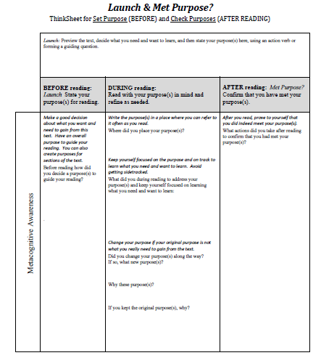
Notice how every step in doing Launch and Met Purpose? demands use of
metacognitive awareness.
You read fully aware of what you need and want to learn. Let that purpose GUIDE your reading.
Finally, prove to yourself that you have met your purpose.
Then you begin reading and consider what you are doing along the way to achieve your purpose.
We will begin with a brief tour of the ThinkSheet for Launch & Met Purpose?
First, you begin with Launch which consists of stating your purpose
and explaining how you chose that purpose.
To keep focused, you have your purpose before you. How will you do this?
Did you make any changes along the way to what you were trying to accomplish?
Why did you make those changes?
What did you do AFTER reading . . .
to make sure you met your purpose?
Or if you kept your original purpose,
why did you keep it?

Slide 4
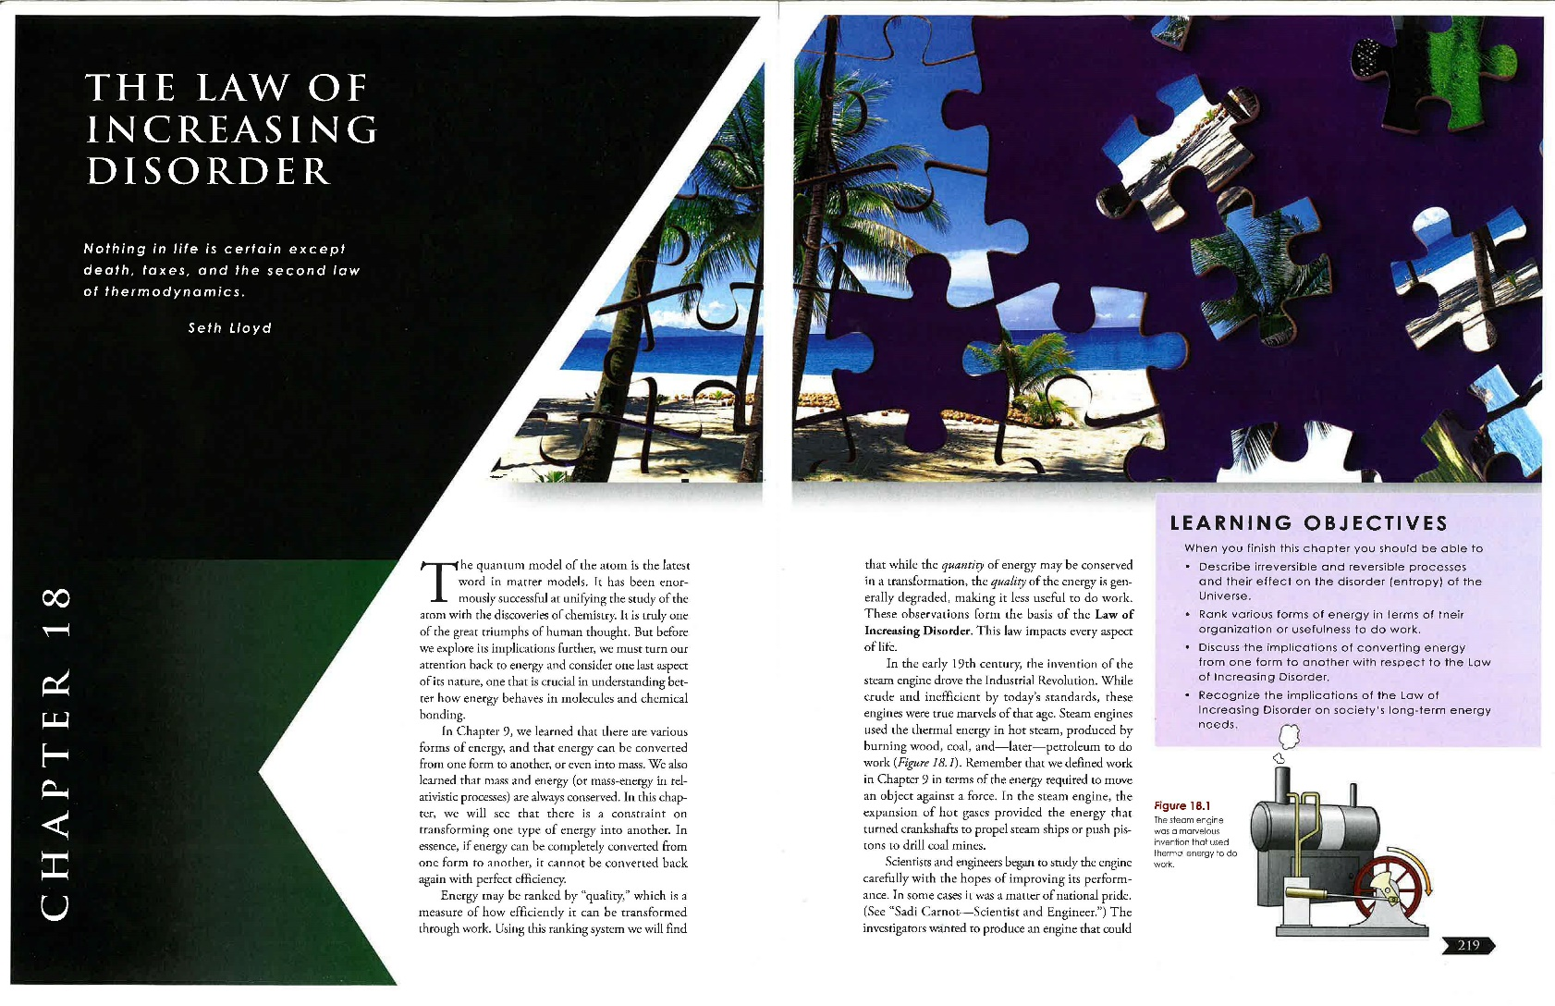
Watch me demonstrate Launch and Met Purpose? for the textbook chapter “The Law of Increasing Disorder”in Physical Science Foundations.

Slide 5
Previewing the text is essential . . .
to see what I could learn
and to decide what I want and need to learn from it—my purpose for reading.

Slide 6
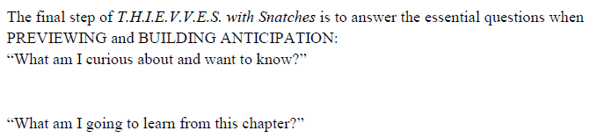
When I did T.H.I.E.V.V.E.S. with Snatches for this chapter, the ThinkSheet guided me to think what I was curious about and wanted to know.
I also listed what I thought the author was going to teach me.
The thoughts and information I glean from my preview become the basis for setting my purposes
for reading this text.
Here is how I answered these questions on the ThinkSheet for T.H.I.E.V.V.E.S. with Snatches.
I am curious why disorder is fundamental to the functioning of the universe.
How does this Law affect me every day even though I have not been aware of it?
What are the long-term implications of this Law for the survival of life and the Earth as we know it?
I am going to learn . . .
what The Law of Increasing Disorder is.
what makes a process reversible and irreversible.
why things become more mixed up over time.
what happens to unused energy and why this is important in understanding the universe.
how this Law impacts social issues.
to solve problems based on this Law.

Slide 7
I am now ready to set my purposes for reading the chapter “The Law of Increasing Disorder.”

Slide 8
Remember -
What do I want to know and be able to do before I can say . . .
“I have finished reading
this text”?
T.H.I.E.V.V.E.S. with Snatches
Is done to help me have enough information to
Set a purpose for reading the text

Slide 9
A good purpose will. . .
guide me through the text
help me decide where to focus for careful study and what parts I can skim or even skip

Slide 10
Here are some examples of useless purposes for reading “The Law of Increasing Disorder”:
“Know everything in this chapter.”
“Understand this for a test.”
Can you see that these purposes do not guide my reading?
They do not help me determine –
what’s important,
where to focus,
if I’ve achieved my purpose(s).

Slide 11
Good purposes can be stated as an action or a question:
Actions
Describe the Law of Increasing Disorder, explain with examples why it is fundamental to the functioning of the universe, and solve problems based on this law.
Questions
What is the Law of Increasing Disorder?
Why is it fundamental to the functioning of the universe?
What are problems to solve based on this law?
How can I solve them?

Slide 12
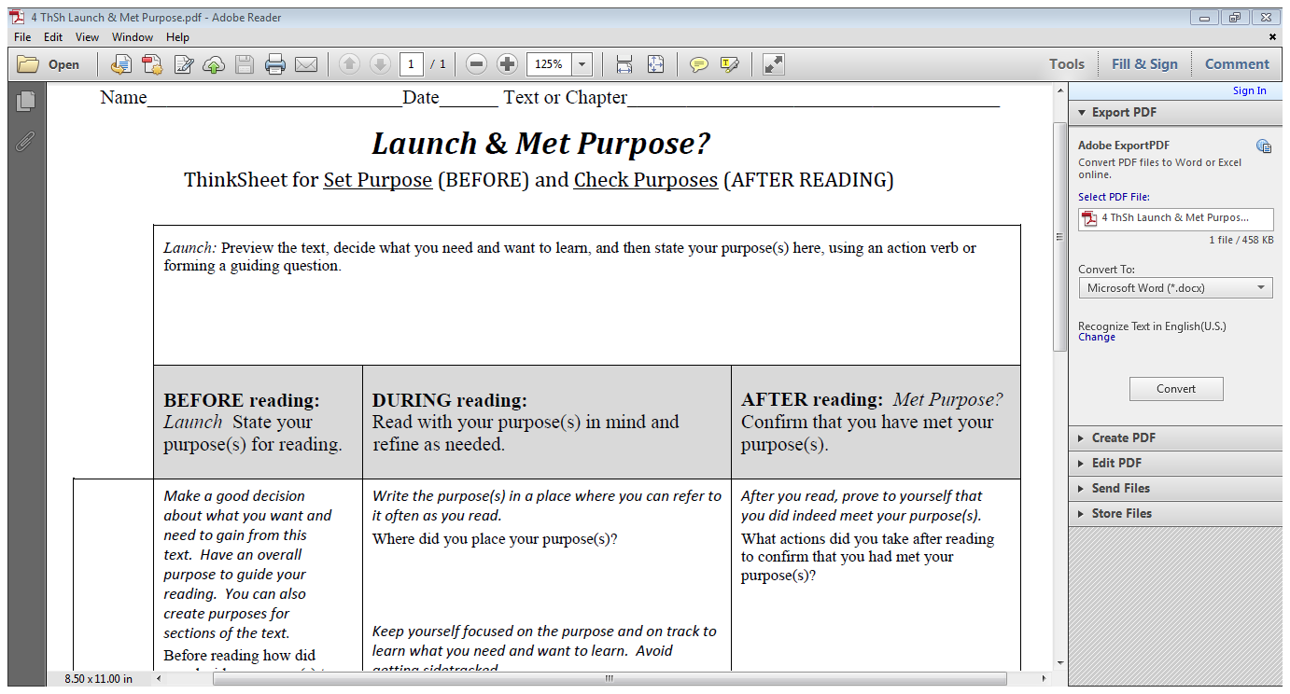
Explain the Law of Increasing Disorder and give examples showing that things become more mixed up over time.
Tell what makes a process reversible and irreversible, and give examples of each.
Discuss what happens to unused energy and why this is important in understanding the universe.
Explain to a nine-year old child how a refrigerator works
Outline some of the implications and social issues of the Law of Increasing Disorder for the future of the planet.
Here is what I want to be able to DO by the time I finish reading this chapter. I state my purposes as actions.

Slide 13
What is the Law of Increasing Disorder? What are examples of it? Why do things get more mixed up over time?
What makes a process reversible and irreversible,? What are some examples of each?
What happens to unused energy? Why is this understanding bout unused energy so important in understanding the universe?
How does a refrigerator work?
What are some of the social issues of the Law of Increasing for long-term survival?
Instead of stating actions for purposes, I could ask questions to guide my reading.

Slide 14
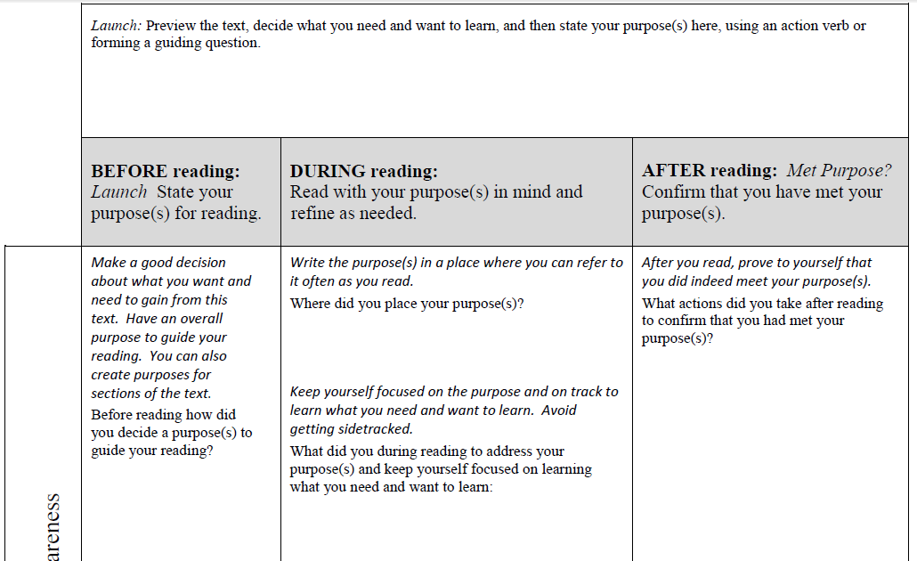
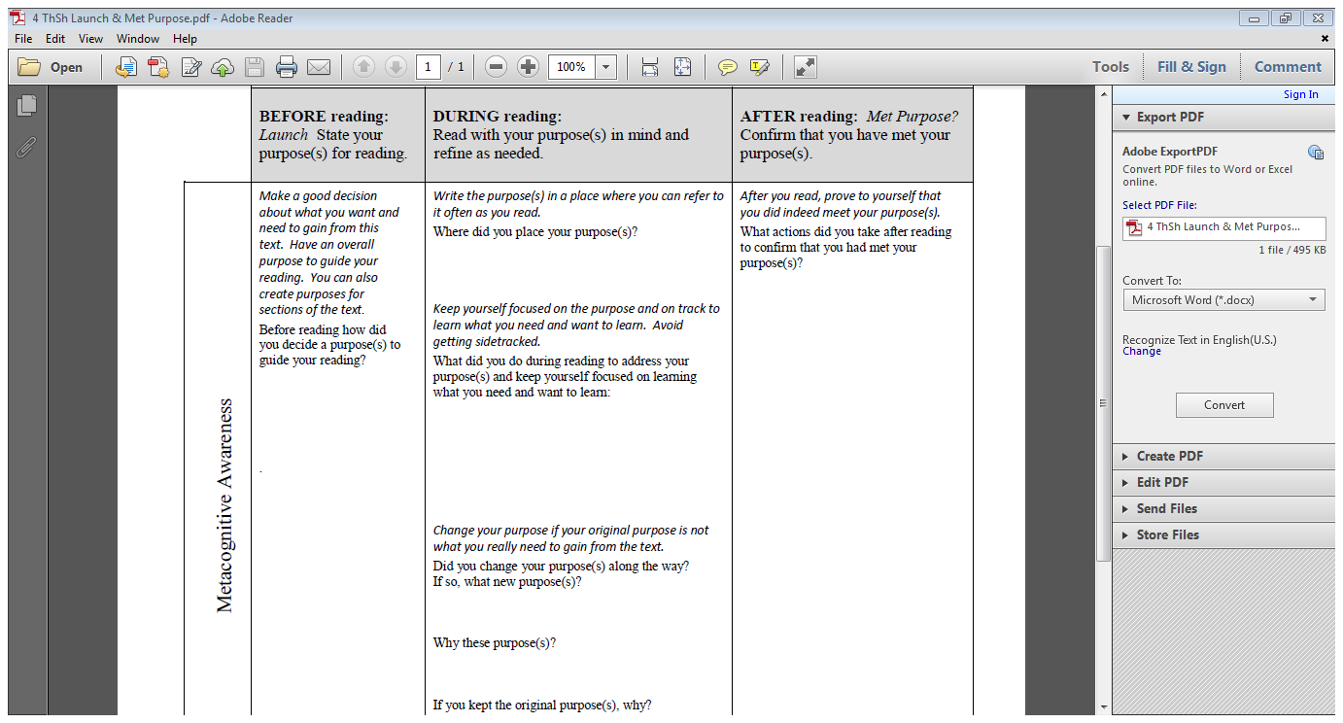
Explain the Law of Increasing Disorder and give examples showing that things become more mixed up over time.
Tell what makes a process reversible and irreversible, and give examples of each.
Discuss what happens to unused energy and why this is important in understanding the universe.
Explain to a nine-year old child how a refrigerator works
Outline some of the implications and social issues of the Law of Increasing Disorder for the future of the planet.
So how did I come up with these purposes?
My purposes are based on my preview. I came away from T.H.I.E.V.V.E.S. with Snatches full of curiosity. I want to know what the Law of Increasing Disorder means and why it is important for the future of the earth and humankind.

Slide 15
Explain the Law of Increasing Disorder and give examples showing that things become more mixed up over time.
Tell what makes a process reversible and irreversible, and give examples of each.
Discuss what happens to unused energy and why this is important in understanding the universe.
Explain to a nine-year old child how a refrigerator works
Outline some of the implications and social issues of the Law of Increasing Disorder for the future of the planet.
Here is my report of what I did DURING the reading to achieve my purpose:
I wrote the five actions on a larger sticky tab and numbered them, but I also condensed the purposes to key phrases to represent my original longer statements.
I looked at the purposes after each section and jotted the number of a purpose in the margin where it was addressed in the text.
I also added in the margin my own example or my thought about an issue or implication to help me achieve my purposes as I went along.

Slide 16
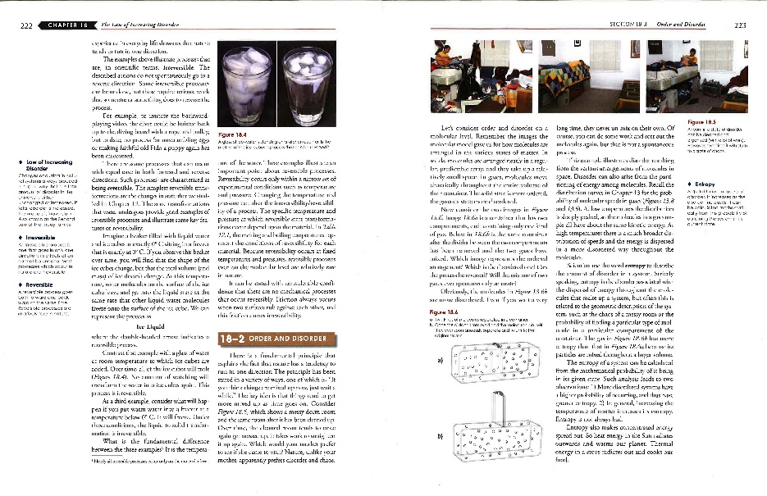
Purposes:
Explain Law. Give examples
Reversible and irreversible process, examples
Unused energy, why important
Explain how refrigerator works
Social implications of Law
See how I placed the sticky note stating my purposes in abbreviated form.
Other times I place it on the desk above the text so I don’t have to keep moving it.

Slide 17
Four things keep me focused on my purposes for reading:
I move the sticky note with my purposes from page to page, or I place it above the text. I refer to it constantly to keep me on track.
Whenever something in the text deals with one of my purposes, I put the number of that purpose in the margin to show where each purpose is addressed. Sometimes I put a comment at that spot to capture what I learned.
I add my own examples to the examples of the author.
I try to pinpoint what confuses me for I must address these or I will not meet my purposes.

Slide 18
Explain the Law of Increasing Disorder and give examples showing that things become more mixed up over time.
Tell what makes a process reversible and irreversible, and give examples of each.
Discuss what happens to unused energy and why this is important in understanding the universe.
Explain to a nine-year old child how a refrigerator works
Outline some of the implications and social issues of the Law of Increasing Disorder for the future of the planet.
6. Explain how ‘entropy’ and ‘radiates out’ fit in the Law of Increased Disorder.
I added, “Explain how ‘entropy’ and ‘radiates out’ fit in the Law of Increased Disorder.”
As I got into it, I realized these concepts had to be well understood if I was to understand the Law.

Slide 19
Explain the Law of Increasing Disorder and give examples showing that things become more mixed up over time.
Tell what makes a process reversible and irreversible, and give examples of each.
Discuss what happens to unused energy and why this is important in understanding the universe.
Explain to a nine-year old child how a refrigerator works
Outline some of the implications and social issues of the Law of Increasing Disorder for the future of the planet.
Explain how ‘entropy’ and ‘radiates out’ fit in the Law of Increased Disorder.
I kept the same purposes with the one addition. I need to meet all these purposes in order to explain my first and most important purpose: Explain the Law of Increasing Disorder.

Slide 20
Explain the Law of Increasing Disorder and give examples showing that things become more mixed up over time.
Tell what makes a process reversible and irreversible, and give examples of each.
Discuss what happens to unused energy and why this is important in understanding the universe.
Explain to a nine-year old child how a refrigerator works
Outline some of the implications and social issues of the Law of Increasing Disorder for the future of the planet.
Explain how ‘entropy’ and ‘radiates out’ fit in the Law of Increased Disorder.
Here is my report of what I did AFTER the reading to achieve my purpose:
I looked at each of my six purposes and quizzed myself on each, aloud. The hardest was #5. I re-read those pages and gave more thought to the issues and implications and then talked through the purposes again.

Slide 21
So what evidence do I have that I met my own purposes?
Evidence that I can do my six purposes is that I met with my study group, showed them my purposes, and asked them to quiz me. They did that and more. They threw in questions such as “How would you explain . . . ?
For one question, I had to go back to the text and study some more. Then I did Met Purpose? again for those purposes.
Finally, I was able to do the exercises at the end of the chapter and explain my answers to myself and several to my study group members.

Slide 22
Here are some final points!
This was an involved example. In reality you can probably do less than what you saw me do.
  Sometimes setting a purpose and checking your purpose is very easy and takes little time.
  Other times it can be very involved.
What does that depend on?
  your purpose,
  the importance of the text,
  the complexity of the text,
  your commitment to the text,
  your professor’s expectations,
  your mood, etc.
The key is to set and achieve purposes informed by your preview and your professor’s expectations. Have them in mind as you construct meaning from the text. Let your purposes guide the metacognitive decisions you make as you read.

Slide 23
As you try these two strategies, Launch and Met Purpose?, you will be amazed how they improve what you can learn and remember from reading an academic text, how they help you focus, and how they show you where to put your energy.
Good luck practicing Launch and Met Purpose? on a text you have previewed!

