Slide 1
Create a Concept Map
Demo
Notes:
Kenneth,
Thank you for the time and work put into this!!
I typed right into the slides in “red” my suggested changes.
One place where there are three layers of quoting in one slide, I cut the middle quote, and suggested rewording in red; so there are only two layers now…..You’ll see.
Slides 3-5…I added #4, and you need to fix the flow…..sorry.
I was trying to show that “icons and pictures” help reinforce “memorable” but they do not replace the words. Please fix my mess.
You mentioned at the end that you had to “make changes” but none were made….HOWEVER, I found one place we could actually show making changes…… slide #18 is a copy of slide #17. Make changes here on #18 (I put colored text to tell you what to do, cause I don’t know how to do it myself…)
What happens now, is if we make this change, you have to make more changes in the entire map to be applied throughout where there is “strength” and “weakness”……oh, dear!!! And that “entire map” is what I talk about in the next paragraph……
The next slide where you present your entire map, please delete her picture and her quote and the red line squaring of what we did together. Just present the entire map without any comments,…and go on… We can readily find and understand the section we did together, you don’t need to point it out.
Thanks, Kenneth!!!

Slide 2

Read about REVIEW and Create a Concept Map in the Handbook and make sure you understand what it is, why it is a useful strategy, and how to create a concept map.
Welcome to this demo of Create a Concept Map. When considering Layered Reading, this is a powerful strategy for reviewing AFTER you have read a text.

Slide 3
organize the key concepts
and most important details
in a visually memorable way.
The purpose in creating a concept map is to . . .
Concept “A”
Concept “B”
relationship between
relationship between
relationship between
Example
Concept “C”
Example

Slide 4




organize the key concepts
and most important details
in a visually memorable way.
Plus, you are to put all of this onto ONE page--the entire text,
whether a one-page short story, a 1000-page novel, or a 40-page trigonometry chapter.
relationship between
example of
relationship between
relationship between
example of

Slide 5
Let’s imagine that I am preparing for an exam in a science course.
Let’s bring in the ThinkSheet

Slide 6
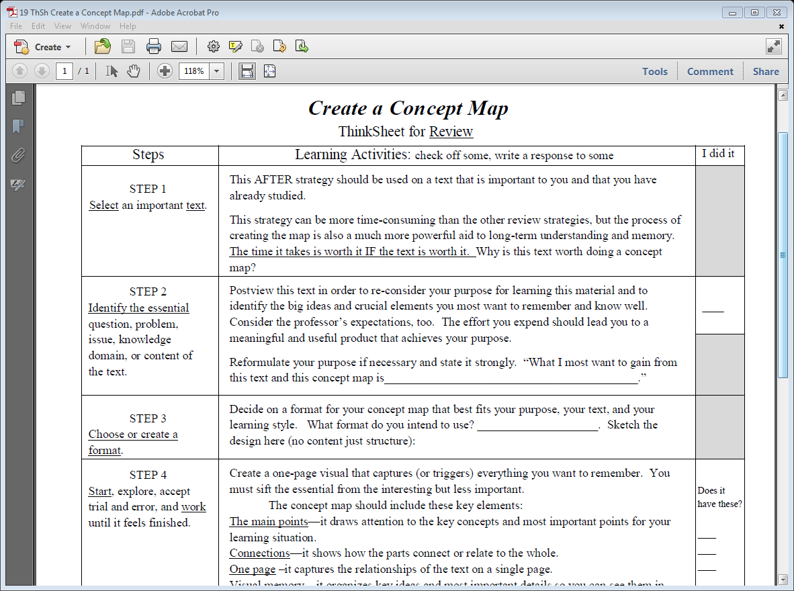

I do not have a good grasp of the information in the “Sources of Knowledge” section.
I need to know this chapter well for class discussion, a test, and as background for later.
I know the chapter is one I need to know well, “Knowledge, Science, and the Universe.”
I answer the question.
I read information in Step 1.

Slide 7
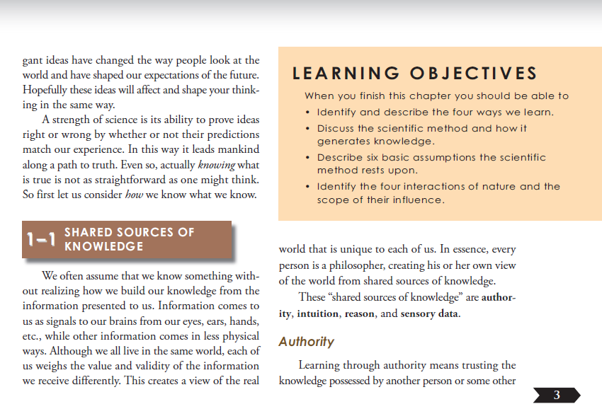
I want to create a Concept Map of the basic concepts learned in this section.

Slide 8
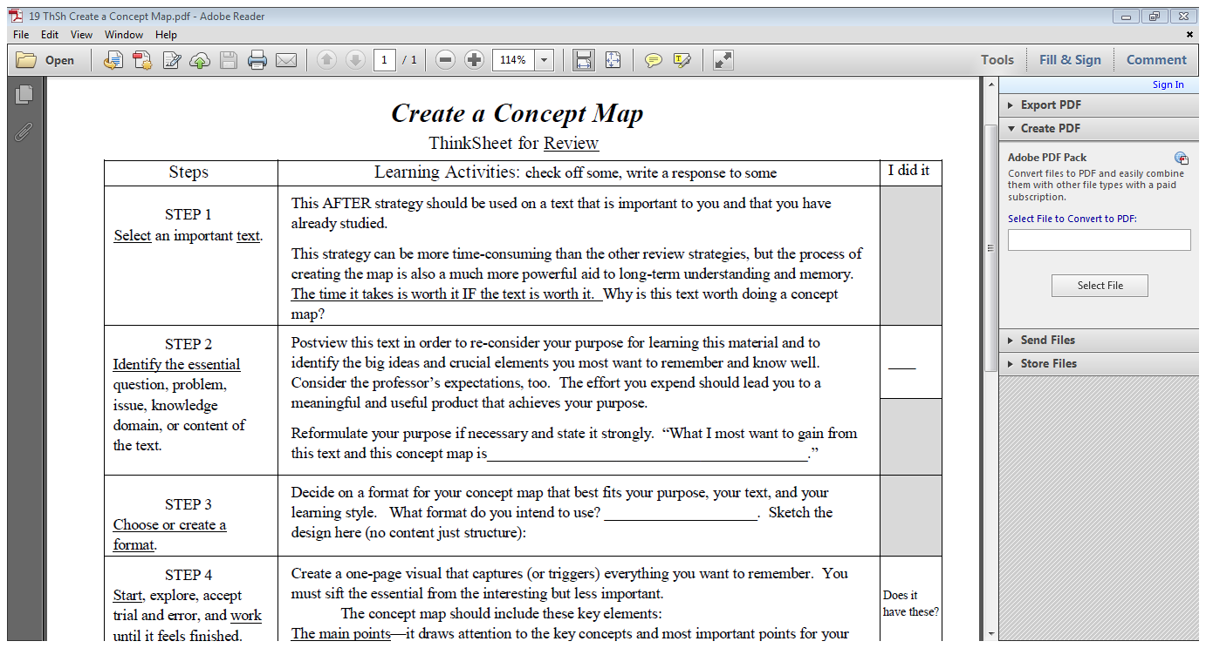
√
State the sources of knowledge and give examples of knowledge that can come from each type of source.
I did a Postview of the chapter and thought about my purpose. I checked the box.
I think about my purpose and realize what I want to be able to do. I fill in the blank.
I read Step 2 (above)

Slide 9
So, I look through the concept map options in the Handbook,
. . . and decide the Semantic Web would help me meet my purpose for long term understanding. I draw a sample.
I read Step 3.
Semantic Web

Slide 10
Now let’s look at some of the concepts from the textbook I will be putting into a semantic web.

Slide 11
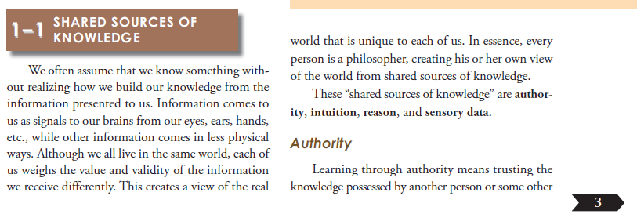
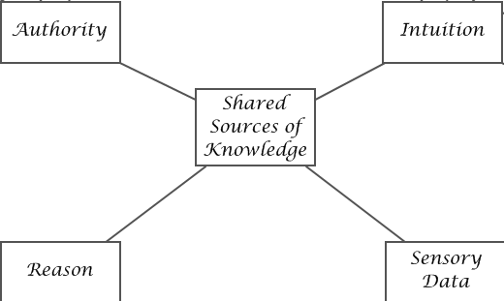

I begin mapping

Slide 12
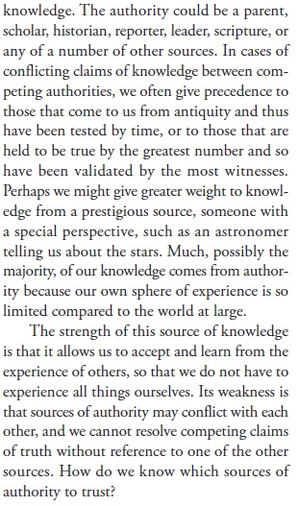
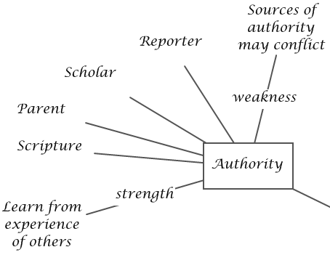
Read each boxed text.

Slide 16
. . . and come up with a semantic web for the entire chapter:
I follow that same process with the other three sections of that chapter: intuition, reason and sensory data,

Slide 17
This is the one we did together.

Slide 18
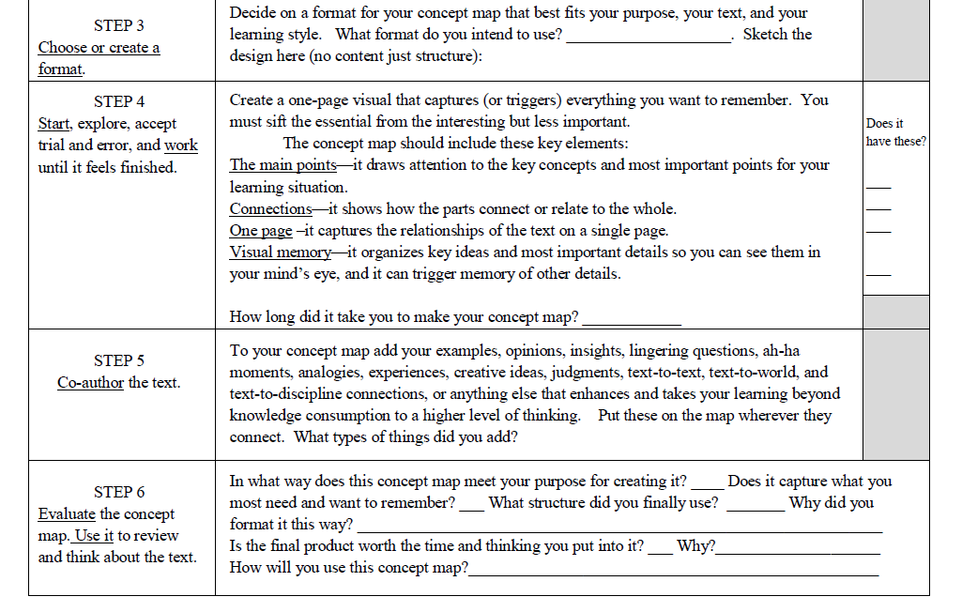
√
√
I fiddle with different arrangements usually in one of three ways:
Paper and pencil –easiest but messy, for me lots of erasing.
Small sticky tabs with a concept on each –easy to move ideas around.
A software program: Inspiration or other similar program –fun to use, easy to move concepts, can be saved electronically, finished product looks good, but I can’t be as creative, must use their designs.
√
I thought I knew the material well, but I realize I am learning the material even better as I try to organize the concepts. Creating a Concept Map is not just a review strategy; it is also a learning strategy.
√
Finally, I have it like I want it. Do I have all the key elements? I have the main points, have made connections, have put it onto one page, and have organized it visually.
I check the boxes and answer the question.
25 minutes – but worth it!
Another tip:
Use your Download Patterns (mini-Concept Maps made along the way) to help you decide what to put onto your one page Concept Map of the entire chapter. .
A semantic web is fairly basic but still requires thought to figure out how I want to organize it.
I read Step 4

Slide 19
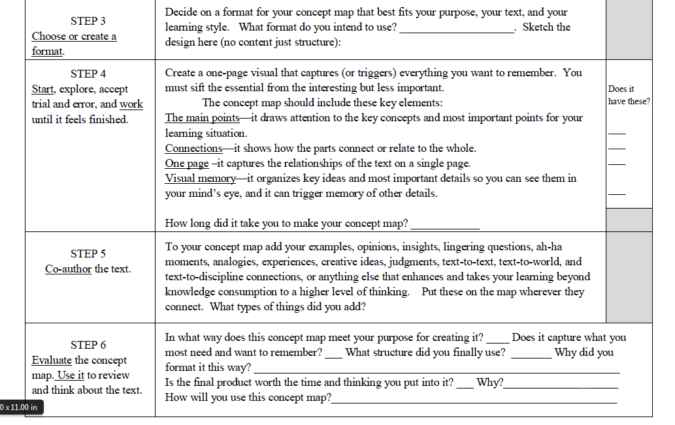
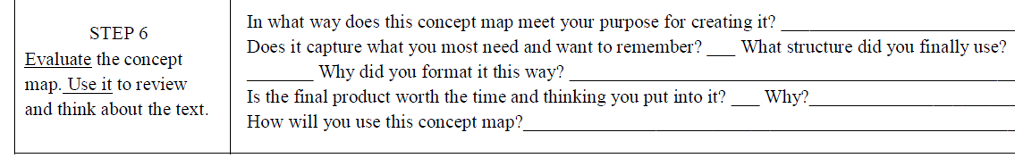
Okay, my
Concept Map has the author’s information that will trigger my memory.
Now, I will add myself to the map for deeper learning and stronger memory.
I now read Step 5.

Slide 20
I am going to fill this in with some examples

Slide 21
Different philosophical camps
Even the Delusional can claim it
Notion of Higher Education
How do you validate the existence of an IQ?
Ventriloquist

Slide 22
Different philosophical camps
Even the Delusional can claim it
Notion of Higher Education
How do you validate the existence of an IQ?
And also some connections.
Ventriloquist

Slide 23
Even the Delusional can claim it
Different philosophical camps
When I felt my son was in trouble. He was.
Notion of Higher Education
The time I stayed after school 3 hrs. to reason through one proof.
How do you validate the existence of an IQ?
Babies want to put things into their mouths to learn about them.
Ventriloquist

Slide 24
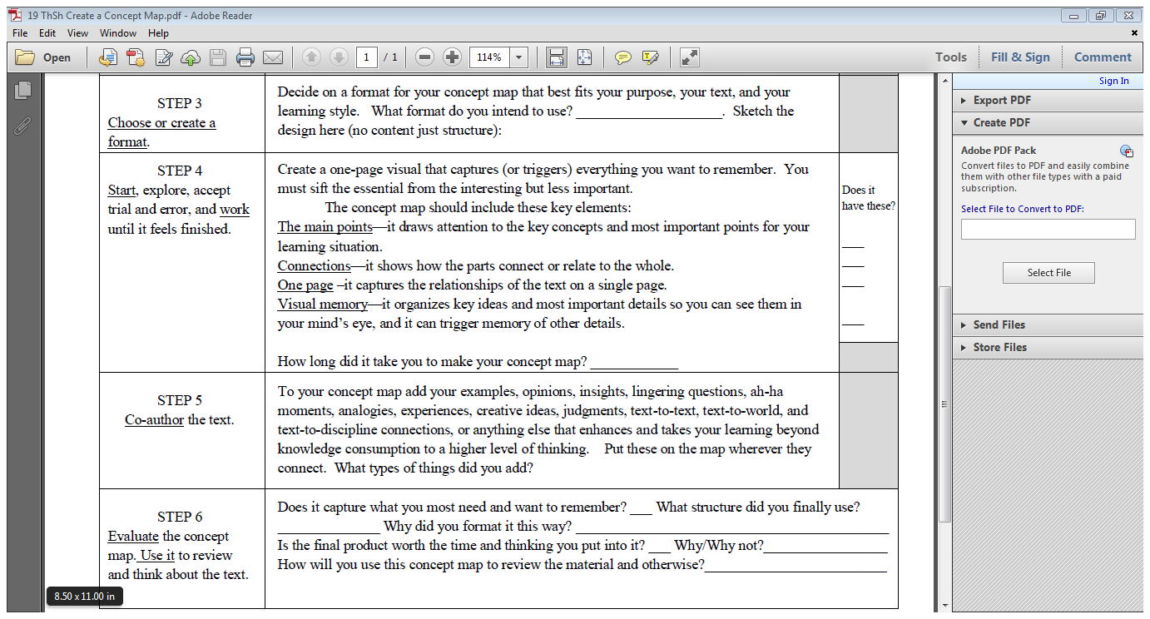
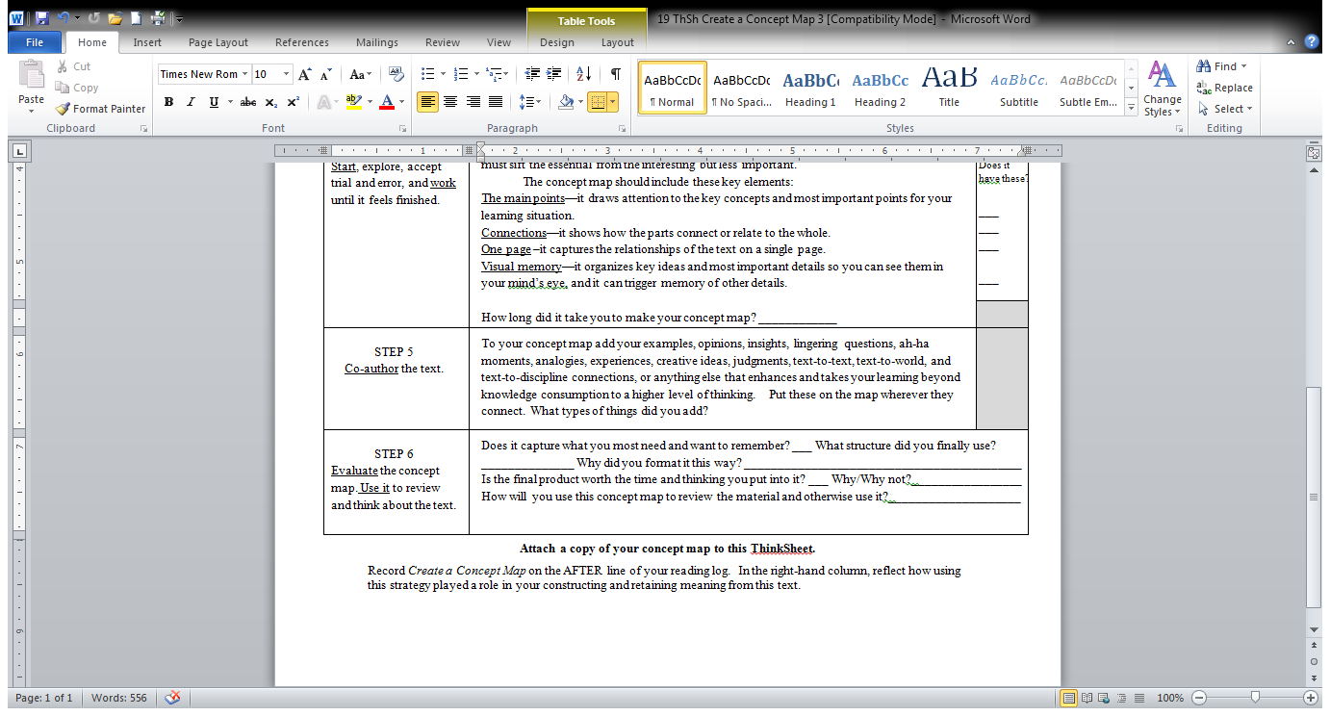
I read Step 6 .
Then read my answers to the questions.
I answer the question on Step 5.
Examples, Connections
Yes
Semantic Web
Shows the key concepts on one page and how they relate to each other. Allows me to add my examples and connect to things not in the text.
Yes
Because it is such a usefui product for review, and I can keep it.
I will
look at it and talk through it, telling myself what I know about each concept including as many details as I can remember, why it is an important source the knowledge, and how the sources of knowledge are distinguished from each other. If the concept map does not trigger my memory for what I need to know, I will return to the text and probably add another node to the map. I will review the map until the ideas are solidly in mind, then on my morning walk I will retell from memory the whole concept map because I can picture it in my mind..

Slide 25
Here are two examples of the
Nodes and Arrows Concept Map. They were great reviews for me on other texts.
They really congealed and deepened my learning
The first is from a Statistics text on Effect Size.

Slide 26
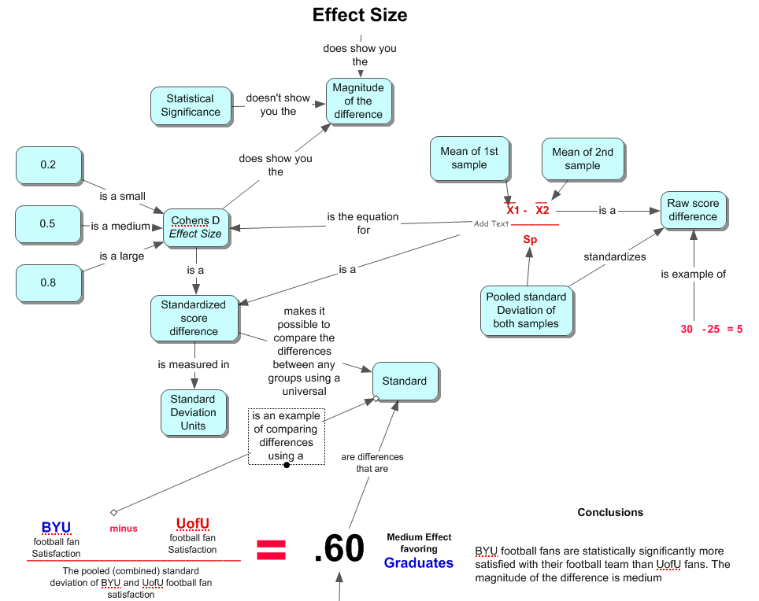

Slide 27
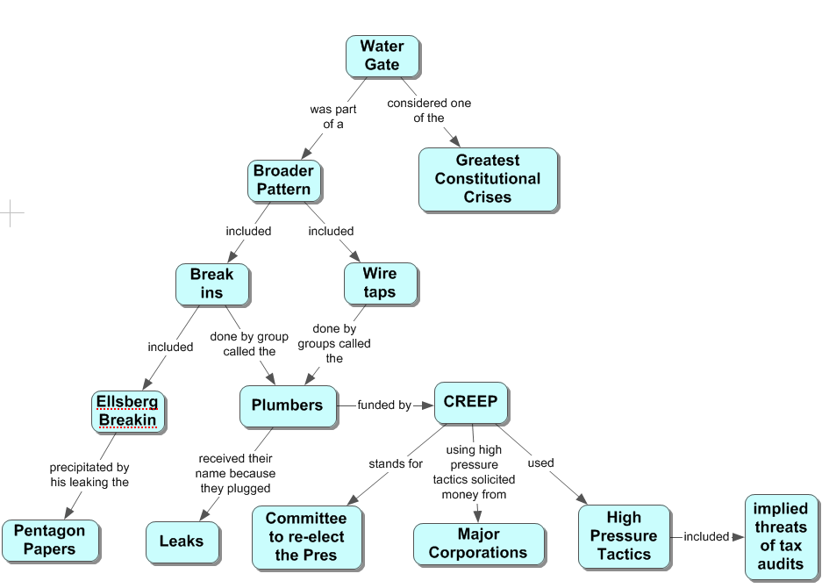
Here is a Nodes and Arrows map on an article about the Watergate Scandal.

Slide 28
Go back to the Handbook and review the other examples of concept maps including a matrix, flow chart, story map, herringbone, etc. Choose the approach that will work best for your purpose.
Now practice on your own text and use the ThinkSheet to guide you through the process.
Happy Creating!

