Slide 1
T.H.I.E.V.V.E.S. with Snatches
DEMO

Slide 2
Welcome to my demonstration of T.H.I.E.V.V.E.S. with Snatches.

Slide 3
As part of Layered Reading, it is a highly effective BEFORE strategy to prepare my mind to learn. With it I PREVIEW the text for content so I know what I will be learning before reading it. . .

Slide 4
T.H.I.E.V.V.E.S. with Snatches is also one of the most popular strategies from the course:
“It was worth taking the class just to learn this strategy!”

Slide 5
. . .and what a difference that makes as you will see.

Slide 6
Before going on . . .
In the Handbook, read the pages about PREVIEW (2 pages) and T.H.I.E.V.V.E.S. with Snatches (2 pages). Learn what this strategy is, why do it, how to do it, and when and under what conditions to use it.

Slide 7
Before going on . . .
Also study the ThinkSheet and example in the Handbook.

Slide 8
Before going on . . .
When you have completed the reading, go to the next slide.

Slide 9
Warning:
In the demo you are about to see, we are slowing down the process for instructional purposes.

Slide 10
Warning:
In reality, with practice, this whole process should move quickly—usually 3 to 10 minutes.

Slide 11
Warning:
These 3 to 10 minutes are well-worth the GREAT payoff for learning and remembering later.

Slide 12
Guiding Question
The question you ask yourself while using T.H.I.E.V.V.E.S. with Snatches is . . .
“What is it I’m going to learn?”
Continue to ask that constantly with every step of T.H.I.E.V.V.E.S.

Slide 13
Here’s the ThinkSheet you will use.

Slide 14
Watch me demonstrate what I do to preview this chapter using T.H.I.E.V.V.E.S. with Snatches.

Slide 15
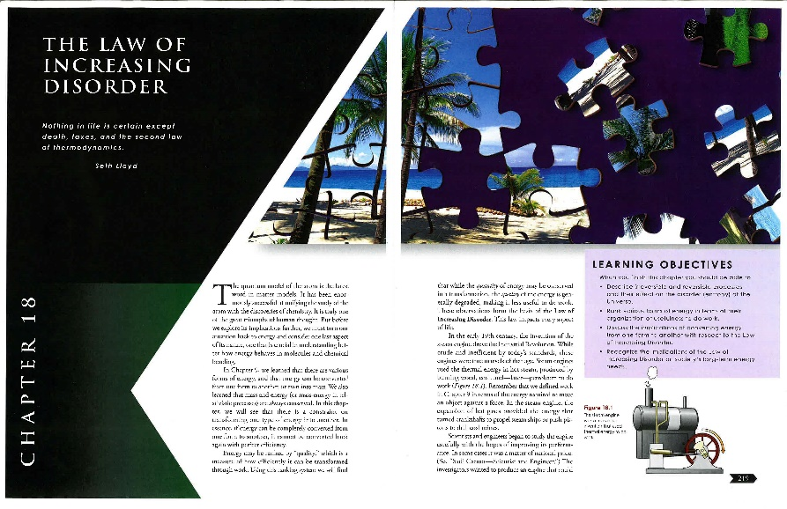
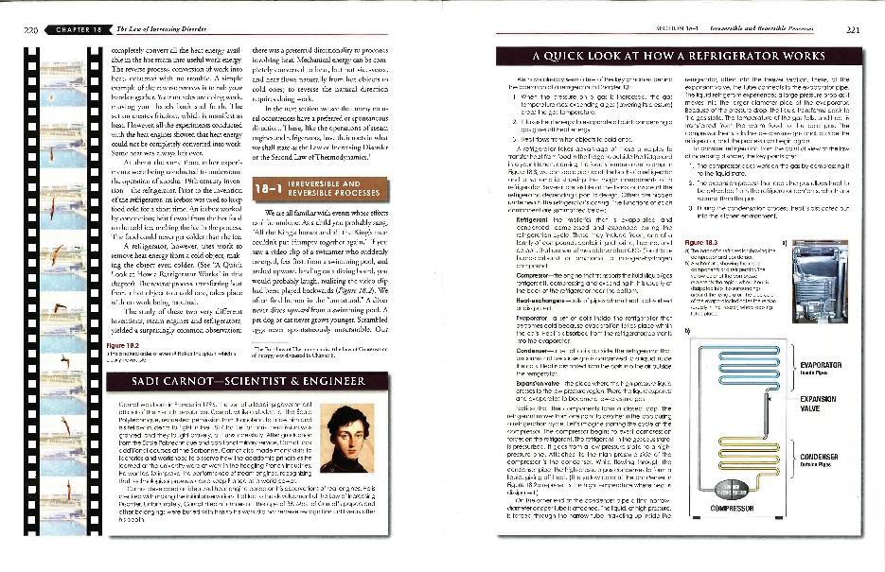
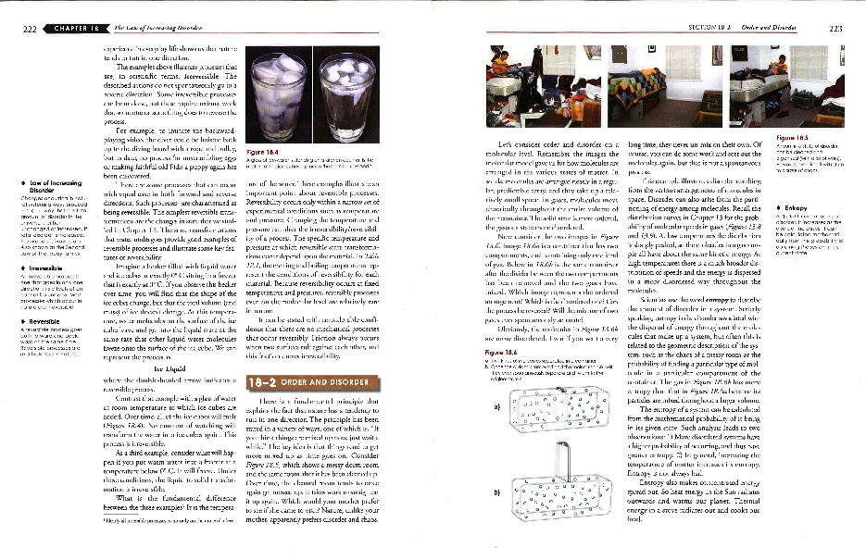
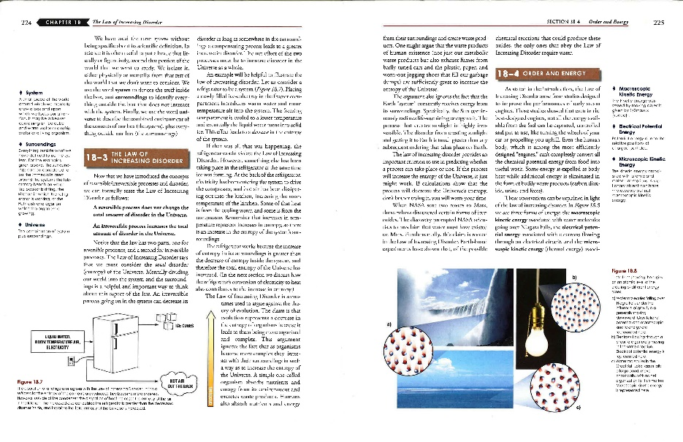
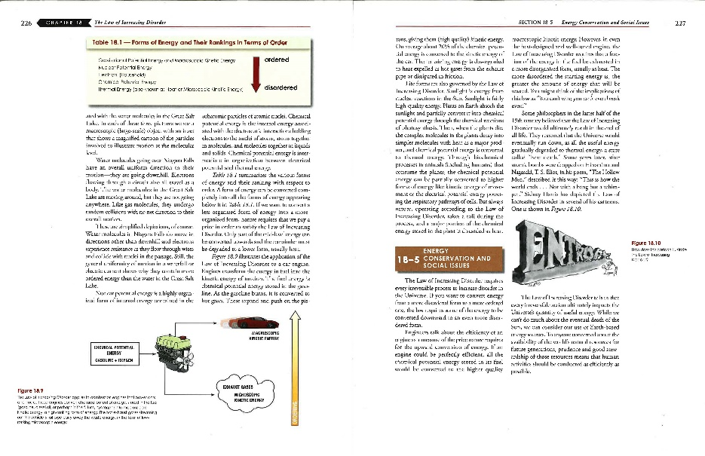
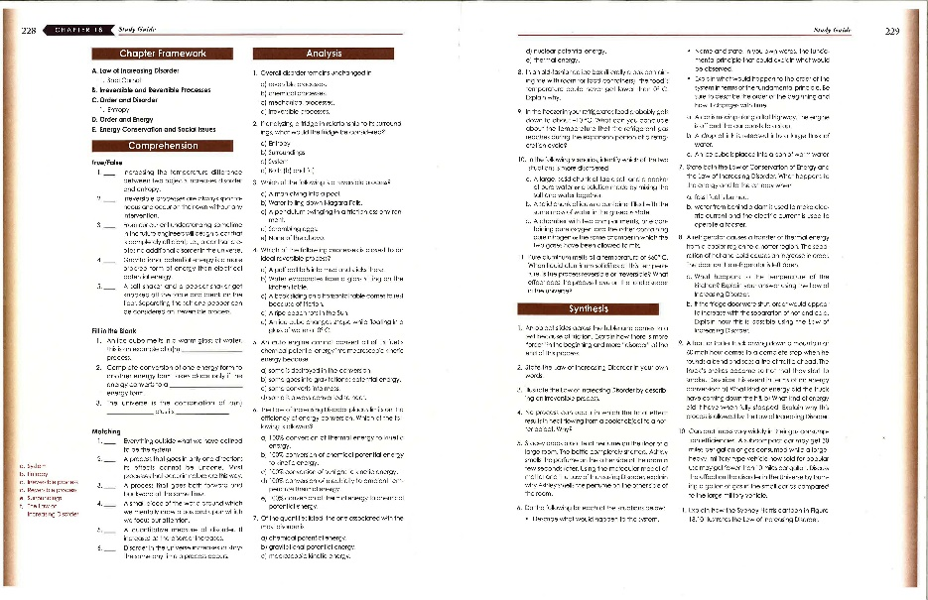
I first flip quickly through the whole chapter to see how it is organized (using the Skeleton strategy). I constantly ask myself, “What is the structure of this chapter?”

Slide 16
I see that this chapter has 12 pages
Notes:
Because of Skeleton, I now see the structure to use like a road map through the text.

Slide 17
It has five sections labeled and numbered.

Slide 18
Because of Skeleton, I now see the structure to use like a road map through the text.

Slide 19
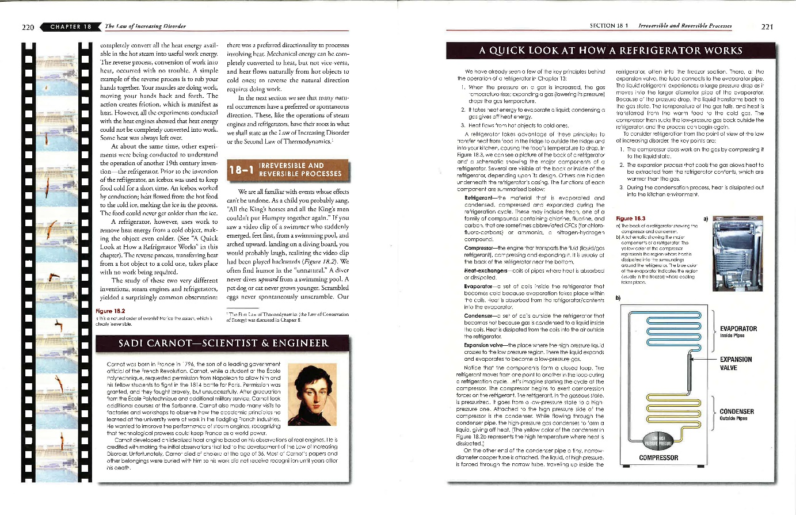
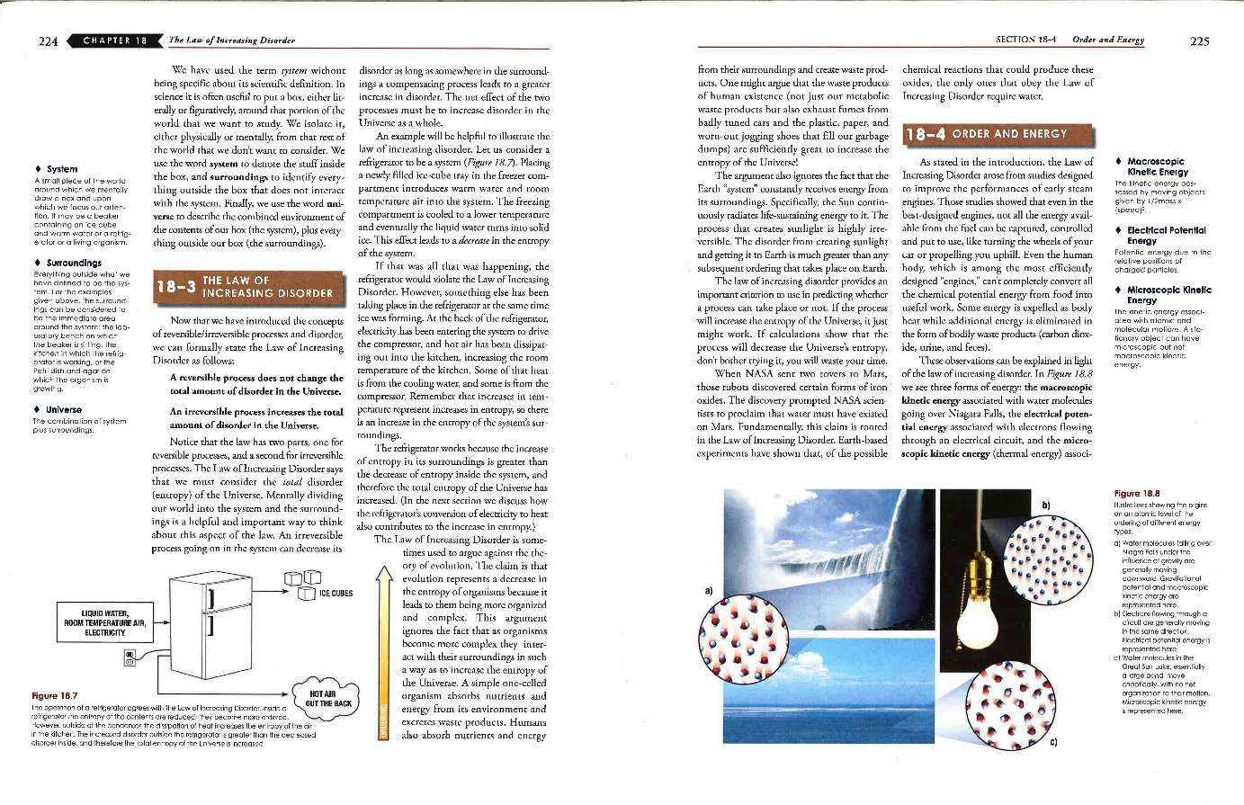
What text features are there?
Is there a Title?
Yes
Are there Headings?
Yes
Is there an Introduction?
Yes
Are there 1st sentences in Every paragraph / section?
Yes
I refer to the ThinkSheet, and, if I need to, I quickly flip through the chapter again just to see which specific parts of T.H.I.E.V.V.E.S. the text provides.
Are there Visuals?
Yes
Is the Vocabulary bolded?
Yes
Are there questions, Every
Question?
Not sure
Is there a Summary?
Not sure

Slide 20
I now start at the beginning of the chapter with this question in mind, “What am I going to learn from the chapter?”
I guess what I am going to learn in this chapter just from the title.
Notes:
All red shapes need to become clouds

Slide 21
“The Law of Increasing Disorder” . . . so, I predict that I will be learning about a law of the universe that shows everything moving toward more and more disorder or chaos. That is a scary thought.

Slide 22
I also guess that this is a very important law.
Why else would the authors devote an entire chapter in an introductory text to a single law of nature?
Now I look at the quote
below the title.
I predict that the Second Law of Thermodynamics is the same as the Law of Increasing Disorder.

Slide 23
Based on just the Title and the quote, I ask the big question for T.H.I.E.V.V.E.S.: What am I going to learn?
And I predict the answer.
Notes:
Transform into

Slide 24
I predict that disorder and chaos are integral to the way the universe works.
Notes:
Transform into

Slide 25
I feel a bit confused and full of questions about this chapter. Why? Because I see much order in most things around me. This perspective seems counterintuitive and new to me.
Notes:
Transform into

Slide 26
It is good to have questions and realize I do not know something that seems important to know. With this mindset I am actively engaged in learning. It prepares me to learn and want to learn from this chapter.
Notes:
Transform into

Slide 27
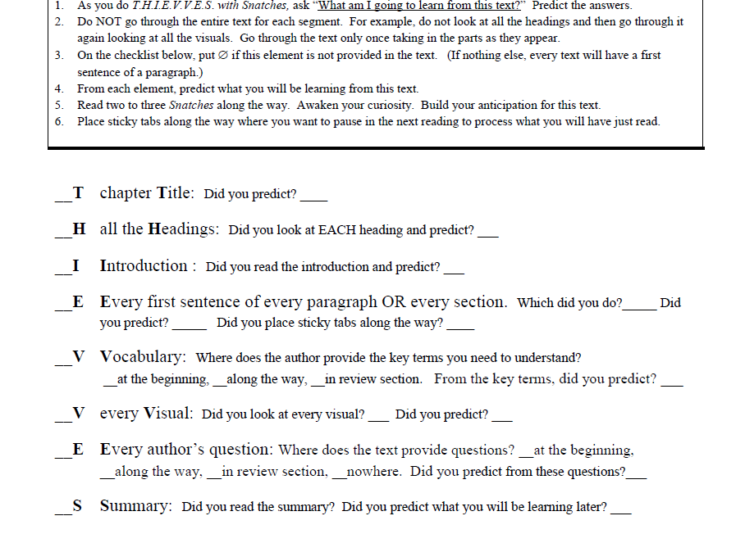
Watch me use the rest of the T.H.I.E.V.V.E.S. steps. You will see me do some “Snatches,” too.

Slide 28
Remember as you watch me that I do NOT do the parts in the order of the T.H.I.E.V.V.E.S. acronym. I do them in the order these parts are given to me in the text.

Slide 29
I try for only one time through for T.H.I.E.V.V.E.S.
With my mind highly alert, I can do this preview very fast. Here we go!

Slide 30
I put the ThinkSheet beside the text and use it to guide me through the process.

Slide 31
Yes
First of all, I see Learning Objectives. I read all four points. This tells me directly what I will learn. I don’t have to predict here. I know the author will address each one. “Thank you, Author, for telling what you expect me to learn from this chapter.”
Notes:
Highlight the visual – YOU DO NOTHAVE TO DO THESE IN ORDER.

Slide 32
Now for the introduction. How do I tell what the introduction is? Of course, it usually follows the title and rarely has a heading. But, there are also some criteria for a good introduction.

Slide 33
Introductions that are most helpful in understanding a text . . .

Slide 34
(1) Have a clear thesis statement.

Slide 35
(2) Give an overview of what the text will cover.

Slide 36
And (3) capture readers’ interest so they want to keep reading.

Slide 37
I see that this introduction is rather long; it carries over to the next page. I will only read enough now to get the gist, the big picture of this chapter, and the main points it will make.

Slide 38
When I start to read the first and second paragraphs, I see that they set the context for this chapter but probably do not give the main message of the chapter. I won’t read these yet.

Slide 39
The third paragraph, however, seems to be where I will learn what this chapter will teach me—why? I saw the bolded Law. I read this paragraph and predict what I will learn from this chapter.

Slide 40
I read only the first sentence in the next two paragraphs. They seem to be giving some history rather than the main message. However, I do predict I will learn how scientists discovered this law.

Slide 41
I read the end of
that first paragraph on this page. Sometimes the main point is there.
I read the first sentence in the next paragraph.
Not sure

Slide 42
I read the last three paragraphs in their entirety to the end of the introduction.
Why? They are short, and I hope the main points will be there.
Not sure

Slide 43
I picked up enough from the introduction to predict what I think I will learn from this chapter.

Slide 44
I predict that I will learn what this law is and why it is important, a bit of the history of its discovery and its applications, and how we humans try to stop the decay.

Slide 45
Since I move quickly through the chapter to preview with T.H.I.E.V.V.E.S. with Snatches, I do not write anything, just predict what this chapter is going to teach me.

Slide 46
The next part of T.H.I.E.V.V.E.S. to appear is a heading and the first sentence of that section. I read these.

Slide 47
I also grab three snatches: the words King’s and Humpty, and the sentence “Scrambled eggs never spontaneously unscramble.” I like the nursery rhyme example in this “snatch” of text.

Slide 48
From this “snatch” I predict a discussion of processes that can be reversed, those that cannot, and why.

Slide 49
I look at the visual. I see someone diving—it is shown in reverse order. What point is the author trying to make with this?
Probably I will learn more about the irreversible nature of some actions.

Slide 50
I also see a box about Sadi Carnot and his picture. Because it is a drawing from at least a century ago, I predict he may be the one who discovered the Law or first stated it.

Slide 51
I see a page about how the refrigerator works. I won’t read any more of this box right now. But it does make me curious to learn what a refrigerator has to do with the Law of Disorder.

Slide 52
I see a photo of two glasses of water. I read its caption.

Slide 53
I see three definitions in the margin. They must be important. A read the first couple of lines in each.

Slide 54
I also sometimes read the last few sentences of a section because they often give me clues to the overall meaning of that section.

Slide 55
I am becoming convinced that my earlier prediction is right—I will be learning about reversible and irreversible processes in nature with examples given.

Slide 56
I continue looking at all the parts of T.H.I.E.V.V.E.S. through the remainder of the chapter, including the first sentence (or even just the first line) of each paragraph. I also continue grabbing a few “snatches” along the way.

Slide 57
Here is an example of what I predict this chapter will teach me by glancing over a section of the text. I made this prediction at the end of section, 18-2:
The movement toward disorder can be good even if irreversible.
Some actions can be reversed but this takes lots of energy.
I will learn technical meanings of entropy and system and how these fit within the Law of Increased Disorder.

Slide 58
I place a sticky tab at the end of the section to prepare the text for when I read it later. It will remind me to pause and think through what I just learned.
I repeat this process over and over for each section, including the earlier sections I may have forgotten.

Slide 59
I look at the table and see that I will learn that some types of energy are more disordered than others. I hope to learn the importance of the continuum between order and disorder for how nature works.

Slide 60
I close my eyes and point randomly at a line and read this sentence I “snatched”.

Slide 61
Wow! This makes me curious. Dying plants produce thermal energy. I see dead plants as dead and producing nothing, just cold and brittle. I can see I have a lot to learn.

Slide 62
I like the cartoon, but based on what I have learned so far, I think the sculptor should be seated working on the E. It disintegrates later, not while he is working on it.

Slide 63
Where is the summary?
I flip the page and realize this is the last paragraph in the entire chapter, so I read it. It is indeed a brief summary and also a call to action.

Slide 64
I predict I will learn some of the social and political implications of an increasingly disordered universe and what, if anything, the human family can do about it or “should” do about it and under what circumstances.

Slide 65
On these last
two pages of the chapter, I see four
sections.

Slide 66
I can use the “Chapter Framework” as an outline for review later. Already I could flesh out this outline with things I think I will be learning about.

Slide 67
For the “Comprehension” questions, I think I could already answer some of them. It might be fun to take this test and compare my answers with those I give after I read the chapter more carefully.

Slide 68
I cannot figure out why “Analysis” is called that. These questions I glanced at seem to be recall questions and thus should belong with the comprehension questions.

Slide 69
Questions 8-11 seem to be thought and application questions as do all the “Synthesis” questions. So, what am I missing here? Maybe the author’s definitions of analysis and synthesis are different from mine.

Slide 70
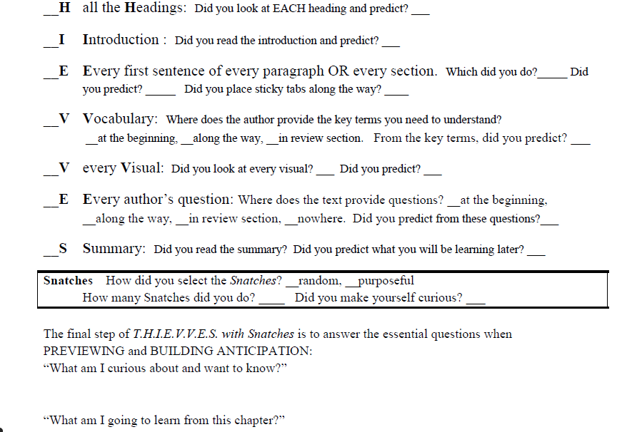
Back to the Thinksheet.
I look at each part of the ThinkSheet and mark my answers.
√
Yes
√
Yes
√
Each section.
Yes
Yes, at the end of each section.
√
In the review section
√
Yes
Bolded, and defined in margins.
√
Yes
√
√
Yes
√
√
5
Definitely.

Slide 71
I am curious why disorder is fundamental to the functioning of the universe.
√
Each section.
Yes
Yes, at the end of each section.
√
In the review section
√
Yes
Bolded, and defined in margins.
√
Yes
Yes
√
√
Yes
√
Yes
x x
5
Yes
I am curious why disorder is fundamental to the functioning of the universe.
How does this Law affect me every day even though I have not been aware of it?
What are the long-term implications of this Law for the survival of life and the Earth as we know it?

Slide 72
√
Each section.
Yes
Yes, at the end of each section.
√
In the review section
√
How does this Law affect me every day even though I have not been aware of it?
Yes
Bolded, and defined in margins.
√
Yes
Yes
√
√
Yes
√
Yes
x x
5
Yes
I am curious why disorder is fundamental to the functioning of the universe.
How does this Law affect me every day even though I have not been aware of it?
What are the long-term implications of this Law for the survival of life and the Earth as we know it?

Slide 73
√
Each section.
Yes
Yes, at the end of each section.
√
What are the long-term implications of this Law for the survival of life and the Earth as we know it?
In the review section
√
Yes
Bolded, and defined in margins.
√
Yes
Yes
√
√
Yes
√
Yes
x x
5
Yes
I am curious why disorder is fundamental to the functioning of the universe.
How does this Law affect me every day even though I have not been aware of it?
What are the long-term implications of this Law for the survival of life and the Earth as we know it?

Slide 74
√
Each section.
Yes
Yes, at the end of each section.
√
In the review section
√
Yes
Bolded, and defined in margins.
√
Yes
Yes
√
√
Yes
I also list what I predicted I would learn from the chapter.
√
Yes
x x
5
Yes
I am curious why disorder is fundamental to the functioning of the universe.
How does this Law affect me every day even though I have not been aware of it?
What are the long-term implications of this Law for the survival of life and the Earth as we know it?
I am going to learn . . .
what The Law of Increasing Disorder is.
what makes a process reversible and irreversible.
why things become more mixed up over time.
what happens to unused energy and why this is important in understanding the universe.
how this Law impacts social issues.
to solve problems based on this Law.

Slide 75
I bet I know what you’re thinking.

Slide 76
Wouldn’t it be easier to just read the chapter instead of going through this process?

Slide 77
That seems reasonable; however, . . .

Slide 78
. . . after a few times practicing it, you will be surprised how fast you can preview an entire text, and your comprehension will sky rocket!
Try it; you’ll like it.

Slide 79
In fact, you will actually read the whole text faster (including your later close reading) than by plodding through the text once.

Slide 80
Practice! Practice!
And you’ll see what I mean.

Slide 81
When you do this for real, it will go much faster because . . .

Slide 82
. . . you will probably read the first sentence in each section rather than in each paragraph.

Slide 83
Here’s a good rule for reading texts with sections:
The less familiar the concepts are, the more often you pause to read first sentences of paragraphs.

Slide 84
Points to Consider
T.H.I.E.V.V.E.S. with Snatches can be fast. All that thinking takes just moments.
Not all texts or articles are laid out as nicely as T.H.I.E.V.V.E.S. would suggest.
Some lack one or more of the parts of T.H.I.E.V.V.E.S. So now what do I do?
I take what the text gives me and work with those parts. For example:
Physical Science Foundations: all the parts of T.H.I.E.V.V.E.S.
Moby Dick: only chapter title and first sentences. T.H.I.E.V.V.E.S.
“Bet on Planet Earth”: only title, intro, first sentences, and a weak visual. T.H.I.E.V.V.E.S.

Slide 85
You have seen a demonstration of T.H.I.E.V.V.E.S. with Snatches.

Slide 86
Now, practice T.H.I.E.V.V.E.S. with Snatches on your own textbook or article.

Slide 87
Be sure to ask, “What am I going to learn from this text” and predict the answers.

Slide 88
I hope you see the value and will ALWAYS PREVIEW an academic text!

