Slide 1
Target, Track, and Defend the Main Points
Demo

Slide 2

Welcome to the DEMO for Target, Track, & Defend the Main Points.
When considering Layered Reading, this strategy has Before, During, and After components, but it is mainly a DURING strategy—helping you figure out what is most important.
Are you like many of our former students who said on Day 1 of the course that they wanted to learn how to figure out what is most important in a text?
Before proceeding further, read the section in the handbook about Determine Importance and Target, Track, and Defend the Main Points.

Slide 3
Here is Chapter 11. I am already familiar with its structure--Skeleton. Now I do T.H.I.E.V.V.E.S. with Snatches for the usual reasons but also to pick up clues to predict the most important message(s) of this text.
I need to read my history text. The professor always expects us to see the big picture of the text with the most important issues and points. He probes us on these.

Slide 4
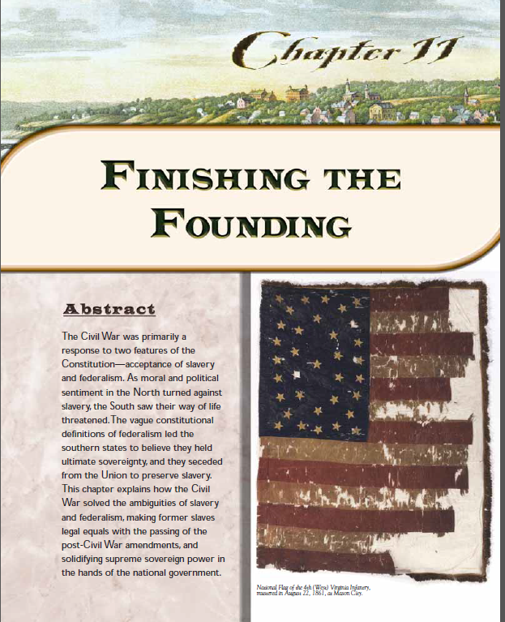
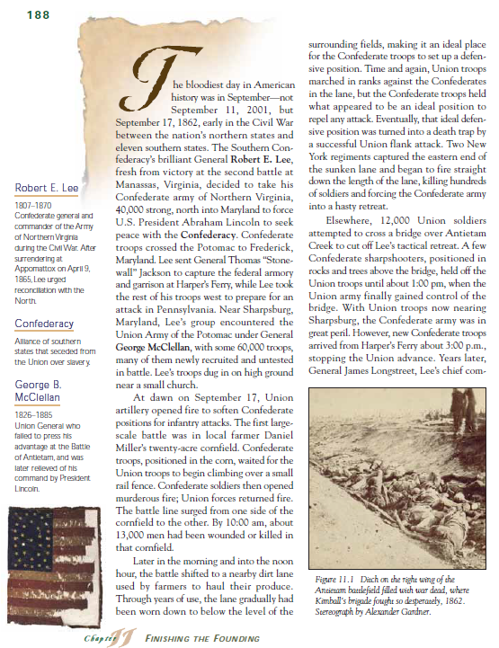
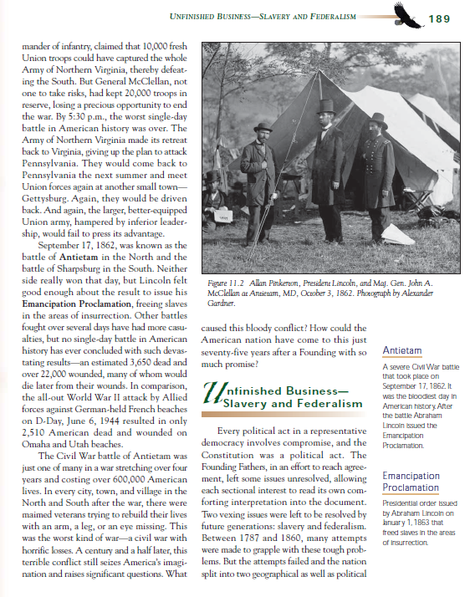
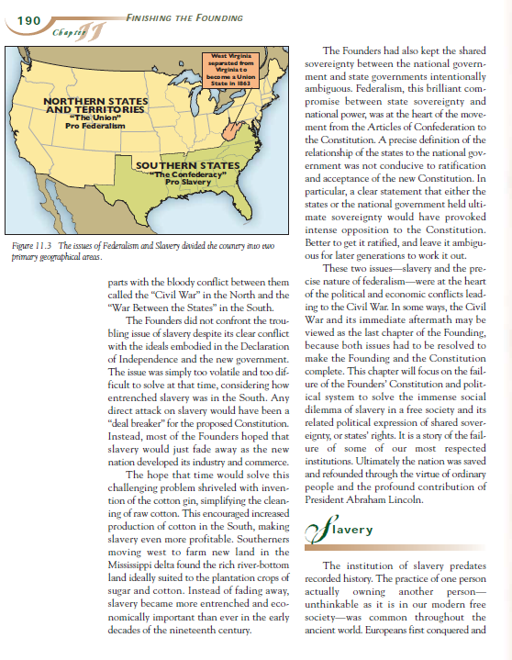
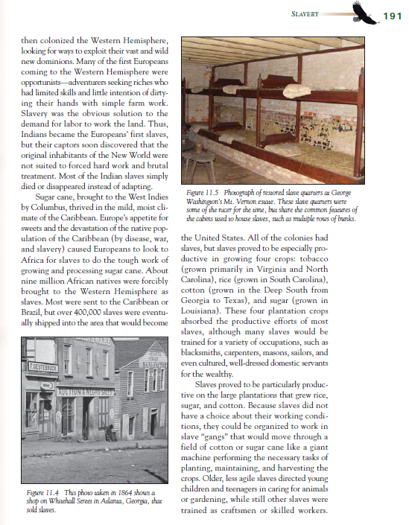
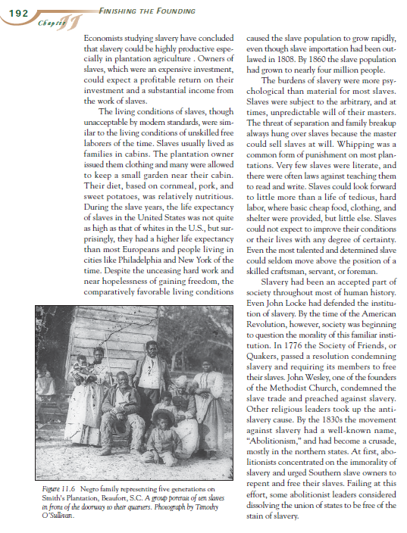
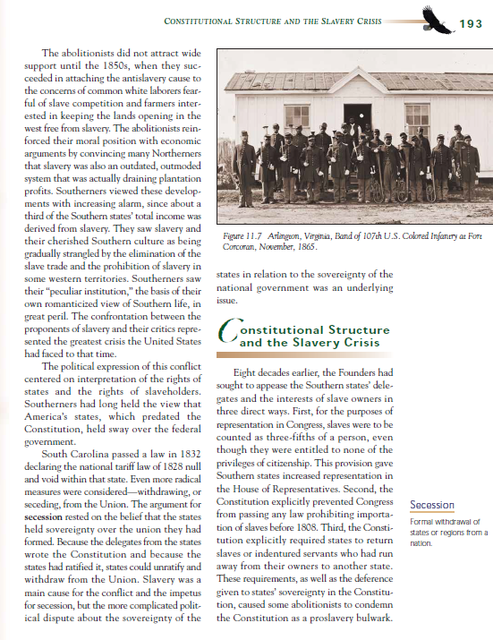
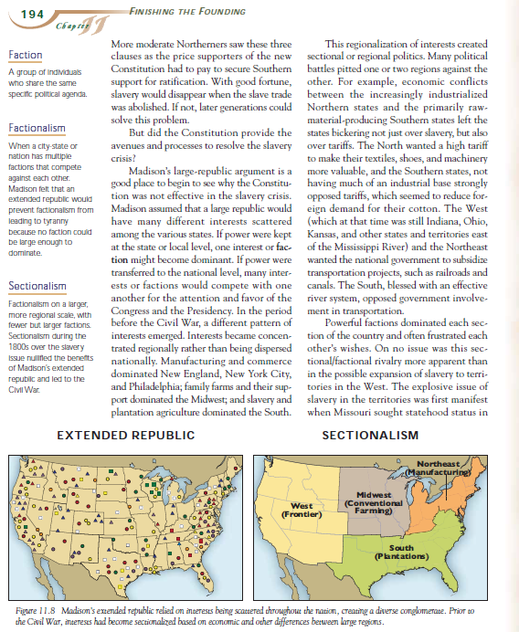
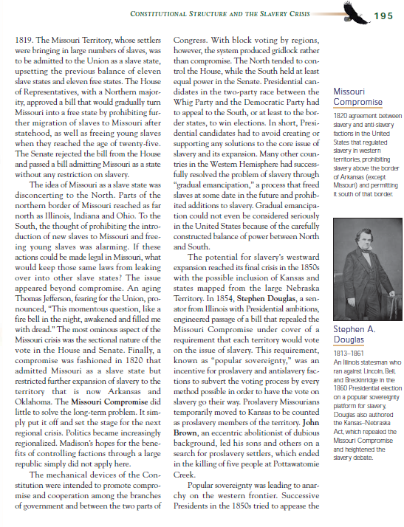
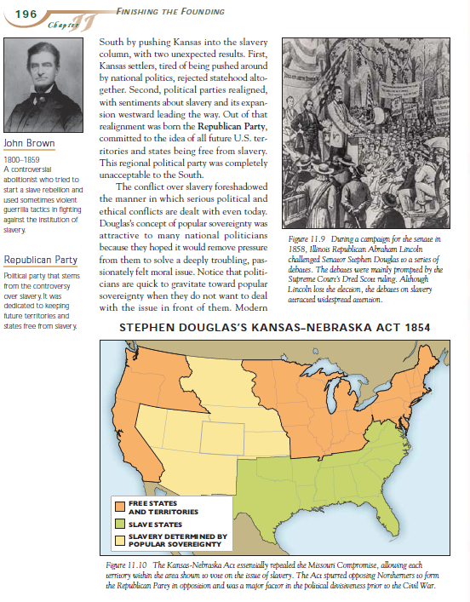
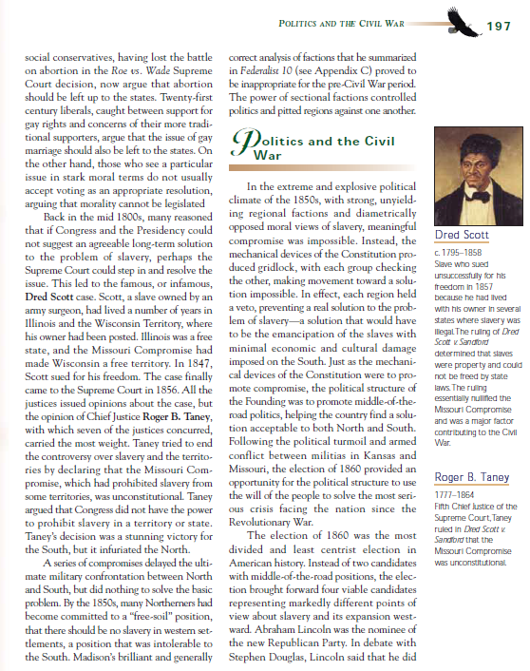
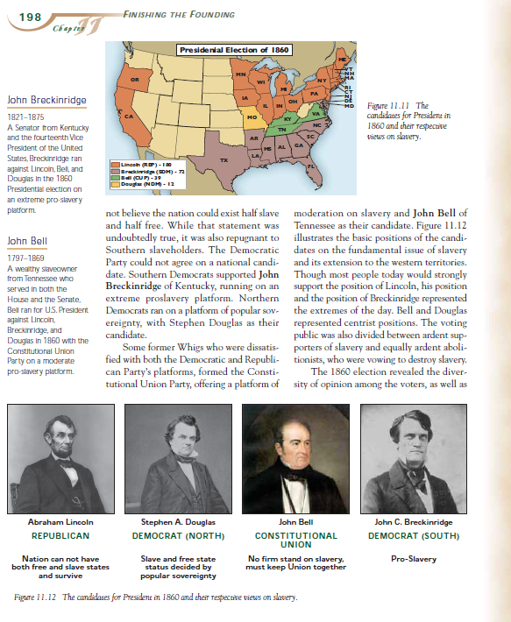
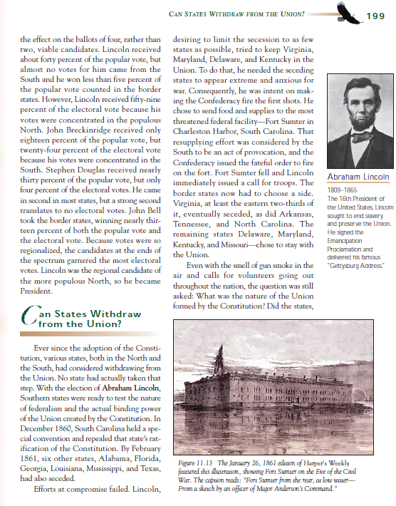
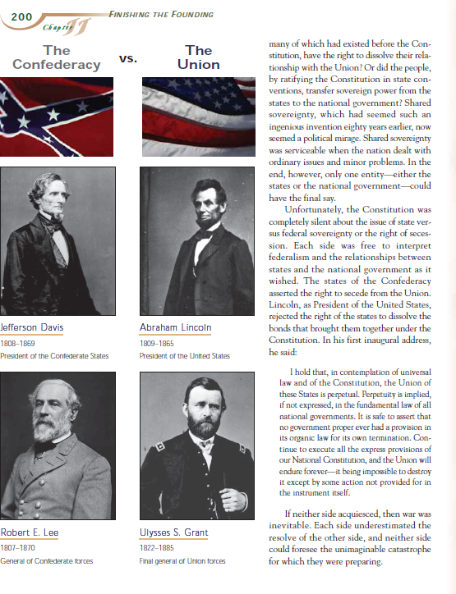
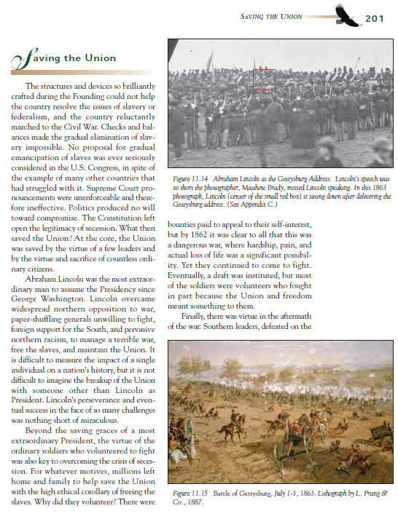
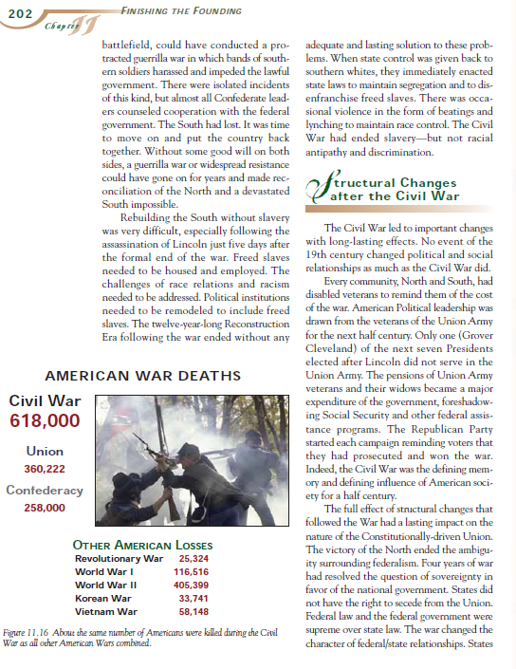
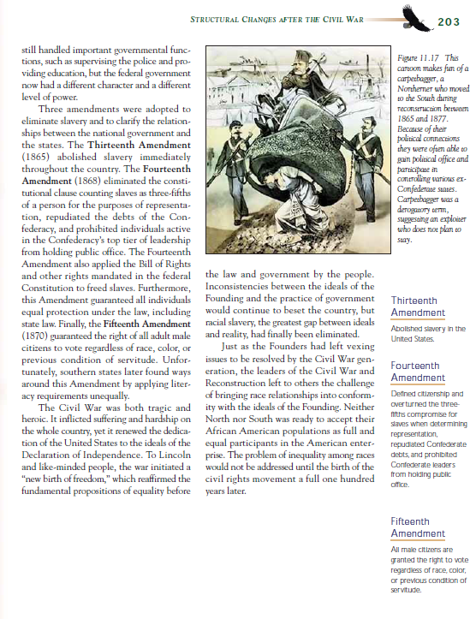
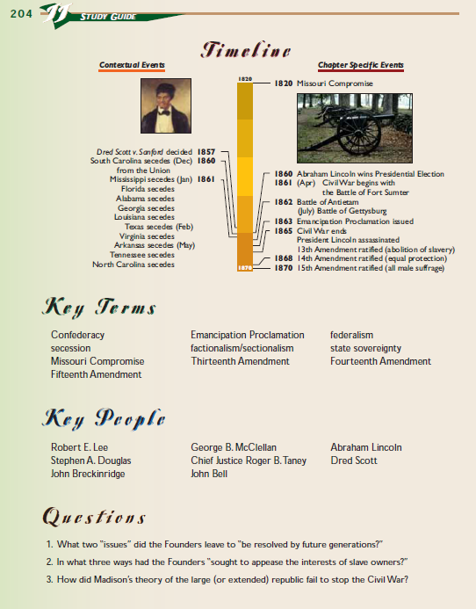
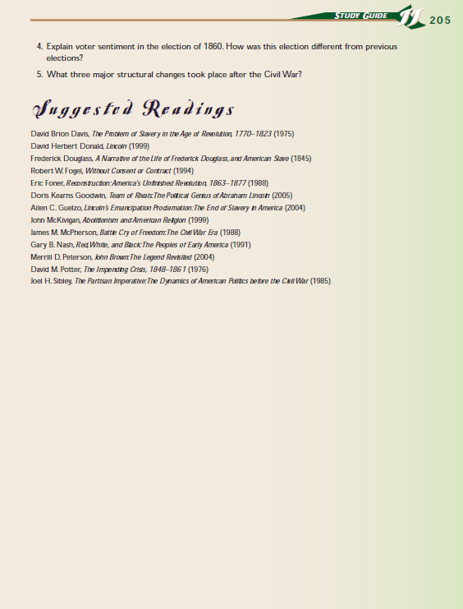
Let’s get to it!

Slide 5
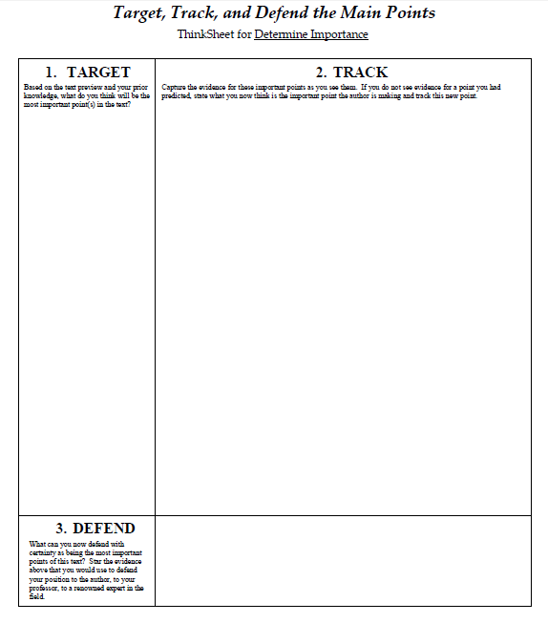
Here is the ThinkSheet for this Strategy.

Slide 6
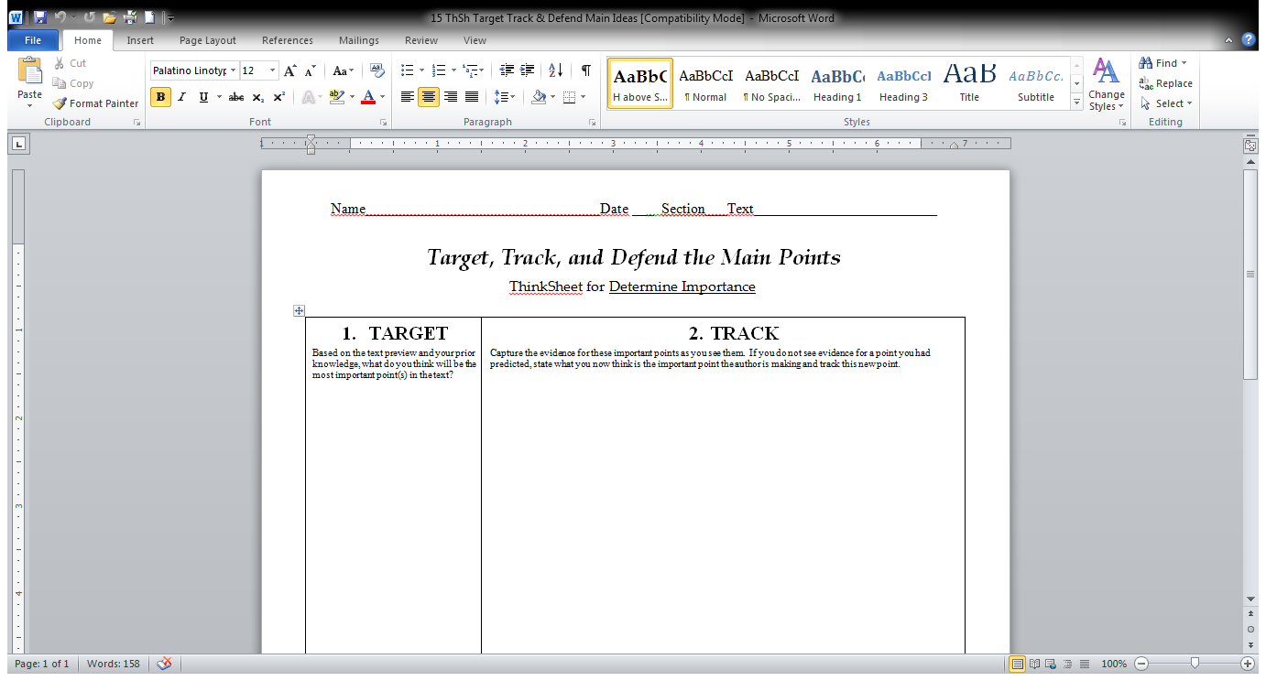
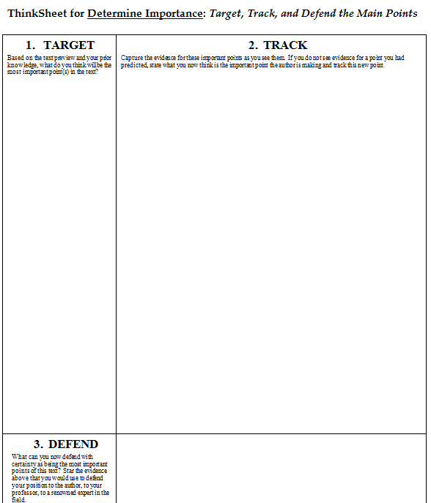
From the clues in the preview, here is what I predict the author will do with these main issues.
Here is what I TARGET to be the main points—based on my preview. My best guess now.
How the Civil War “finished the founding” of U.S.A. by dealing with two purposely unresolved issues:
Slavery
Federalism
Explain why the big issue of slavery was put off.
Show how the slavery issue brought the Federalism issue to the forefront.
Describe how both were resolved.
Show how these issues played out after the war & today.

Slide 7
How the Civil War. “finished the founding” of U.S.A. by dealing with two purposely unresolved issues:
Capture the evidence for these important points as you see them. If you do not see evidence for a point you had predicted, state what you now think is the important point the author is making and track this new point.
Capture the evidence for these important points as you see them. If you do not see evidence for a point you had predicted, state what you now think is the important point the author is making and track this new point.
Capture the evidence for these important points as you see them. If you do not see evidence for a point you had predicted, state what you now think is the important point the author is making and track this new point.
Slavery
Federalism
Prediction of how the authors will discuss these issues:
Now I TRACK these points to see if they are indeed the main ideas.
As I do this DURING part of the strategy, I will confirm, reject, add to, or tweak these predictions as I read.
Explain why it was put off.
Show how slavery issue brought the Federalism issue to the forefront.
Describe how both were resolved.
Show how these issues played out after the war & today.

Slide 8
It’s too divisive & volatile and the infant nation was too fragile to survive these issues (p. 198, 201)
Founders knew these issues would have to be dealt with - - - BUT LATER.
Founders hoped Slavery would soon end without trouble – but no – it actually became more entrenched in the South. (p. 192+)
How the Civil War. “finished the founding” of U.S.A. by dealing with two purposely unresolved issues:
Slavery
Federalism
Prediction of how the authors will discuss these issues:
Explain why it was put off.
Show how slavery issue brought the Federalism issue to the forefront.
Describe how both were resolved.
Show how these issues played out after the war & today.

Slide 9
STRONG regional view – entrenched, NO COMPROMISE – so how to resolve?
Many unsuccessful compromises
  Secession & keep slavery?
  Keep union together & abolish slavery?
Finally Civil War was needed to resolve who has supreme power: the States or the Federal Government
  Founders 1787 shared sovereignty between states & national gov’t.
  For example, Missouri Compromise 1820
    Missouri – slave state
    Permit slavery below Arkansas’s northern border & forbid it above.
How the Civil War. “finished the founding” of U.S.A. by dealing with two purposely unresolved issues:
Slavery
Federalism
Prediction of how the authors will discuss these issues:
Explain why it was put off.
Show how slavery issue brought the Federalism issue to the forefront.
Describe how both were resolved.
Show how these issues played out after the war & today.

Slide 10
SLAVERY –abolished
Emancipation Proclamation
After War, severe problems. How to deal with:
  Housing?
  Employment?
  Pensions?
  Illiteracy?
  Political inclusion?
  Racism?
3 Amendments (#13 abolished slavery, #14 defined former slaves as full citizens, #15 gave them the right to vote)
How the Civil War. “finished the founding” of U.S.A. by dealing with two purposely unresolved issues:
Slavery
Federalism
Prediction of how the authors will discuss these issues:
Explain why it was put off.
Show how slavery issue brought the Federalism issue to the forefront
Describe how both were resolved.
Show how these issues played out after the war & today.
FEDERALISM --National Govt. has supremacy, not States
Abraham Lincoln – HUGE impact
The Southern leaders urged reconciliation after war.

Slide 11
AFTER
Reconstruction – 12 years (tragic aspects)
Literacy requirements in South circumvented by 15th amendment
Rampant & visceral racism
How the Civil War. “finished the founding” of U.S.A. by dealing with two purposely unresolved issues:
Slavery
Federalism
TODAY
Racism & inequality not fully addressed –came to a head in the 1960s (Civil Rights Movement); still big issues currently
Impacted how we deal with political & ethical conflicts
  Gay marriage
  Abortion
  Gridlock in congress
  States’ rights vs. Federal Govt.
Prediction of how the authors will discuss these issues:
Explain why it was put off.
Show how slavery issue brought the Federalism issue to the forefront.
Describe how both were resolved.
Show how these issues played out after the war & today.

Slide 12
What can you now defend with certainty as being the most important point of this text?
Star (*) the evidence above that you would use to defend your position to the author, to your professor, or to a renowned expert in the field.
FEDERALISM (dividing power between state & national governments) was the major issue resolved by the Civil War with national government coming to have the ultimate power, but it was brought about by the moral and economic issues of SLAVERY!

Slide 13
Here’s my completed ThinkSheet. Each star * triggers my thinking to DEFEND what I consider to be the main message of the chapter .

Slide 14
STRONG regional view – entrenched, NO COMPROMISE – so how to resolve?
Many unsuccessful compromises
  Secession & keep Slavery?
  Keep union together & abolish slavery?
Finally Civil War to resolve who has supreme power
  Founders 1787 shared sovereignty between states & national gov’t.
  Missouri Compromise 1820
    Missouri – slave state
    Permit slavery below Arkansas border & forbid it above.
How the Civil War. “finished the founding” of U.S.A. by dealing with two purposely unresolved issues:
*
Slavery
Federalism
*
SLAVERY –abolished, sort of
Emancipation Proclamation
After War, severe problems
  Housing?
  Employment?
  Pensions?
  Illiteracy?
  Political inclusion?
  Racism?
3 Amendments (#13 abolished slavery, #14 defined former slaves as full citizens, #15 gave them the right to vote)
My predictions of the points to author will make on these issues:
Explain why slavery issue put off.
Show how slavery brought the Federalism issue to a head.
Describe how both were resolved.
Show how these issues played out after the war & today.
FEDERALISM --National Govt. has supremacy, not States
Abraham Lincoln – HUGE impact
The Southern leaders urged reconciliation after war.
*
TODAY
Racism & inequality not fully addressed –came to a head in the 1960s (Civil Rights Movement); still big issues currently
Impacted how we deal with political & ethical conflicts
  Gay marriage
  Abortion
  Gridlock in congress
  States’ rights vs. Federal Govt.
*
FEDERALISM (dividing power between state & national governments) was the major issue resolved by the Civil War with national govt. coming to have the ultimate power, but it was brought about by the moral and economic issues of SLAVERY!

Slide 15
It’s fun—you see your fine mind at work. It demands active processing.
You will learn a lot from the text.
Go for it now
using your own text.
Use this powerful strategy to determine the important points before reading (TARGET) and during reading (TRACK) so you can generate and DEFEND the main messages of your text (after reading).

