Slide 1
That Reminds Me
Demo

Slide 2
Before proceeding further, read the pages in the Handbook about the principle Connect the Text and the strategy That Reminds Me.
After you have learned from the Handbook, go to the ThinkSheet for this Strategy.
Welcome to a DEMO of That Reminds Me.
When considering Layered Reading, this is a During strategy that helps you draw on your prior knowledge while reading—a very important part of learning well.

Slide 4
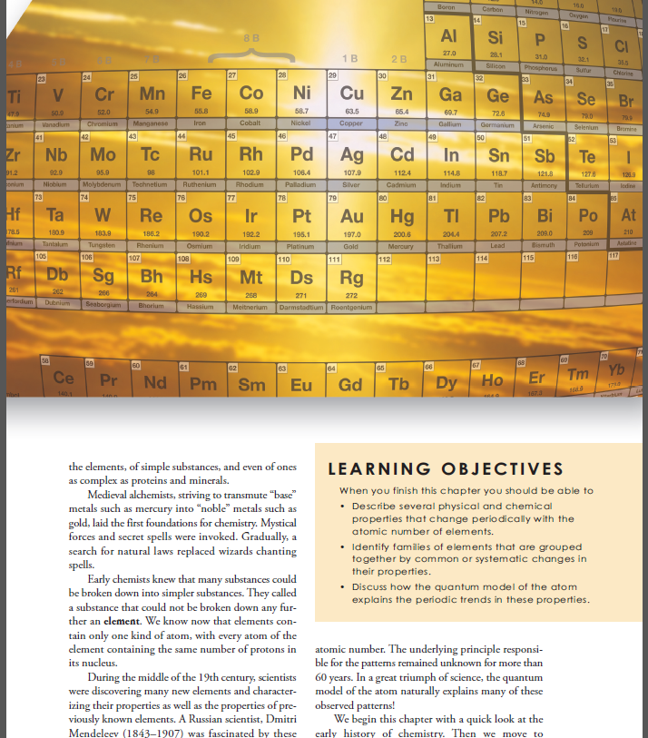
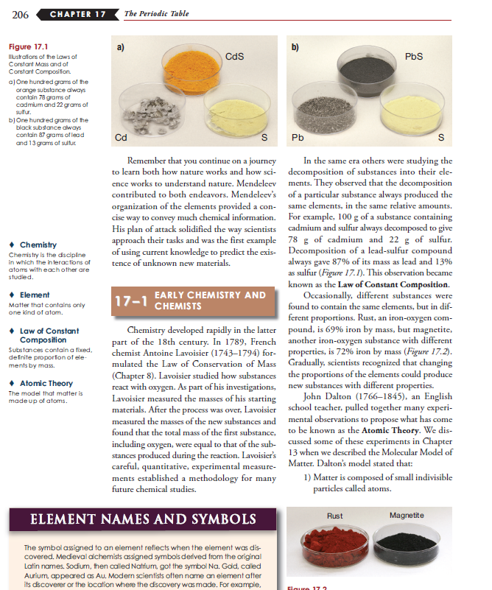
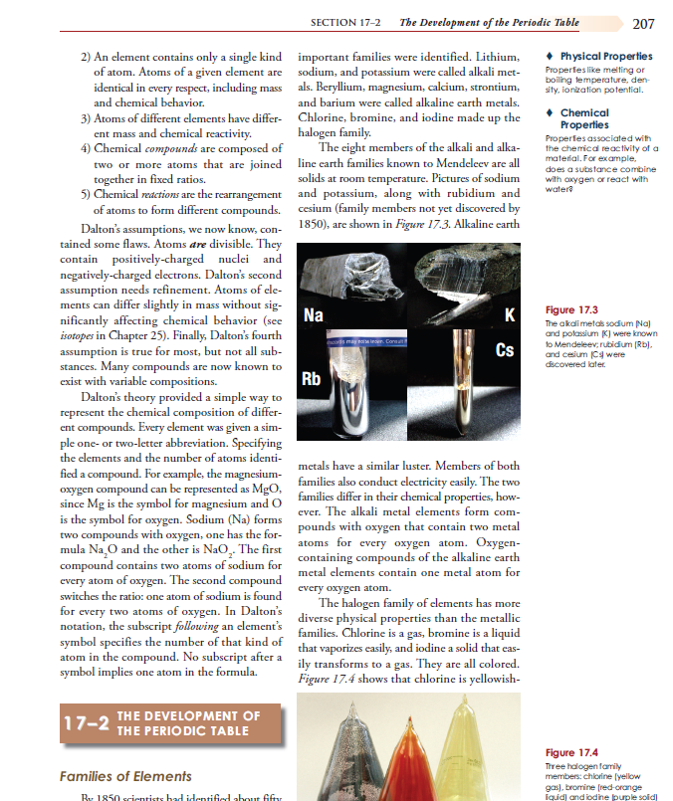
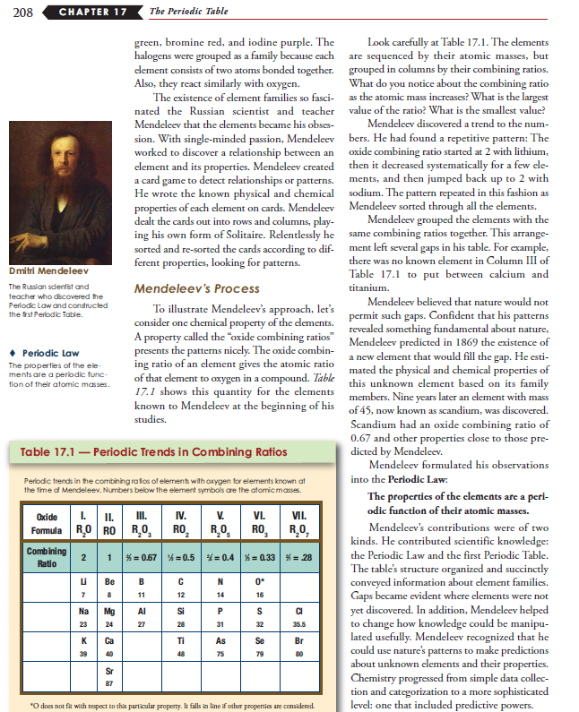
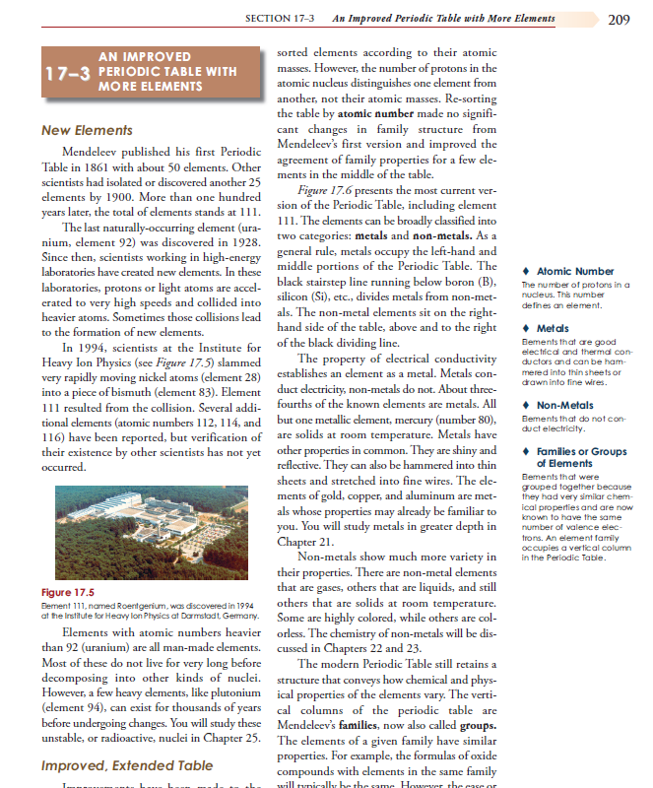
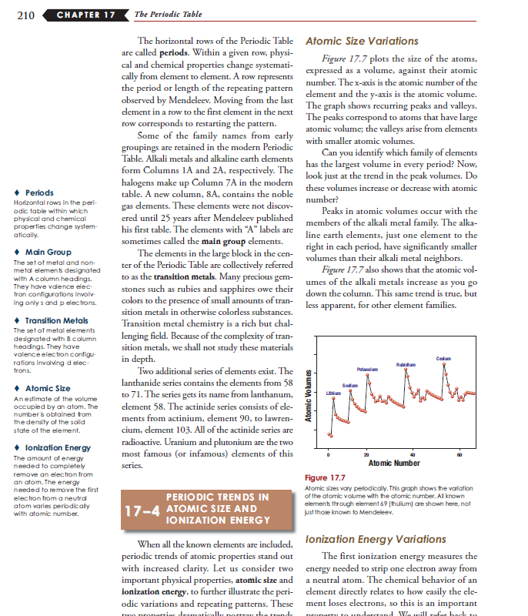
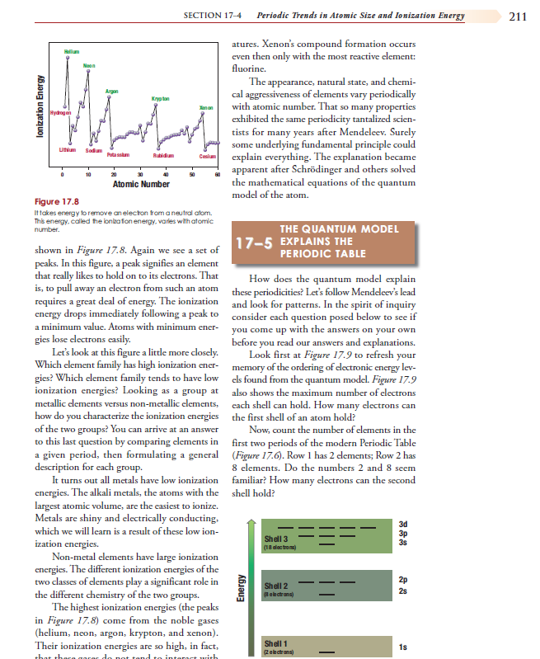
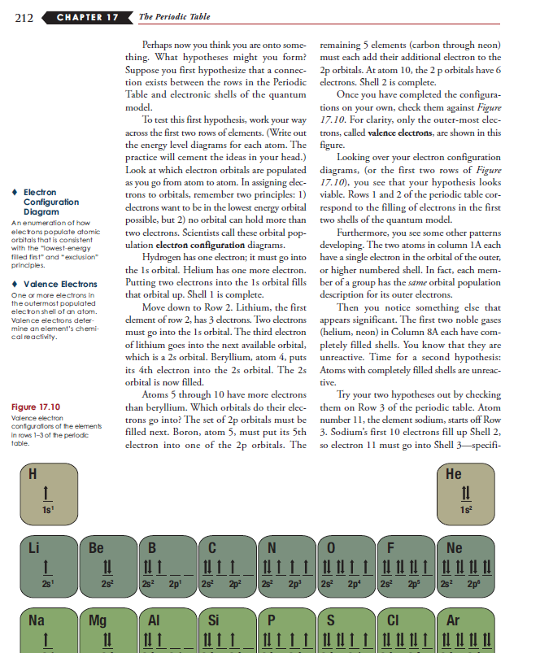
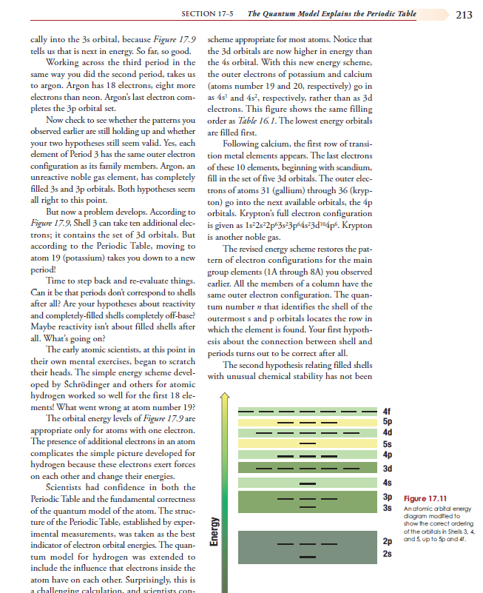
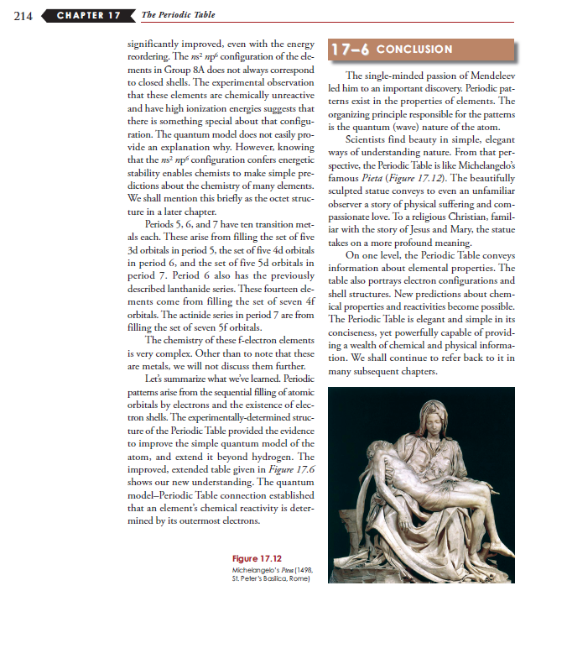
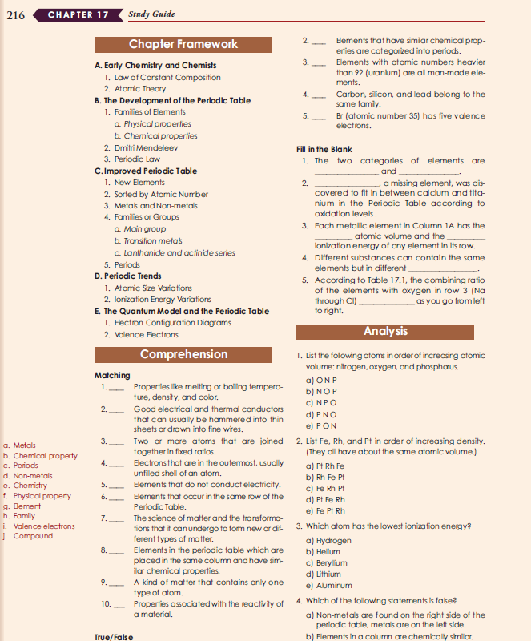
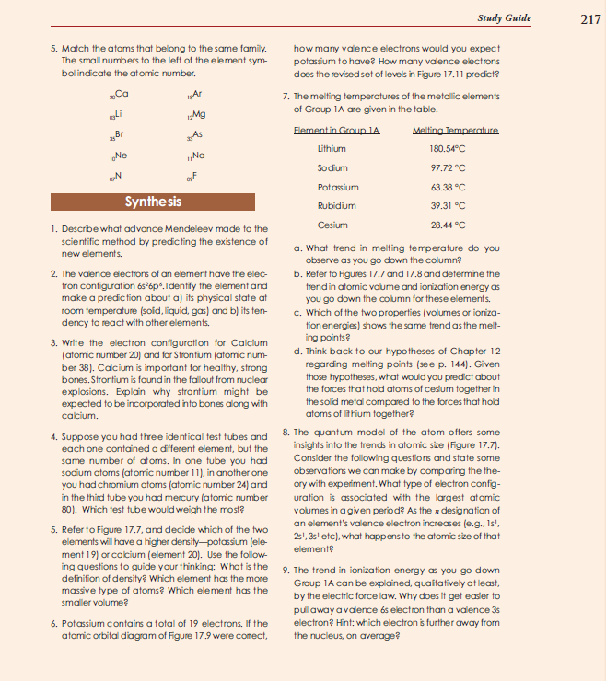
We’ll be working with the physical science text, Chapter 17
“The Periodic Table”

Slide 5
Let’s begin with how
the text “Reminds Me” of something in my own life:
Text to Self
T-S

Slide 6
p. 204b
Atoms form partnerships & exchange old partners for new ones

Slide 7
p. 204b
Atoms form partnerships & exchange old partners for new ones
Dance experiences in high school & college

Slide 8
p. 204b
Atoms form partnerships & exchange old partners for new ones
Dance experiences in high school & college
p. 204b
Atoms dance solo, in pairs, in lines, and complex formations.
I have watched opening ceremonies of the Olympics: Most complex - China

Slide 9
p. 204b
Atoms form partnerships & exchange old partners for new ones
Dance experiences in high school & college
p. 204b
Atoms dance Solo, in pairs, in lines, complex formations like
I have watched opening ceremonies: Most complex - China
p. 204b
Halogen family
We have halogen lamps. What is this connection? If any?

Slide 10
p. 204b
Atoms form partnerships & exchange old partners for new ones
Dance experiences in high school & college
p. 204b
Atoms dance Solo, in pairs, in lines, complex formations like
I have watched opening ceremonies: Most complex - China
p. 207d
Halogen family
We have halogen lamps. What is this connection? If any?
Mendeleev relentlessly sorted & re-sorted according to different properties/patterns.
I try to categorize similar ideas to see how they are the same and different, such as for my education course when I observed the class management systems of three different teachers.
p. 208a

Slide 11
. . . now, I write them in the margins and code the kind of connection I am making: T-S, T-T, T-TT, T-W, T-D. Sometimes they overlap, so I code it as the first type of connection that comes to mind and write a trigger word to remind me of my connection.
When I first learned this strategy, I made notes on the ThinkSheet;

Slide 12
The text can also
“Remind Me” of something I’ve read in Other Texts
Text to Other Texts
T-OT
Remember to think of “Other Texts” broadly: a movie, your professor’s lecture, an essay in a magazine, a work of art, and any human-made communication.
p. 204b
Atoms form partnerships & exchange old partners for new ones
Dance experiences in high school & college
p. 204b
Atoms dance Solo, in pairs, in lines, complex formations like
I have watched opening ceremonies: Most complex - China
p. 207d
Halogen family
We have halogen lamps. What is this connection? If any?
p. 208a
Mendeleev relentlessly sorted & re-sorted according to different properties / patterns
How I go about learning new things: Doing qualitative research – looking for patterns .

Slide 13
p. 204b
Atoms form partnerships & exchange old partners for new ones
Dance experiences in high school & college
p. 204b
Atoms dance Solo, in pairs, in lines, complex formations like
I have watched opening ceremonies: Most complex - China
p. 207d
Halogen family
We have halogen lamps. What is this connection? If any?
p. 208a
Mendeleev relentlessly sorted & re-sorted according to different properties / patterns
How I go about learning new things: Doing qualitative research – looking for patterns .
p. 204 par 3
In an old Smithsonian magazine I found this:
“Out of 88 natural elements, only 20 are found in the native state meaning that it is not combined with other elements.” (Smithsonian Magazine)
Ah, the Periodic Table changes over time.
Periodic Table 111 elements
23 elements are not natural elements –
hmm . . . man-made?

Slide 14
I naturally connect the parts to earlier parts. Do you? They all enhance understanding of each other: “Ah, that’s what xyz meant back in Chapter 2. Now I get it.” I do not squelch those connections; I invite them.
Often something I’m reading will remind me of something I had read in that same text earlier.
Text to Same Text
T-ST

Slide 15
p. 204b
Atoms form partnerships & exchange old partners for new ones
Dance experiences in high school & college
p. 204b
Atoms dance Solo, in pairs, in lines, complex formations like
I have watched opening ceremonies: Most complex - China
p. 207d
Halogen family
We have halogen lamps. What is this connection? If any?
p. 208a
Mendeleev relentlessly sorted & re-sorted according to different properties / patterns
How I go about learning new things: Doing qualitative research – looking for patterns .
p. 204 par 3
I remember a magazine article at my parent’s. I looked it up and found this:
P. 204 – 1st sentence...
Entire Ch. 16 discusses quantum model of the atom
Periodic Table 111 elements
23 elements are not natural elements –
hmm . . . man-made?
“Out of 88 natural elements, only 20 are found in the native state meaning that it is not combined with other elements.” (Smithsonian Magazine)
Must be an out of date article.
P. 214b – Lanthanide & Actinide series
Go back to my discovery of my misunderstanding on p. 210b
P. 212 – S & P
Studied pp. 196+197 to make sense of these symbols

Slide 16
Now I will connect what’s
in the text with general world knowledge.
Text to World
T-W
These Text to World connections probably came from some “text,” broadly defined. I have the knowledge but can’t think where I learned it. It is now just part of what I know—ah, my prior knowledge.
For example, when someone says the “boot of Europe,” I picture Italy.
When did I learn that? Where? It doesn’t matter; it came from somewhere and is now part of my background world knowledge.

Slide 17
p. 204b
Atoms form partnerships & exchange old partners for new ones
Dance experiences in high school & college
p. 204b
Atoms dance Solo, in pairs, in lines, complex formations like
I have watched opening ceremonies: Most complex - China
p. 207d
Halogen family
We have halogen lamps. What is this connection? If any?
p. 208a
Mendeleev relentlessly sorted & re-sorted according to different properties / patterns
How I go about learning new things: Doing qualitative research – looking for patterns .
p. 204 par 3
This reminds me of something I read.
P. 204 – 1st sentence...
Entire Ch. 16 discusses quantum model of the atom
Periodic Table 111 elements
23 elements are not natural elements –
hmm . . . man-made?
I looked it up and found this:
P. 214b – Lanthanide & Actinide series
Go back to my discovery of my misunderstanding on p. 210b
“Out of 88 natural elements, only 20 are found in the native state meaning that it is not combined with other elements.” (Smithsonian Magazine)
P. 212 – S & P
Studied pp. 196+197 to make sense of these symbols
Author gives analogy of Michelangelo’s Pieta to better understand the Periodic Table
The connection seems bizarre in a physical science text, but maybe not to a chemist. It is probably meant to be an analogy to the elegance and beauty of art , Pieta, and of nature, the Periodic Table.

Slide 18
This type of connection doesn’t usually come naturally for me; I have to consciously work at it. Part of the problem is that I know too little about this discipline.
My professor will make these connections easily because she has abundant knowledge of the discipline.
Yet, as I try to make such connections, this field becomes more fascinating, and much less a bunch of facts to learn. I begin to see the big picture and why this discipline is very important.
This connection is obviously founded on the other types of connections, especially Text to Other Text and Text to World, but since I am studying a specific discipline and want to learn well, I need to see how what I am studying right now fits within the major issues, knowledge base, and contributions of the discipline.
Finally I will connect what’s
in the text with the specific discipline of study.
Text to Discipline
T-D
So, yes, I make fewer of these Text to Discipline connections than the other types. But as I immerse myself in my major, I am able to make more and more of these connections, and I must.

Slide 19
p. 204b
Atoms form partnerships & exchange old partners for new ones
Dance experiences in high school & college
p. 204b
Atoms dance Solo, in pairs, in lines, complex formations like
I have watched opening ceremonies: Most complex - China
p. 207d
Halogen family
We have halogen lamps. What is this connection? If any?
p. 208a
Mendeleev relentlessly sorted & re-sorted according to different properties / patterns
How I go about learning new things: Doing qualitative research – looking for patterns .
p. 204 par 3
This reminds me of something I read.
P. 204 – 1st sentence...
Entire Ch. 16 discusses quantum model of the atom
Periodic Table 111 elements
23 elements are not natural elements –
hmm . . . man-made?
I looked it up and found this:
P. 214b – Lanthanide & Actinide series
Go back to my discovery of my misunderstanding on p. 210b
“Out of 88 natural elements, only 20 are found in the native state meaning that it is not combined with other elements.” (Smithsonian Magazine)
P. 212 – S & P
Studied pp. 196+197 to make sense of these symbols
Author gives analogy of the Pieta to better understand the Periodic Table
Grew out of Einstein’s theories, but goes way beyond.
I have seen it in person – .
Quantum model
of the atom
Descriptive, predictive ,
orderly pattern
the connection seems far-fetched, but to a chemist, maybe not.
Periodic table
Shells
This seems to be an essential concept I must know to move forward in chemistry. The meaning is very different from its common meaning.
Orbitals

Slide 20
Making connections in and out of the text connects me much stronger to the text itself and definitely enhances my understanding.
Good luck practicing on your own text!

