Slide 1
4 x 4 Download
Demo

Slide 2
Welcome to the Demo
for 4 x 4 Download.
This DURING strategy in Layered Reading helps you focus
as you read on what you need from a text. Furthermore, it is a powerful way to process the text for long term understanding.
It takes a bit to set it up, but then you have a systematic way to learn from your text.
Plus the product is a great review tool!

Slide 3
However, its effectiveness depends on the caliber of questions you ask.
Asking superficial, memory questions
=
transfer of information with shallow understanding,
BUT
Asking probing, thought-filled, important questions
=
solid understanding, long-term retention, and deep learning.
More about that later.
Go now to the Handbook and read all the pages about the strategy
4 x 4 Download.
The challenging part is to come up with four generic questions to guide your thinking as you read. Once that is done, smooth-sailing and deep learning.

Slide 4
Now for the demonstration. I am going to read this chapter in City upon a Hill for the American Heritage course.

Slide 5
First, as always for reading any text for an academic purpose, I preview the chapter (T.H.I.E.V.V.E.S. with Snatches) and set my purposes for reading (Launch).
My preview has made me interested in learning from this chapter. I see that I will be learning about the influences from English history on the thinking of the Founders of the American system of government.
I decided what I most want to be able to do after reading this text:
MY PURPOSE: List the English and Classical influences on American government and explain the three most prominent influences with good details.

Slide 6
Here is the ThinkSheet.

Slide 7
I am to come up with questions that are not specific to any section; rather they are ones I can ask of any section in the chapter. I will ask these same few questions over and over for each section I read.
Here are three examples of
GENERIC Questions,
the kind of questions to use for 4x4 DL:
What main points increase my understanding of English and Classical influences on the U.S. Constitution?
What key terms must be understood to understand the formation of the U. S. system of laws?
What are my lingering questions about the ideas in this section?
Do you see that these questions can be asked over and over for each section of the text?
Do you also recognize that these questions will help me meet my purposes for reading?
Here are three examples of
SPECIFIC Questions,
the kind of questions NOT to use for 4x4 DL:
What was Locke’s explanation of natural law?
What does habeas corpus mean?
What does generality mean in terms of natural law?
Can you see that these questions cannot be asked over and over but only for the one section that deals with that topic?
My first task is to create four useful, but generic questions.

Slide 8
I want to make clear that the specific questions I asked are not “bad” questions; in fact, they may be excellent questions I need to answer.
So, I could make one of the 4x4 questions be something like this:
“What ought I be able to answer from this section?”
Ah, Professor’s Questions!
I could choose “Prof’s ?s” to be one of the four generic questions to ask
over and over.

Slide 9
First, I look at my purpose and think what questions would most likely help me meet those purposes.
Then I look for ideas from the list of suggestions in the Handbook under
4x4 Download,
“Informational Text.”
MY PURPOSE: List the English and Classical influences on American government and explain the three most prominent influences with good details.
Let me show you how I set up the ThinkSheet for maximum benefit in the quickest way.
Informational Text
Sample basic questions main points, important details, Prof’s Questions, vocabulary and definitions.
Sample advanced questions counter-arguments, details to supplement arguments, connections, unanswered questions, hypotheses, examples, so what?, purpose of this section, still fuzzy for me, essential equations, author’s intentions, biases, implications, my opinions, underlying assumptions, My Questions, theoretical perspective, applications, properties, analogies, problems.

Slide 10
Do you see that the first two are generic even though they are worded specifically for this text?
I can use these four questions for this chapter, no matter the section.
I decide on four:
English and Classical Influences on the Founders’ thinking.
Important details about these influences.
Professor’s Questions.
My Questions.
Do you also see that they will help me meet my purposes of being able to list the influences and to explain the main influences?

Slide 11
I now write these into the first quadrant.
I won’t need to write them again because I can easily see what they are.
Or I could put a key word or an abbreviation in the remaining quadrants.
Engl or Classic Infls
Details abt infls
Influ
D
Prof’s ?s
My ?s
P ?
My ?

Slide 12
As I started reading, I immediately realized that Prof’s Questions was a waste of time because I was basically recopying what I had written for the first two questions. So, I changed the 3rd question to American Applications of these Ideas
Engl or Classic Infls
Details abt influ.s
Influ
D
Prof’s ?s
My ?s
Am
My ?
P ?
Ameri. Appli

Slide 13
You do this, too.
Use your metacognitive awareness to decide if the questions are working for you and taking you where you want to go. If not, change them, as I did.
The 4x4 Download should not be busy work. Instead make every moment a highly productive learning experience for you.
Engl or Classic Infls
Details abt influ.s
Influ
D
Prof’s ?s
My ?s
Am
My ?

Slide 14
I like to put in the main topic for each section at the top of the section oval with the page numbers listed. This keeps me on track and shows me where I am in the text when reviewing later.
Engl or Classic Infls
Details abt influ.s
Influ
D
30-34 Lochean Liberty
35-36 Generality
Prof’s ?s
My ?s
Am
My ?
Influ
D
D
Influ
36 Prospectivity
37 PublicityGenerality
Am
My ?
Am
My ?

Slide 15
I can set up 4x4 much faster than it seems in this demonstration. The hard part for me is deciding the questions to guide my reading.
Now, I read the chapter, and fill in a 4x4 quadrant at the end of each section.
Watch me.
Infls
Details abt influ
Influ
D
Locke & natural law
Influenced by Classical Greeks & Romans
Common law –applied to legal & political processes
Writ of Habeas corpus: immediate release after arrest if not enough evidence
Must be tried by panel of disinterested peers
Discovery of nat. laws
Precedents set by earlier courts
30-34 Lochean Liberty
35-36 Generality
Am
My ?s
Am
My ?
Founders –vision of English system, “let’s implement it better than they do.”
Innate moral sense—the natural laws, God-given rights
Taxpayers should have a say!
Is “Rule of Law” a specific term that includes certain attributes?
Are these canonized?
How did Rule of Law evolve?
Influ
D
D
Influ
36 Prospectivity
37 Publicity
Am
My ?
Am
My ?

Slide 16
Infls
Details abt influ
Influ
D
Locke & natural law
Influenced by Classical Greeks & Romans
Common law –applied to legal & political processes
Writ of Habeas corpus: immediate release if not enough evidence
tried by panel of peers
Discovery of nat. laws
Precedents set by earlier courts
30-34 Lochean Liberty
35-36 Generality
Am
My ?s
Am
My ?
Founders –had vision of English system,--”Let’s implement it better “
Innate moral sense—natural laws, a right
Taxpayers – a say!
Is “Rule of Law” a specific term that includes certain attributes?
Are these canonized?
How did Rule of Law evolve?
Notice several things:
I write talking points to jog my memory.
I use few words and try for no more than four points per question. Distill. Distill.
As I fill in the 4x4, I go left to right, left to right as though reading. You can use a different order, but be systematic.
The center oval is like an Abstract of that entire section.
D

Slide 17
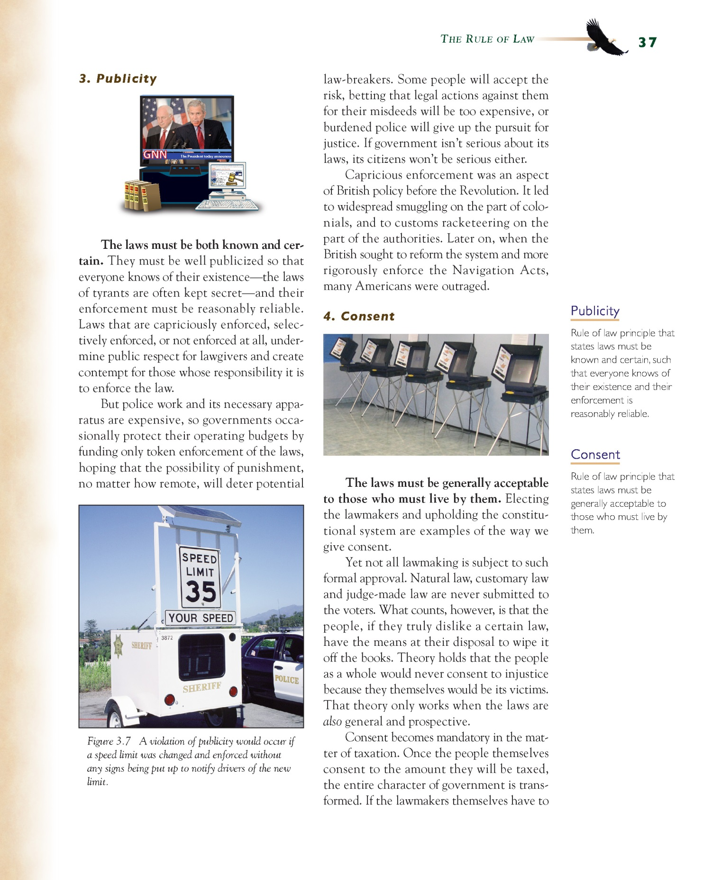
Infls
Details abt influ
Influ
D
Locke & natural law
Influenced by Classical Greeks & Romans
Common law –applied to legal & political processes
Writ of Habeas corpus: immediate release if not enough evidence
tried by panel of peers
Discovery of nat. laws
Precedents set by earlier courts
I know exactly what I will look for as I read:
What were the English and Classical influences on the Founders’ thinking? (INFLS)
What are some important details about these influences? (D)
How did Americans apply these ideas? (AM)
What are my lingering questions? (MY ?)
I read the section with these questions in mind.
Please read it so you can understand my thinking processes.
Watch me do one more quadrant in depth.
I’ll do a short section in the chapter labeled “Publicity.”
30-34 Lochean Liberty
35-36 Generality
Am
My ?s
Am
My ?
Founders –had vision of English system,--”Let’s implement it better “
Innate moral sense—natural laws, God-given
Taxpayers – a say!
Is “Rule of Law” a specific term that includes certain attributes?
Are these canonized?
How did Rule of Law evolve?
Influ
D
D
Influ
36 Prospectivity
37 Publicity
Am
My ?
Am
My ?

Slide 19
This small section “Publicity” that you have just read is a sub-section of a larger section entitled “The Rule of Law.”
Here is the picture and caption you missed.

Slide 20
Infls
D
See how I answered the question for each of the four quadrants.
First, I show you the generic question.
Then I show you how I answered it based on my reading of the “Publicity” section.
I point this out because you can
start answering any of the four questions wherever you want. Furthermore, you can jump around, leaving and return to a quadrant as you desire. You will see this when I answer Questions 1 and 2 back and together at the same time.
Nevertheless, I usually go in order unless I have a compelling reason to do otherwise.
This may seem funny, but
I don’t always do the questions in order. For example, after I finished reading this section, I had my own questions that I wanted to write down right away, so I started with Question 4.
37 Publicity
Am
My ?

Slide 21
Infls
D
37 Publicity
Am
My ?
How can we possibly “know” the laws—hundreds are made or overturned every year.?
Instead of “know” the laws is the reality that the opportunity is available to anyone to “know” of each law?
How does law enforcement keep up with the laws so they know what to enforce?
Q4 What are my lingering questions?

Slide 22
Infls
D
Negative British example of capricious, selective law enforcement, or no enforcement
British enforcement , capricious., before Revolution.
Angry backlash when British started rigorously enforcing Navigation Acts.
Q1 What were the English and Classical influences on the Founders’ thinking?
Q2 What are some important details about these influences?
Respect for laws essential
Comes from fair laws being well publicized and equitably enforced.
Some people take the risk of doing misdeeds ,--”won’t come after me.”
-police too burdened
-too expensive
37 Publicity
Am
My ?

Slide 23
Infls
D
37 Publicity
Am
My ?
Determined to avoid tyranny.
Determined to publicize laws.
Determined to enforce just laws .
Were serious about the laws.
(Put in place ways to make acceptable laws and ways to change bad laws.)
Q3 How did Americans apply these ideas?

Slide 24
Infls
D
Negative British example of capricious, selective law enforcement, or no enforcement
British enforcement , capricious., before Revolution.
Angry backlash when British started rigorously enforcing Navigation Acts.
Now I synthesize the section in just a few words—a Telegram. I write it in the center oval
Respect for laws essential
Comes from fair laws being well publicized and equitably enforced.
Some people take the risk of doing misdeeds ,--”won’t come after me.”
-police too burdened
-too expensive
37 Publicity
Citizens must be able to know the laws and trust they will be reasonably enforced
Am
My ?
Determined to avoid tyranny.
Determined to publicize laws.
Determined to enforce just laws .
Were serious about the laws.
(Put in place ways to make acceptable laws and ways to change bad laws.)
How can we “know” the laws, hundreds are made or overturned every year.
Instead of “know” the laws is the reality that the opportunity is available to everyone to “know” of each law?
How does law enforcement keep up with the laws so they know what to enforce?

Slide 25
When I finish the entire
chapter, I write a synopsis in one of the large center ovals.
Essentially I Make an Abstract.
Here is what I wrote synthesizing the whole “English Legacy”
chapter.
I continue like this, completing
a 4x4 quadrant for each section I need to read. I usually write fewer words than I showed you, just enough to TRIGGER my memory.
English political theorists (John Locke, etc.) and Classical thought influenced America’s Founders, specifically the ideas of natural laws and rights such as
the social contract between the governed and the government,
the Rule of Law with its meta-legal principles to protect the freedoms and natural rights of the people, and
the curtailing of the misuses of power (tyranny, corruption, etc.) through mixed and balanced power structures (e.g., checks and balances among three branches of government).
The Founders inserted provisions for the Rule of Law to assure steady, even-handed, and predictable laws that would secure the people’s natural rights.
Notes:
The 4x4 Download ThinkSheet was originally conceptualized to include only four parts of a chapter. This is unrealistic for most chapters.

Slide 26
. . .so, I suggest you ignore all the large center ovals until you have finished the text. In fact, because you only need one large oval, use the extra space, as needed, to address your four questions.
Then write your synthesis of the entire chapter in a space large enough for the type of abstract you want to write—think NAPE: News release, Annotation, or Publishable abstract, probably not an Executive summary.
The 4x4 Download ThinkSheet
was originally conceptualized to include only four parts of a chapter. That is why you see a large oval in the center of each page for your overall synopsis.
Dividing a chapter into only four parts is unrealistic for most chapters; . . .
Notes:
The 4x4 Download ThinkSheet was originally conceptualized to include only four parts of a chapter. This is unrealistic for most chapters.

Slide 27
Now you try
4x4 Download
for an important chapter
you need to learn well.
Come up with four generic questions that will lead you to gain what you need from the chapter at whatever depth of processing and thinking
you desire.
Happy learning!

