Slide 1
New Questions / New Thoughts
Demo

Slide 2

Welcome to the Demo for
New Questions / New Thoughts
This AFTER strategy in Layered Reading makes you “an active creator rather than a passive recipient of meaning” (Brent, 1992, p. 23) . Add imagination to what you are learning and you explore, create, invent, and become a scholar.

Slide 3
New Questions / New Thoughts
certainly makes the content in a text yours as you turn it in all directions to explore it, brainstorm applications, and make memorable connections.
This After strategy may lead to important discoveries, surely for yourself and your learning.
These processes can be an adventure not to be missed.
Go now to the Handbook and read the pages about Generate New Thinking and the strategy
New Questions / New Thoughts.
Plus, it is FUN to see your fine mind at work. So let’s get started.

Slide 4
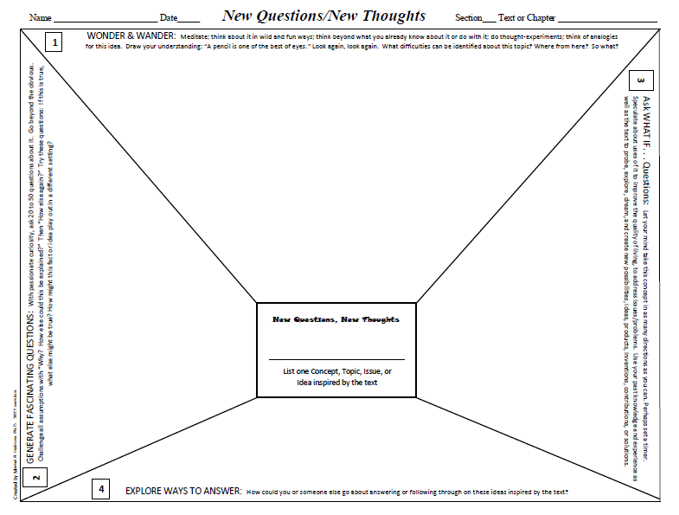

Here is the ThinkSheet.
I’ll give you an overview.
First, you decide your focus for thinking.

Slide 5
Then, you Wonder & Wander,

Slide 6
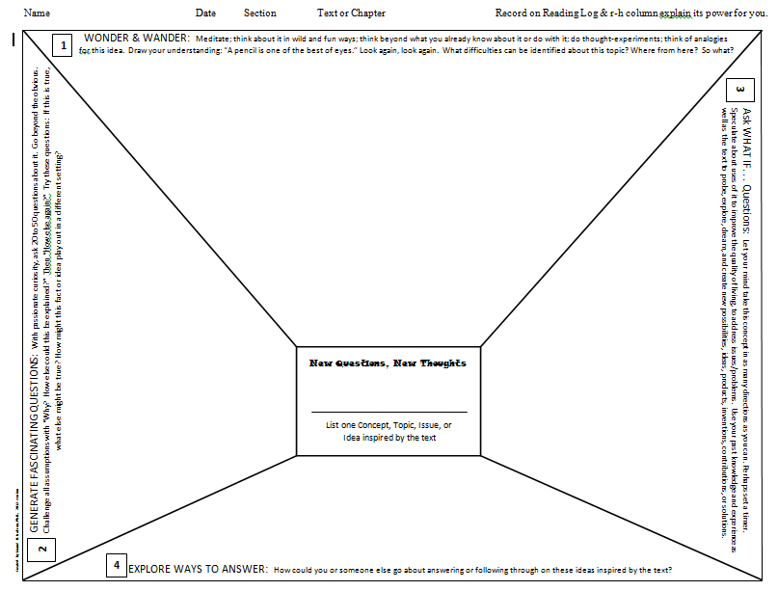
Generate Fascinating Questions,

Slide 7
Ask What if . . . Questions,

Slide 8
and Explore Ways to Answer.

Slide 9
Watch me do this strategy.

Slide 10
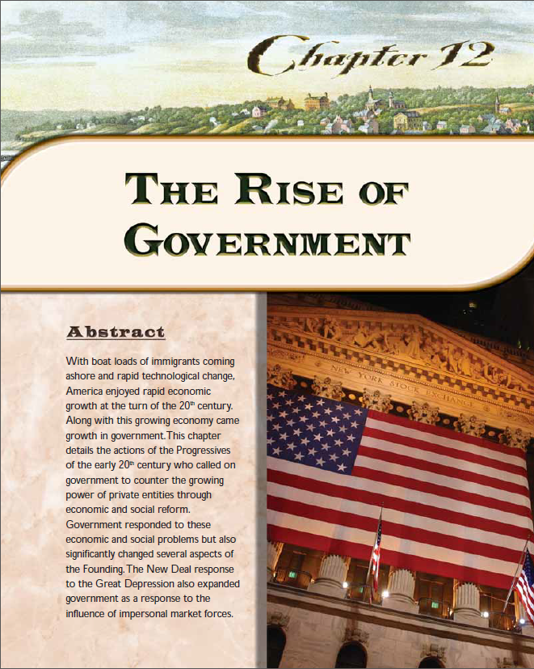
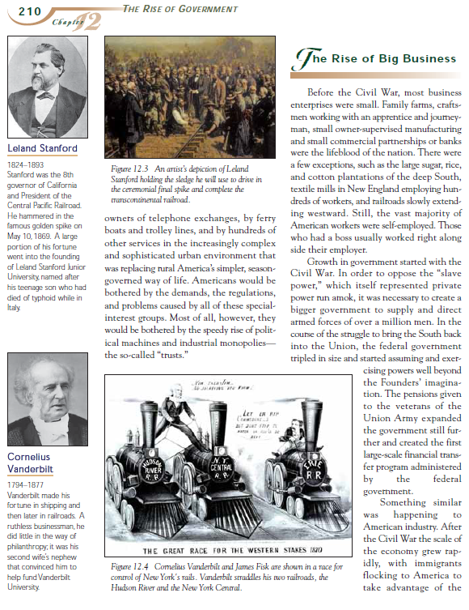
I have finished reading this text
City Upon a Hill, Chapter 12
“The Rise of Government.”

Slide 11
From my reading, an issue that intrigued and bothered me was the dubious impact on society of the rise of big business during the late 19th century—onward.
This issue will focus (but not limit) my thinking throughout the processes of this strategy.
I write this on the line provided.
I start in the middle of the ThinkSheet.
Concerns about the rise of big business

Slide 12
Now I go to
the first task: Wonder & Wander. I free my mind to think about this issue.
The ThinkSheet has several suggestions for letting my mind “wonder” and “wander.”
Meditate.
Think about it in wild and fun ways.
Think beyond what I already know about it or do with it.
Do thought-experiments.
Think of analogies for this idea.
Draw my understanding: “A pencil is one of the best eyes.”
Look again, look again.
Think of difficulties identified about this topic?
Ask “Where from here?”
Ask “So what?”
Concerns about the rise of big business

Slide 13
Here is my wondering and wandering about the rise of big business.
Concerns about the rise of big business

Slide 14
Were are the ethics of some businesses taking advantage of their employees?
Are the problems of over-regulation of business worse than the problems caused by little or no regulation?
How were the following outcomes reduced or eliminated? And where might they still be happening—anywhere?
STEEL – many killed in unsafe mills.
TEXTILES – Child labor 10 to 14 hours a day
How to improve the situation? What can cause change?
Have/Would some of the following work?
--Workers protest & organize.
--Voters nominate regulator types.
--Voters pressure Congress.
Concerns about the rise of big business

Slide 15
With passionate curiosity, ask 20 to 50 questions about it. After three or four obvious questions, push yourself beyond those to 50 questions. (Of course, you will need extra space.)
Challenge all assumptions with “Why are things this way?
How else could this be explained?” and “How else?” again.
Try these questions:
If this is true, what else might be true?
How might this fact or idea play out in a different setting?
Now, let’s look at the second task:
Generate Fascinating Questions
Concerns about the rise of big business

Slide 16
Where are the ethics of some businesses taking advantage of their employees?
Are the problems of over-regulation of business worse than the problems caused by little or no regulation?
How were these outcomes reduced or eliminated? And could be if still happening—anywhere?
STEEL – many killed in unsafe mills.
TEXTILES – Child labor 10 to 14 hours a day
How were these outcomes reduced or eliminated? And could be if still happening—anywhere?
STEEL – many killed in unsafe mills.
TEXTILES – Child labor 10 to 14 hours a day
Are the problems of over-regulation of business worse than the problems caused by little or no regulation?
How to cause change?
Have/Would some of these work?
Where are the ethics of some businesses taking advantage of their employees?
Workers protest & organize.
Voters nominate regulator types.
Voters pressure Congress.
Concerns about the rise of big business
How to cause change?
Have/Would some of these work?
Workers protest & organize.
Voters nominate regulator types.
Voters pressure Congress.

Slide 17
1. If people are happy to get a job, (any job) are they inevitably at the
mercy of the owner? (think of Grapes of Wrath where owners
publicized job openings when there weren’t any so an over
abundance of job seekers took the place of disgruntled lower-
paid workers for even lower pay.)
2.Why do we call any attempt to regulate “Socialism”?
3. Why does greed seem to be the father of
business? I’d like to research the businesses
that really care for their employees and
customers and still are successful.
4. How can compassion and
success go hand-in-hand?
Seems like a win-win..
Where are the ethics of some businesses taking advantage of their employees?
Are the problems of over-regulation of business worse than the problems caused by little or no regulation?
How were these outcomes reduced or eliminated? And could be if still happening—anywhere?
STEEL – many killed in unsafe mills.
TEXTILES – Child labor 10 to 14 hours a day
How were these outcomes reduced or eliminated? And could be if still happening—anywhere?
STEEL – many killed in unsafe mills.
TEXTILES – Child labor 10 to 14 hours a day
Are the problems of over-regulation of business worse than the problems caused by little or no regulation?
How to cause change?
Have/Would some of these work?
Here are some of the questions that grabbed me.
Where are the ethics of some businesses taking advantage of their employees?
Workers protest & organize.
Voters nominate regulator types.
Voters pressure Congress.
Then, believe it or not, I
generated 23 more fascinating questions in the next ten minutes.
Concerns about the rise of big business
How to cause change?
Have/Would some of these work?
Workers protest & organize.
Voters nominate regulator types.
Voters pressure Congress.

Slide 18
The third task is my favorite: Ask WHAT IF . . . Questions.
Where are the ethics of some businesses taking advantage of their employees?
Are the problems of over-regulation of business worse than the problems caused by little or no regulation?
How were these outcomes reduced or eliminated? And could be if still happening—anywhere?
STEEL – many killed in unsafe mills.
TEXTILES – Child labor 10 to 14 hours a day
Concerns about the rise of big business
1. If people are happy to get a job, (any job) are they inevitably at the
mercy of the owner? (think of Grapes of Wrath where owners
publicized job openings when there were not any so an over
abundance of job seekers took the place of disgruntled lower
paid workers for even lower pay.)
2.Why do we call any attempt to regulate “Socialism”?
3. Why does greed seem to be the father of
business? I’d like to research the businesses
that really care for their employees and
still are successful.
4. How can compassion and
success go hand-in-hand?
Seems like a win-win.
How to cause change?
Have/Would some of these work?
Workers protest & organize.
Voters nominate regulator types.

Slide 19
Let my mind take this concern about business and run with it asking “What would happen if. . .” “What if we tried this idea?” and so on.
Speculate about uses of the rise of business to improve the quality of life, to address issues/problems.
Use my past knowledge and experiences as well as the text to ask “What If. . . Questions” to probe, explore, dream, and create new possibilities, ideas, products, inventions, contributions, solutions, etc.
I will set a timer for 20 minutes and make myself keep producing.
Let’s look what the ThinkSheet is suggesting I do.
Concerns about the rise of big business

Slide 20
What if owners had to work beside their workers three days a month in
randomly chosen places?
What if bosses were rated by workers as are professors by students?
What if workers could submit suggestions for improving the
work place AND productivity? What if a committee
considered the suggestions and rewarded those whose
ideas were implemented?
What if the government regulators actually
put a stop to fraud and saved taxpayers
billions of dollars? Who would be up-
set about that? Why?
Here are a few of the WHAT IF . . . Questions I asked.
I really want to explore answers to the abuses of business without thwarting a strong economy.
I want to discuss the history of corporate America, especially in light of a book I just read The Divide: American Justice in the Age of the Wealth Gap.
I definitely feel engaged in the issues of this text.
What if there were no checks
on businesses, no regula-
tions at all?
Where are the ethics of some businesses taking advantage of their employees?
Are the problems of over-regulation of business worse than the problems caused by little or no regulation?
How were these outcomes reduced or eliminated? And could be if still happening—anywhere?
STEEL – many killed in unsafe mills.
TEXTILES – Child labor 10 to 14 hours a day
Concerns about the rise of big business
1. If people are happy to get a job, (any job) are they inevitably at the
mercy of the owner? (think of Grapes of Wrath where owners
publicized job openings when there were not any so an over
abundance of job seekers took the place of disgruntled lower
paid workers for even lower pay.)
2.Why do we call any attempt to regulate “Socialism”?
3. Why does greed seem to be the father of
business? I’d like to research the businesses
that really care for their employees and
still are successful.
4. How can compassion and
success go hand-in-hand?
Seems like a win-win.
How to cause change?
Have/Would some of these work?
Workers protest & organize.
Voters nominate regulator types.

Slide 21
Where are the ethics of some businesses taking advantage of their employees?
The last step is what can make action happen. I am to explore ways to the address the issue and to answer my questions.
Here is what the ThinkSheet suggests I think about.
Are the problems of over-regulation of business worse than the problems caused by little or no regulation?
1. If people are happy to get a job, (any job) are they inevitably at the
mercy of the owner? (think of Grapes of Wrath where owners
publicized job openings when there were not any so an over
abundance of job seekers took the place of disgruntled lower
paid workers for even lower pay.)
2.Why do we call any attempt to regulate “Socialism”?
3. Why does greed seem to be the father of
business? I’d like to research the businesses
that really care for their employees and
still are successful.
4. How can compassion and
success go hand-in-hand?
Seems like a win-win.
How were these outcomes reduced or eliminated? And could be if still happening—anywhere?
STEEL – many killed in unsafe mills.
TEXTILES – Child labor 10 to 14 hours a day
How to cause change?
Have/Would some of these work?
What if owners had to work beside their workers three days a month in
randomly chosen places?
What if bosses were rated by workers as are professors by students?
Workers protest & organize.
Voters nominate regulator types.
What if workers could submit suggestions for improving the
work place AND productivity? What if a committee
considered the suggestions and rewarded those whose
ideas were implemented?
How could you or someone else go about answering or following through on these ideas inspired by the text?
Voters pressure Congress..
What if the government regulators actually
put a stop to fraud and saved taxpayers
billions of dollars? Who would be up-
set about that? Why?
Concerns about the rise of big business
What if there were no checks
on businesses, no regula-
tions at all?

Slide 22
Here are some ways I thought I or others could explore for answers and address my concerns about big business.
Where are the ethics of some businesses taking advantage of their employees?
Are the problems of over-regulation of business worse than the problems caused by little or no regulation?
1. If people are happy to get a job, (any job) are they inevitably at the
mercy of the owner? (think of Grapes of Wrath where owners
publicized job openings when there were not any so an over
abundance of job seekers took the place of disgruntled lower
paid workers for even lower pay.)
2.Why do we call any attempt to regulate “Socialism”?
3. Why does greed seem to be the father of
business? I’d like to research the businesses
that really care for their employees and
still are successful.
4. How can compassion and
success go hand-in-hand?
Seems like a win-win.
How were these outcomes reduced or eliminated? And could be if still happening—anywhere?
STEEL – many killed in unsafe mills.
TEXTILES – Child labor 10 to 14 hours a day
How to cause change?
Have/Would some of these work?
What if owners had to work beside their workers three days a month in
randomly chosen places?
What if bosses were rated by workers as are professors by students?
Workers protest & organize.
Voters nominate regulator types.
What if workers could submit suggestions for improving the
work place AND productivity? What if a committee
considered the suggestions and rewarded those whose
ideas were implemented?
Voters pressure Congress..
What if the government regulators actually
put a stop to fraud and saved taxpayers
billions of dollars? Who would be up-
set about that? Why?
Concerns about the rise of big business
What if there were no checks
on businesses, no regula-
tions at all?
1. Search history for attempts to come
to a just balance between business practices and government regulation that benefit business and society.
2. Look at current laws protecting workers and consumers. Sufficient? Enforced?
3. Contact folks who are currently addressing damaging business practices and government
overreach. How are they fighting big business and unnecessary government regulation?
4. Search for what has worked for both business owners, workers, and consumers at the same time. What principles
behind these successes could be exported to other businesses?

Slide 23
Now select an idea, issue,
or concept in your text and use the ThinkSheet to practice exploring it with your knowledge and imagination.
Come up with New Questions and New Thoughts
Have fun!

