Slide 1
Probe My Mind
Demo

Slide 2
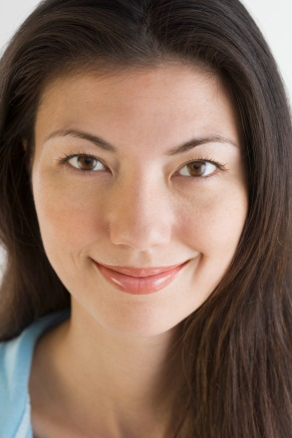
Before going on, read the pages in the Handbook discussing the Probe My Mind strategy.
Now that you’ve probed the Author’s mind, you are ready to probe your own mind.
Welcome to the Demo of
Probe My Mind.
This AFTER strategy of Layered Reading makes you explore your own points of view, uncover your own biases, and realize how your views affect your understanding
of the text.

Slide 3
Here is the ThinkSheet for this strategy.
Notice the three sections:
Ask the same questions for Probe the Author’s Mind of yourself —after all, you co-authored this text as you read.
How does this text challenge or reinforce your prior understanding?
Let the book “read you” and probe what your views say about you.

Slide 4
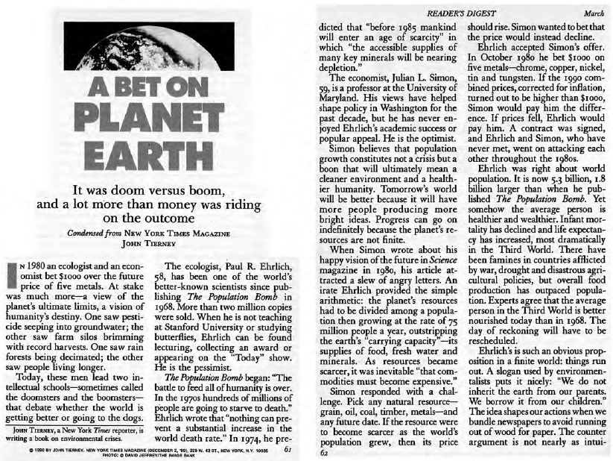
We’ll continue working with
A Bet on Planet Earth. You know it well by now.

Slide 5
Let’s look at the first section of the ThinkSheet.

Slide 7
I worry about the sustainability of the way we humans are using and abusing the earth. I try hard to lighten my footprint on it –use mass transit or walk whenever possible, conserve electricity, recycle, etc. But I know that these steps count for little, so I like Simon’s arguments about human ingenuity. I appreciate Simon’s research about the ability of the human mind to invent, improvise, explore, and discover viable solutions. I am amazed at what we as a human family have accomplished across history and certainly do believe we can solve problems in the future.
I let my thoughts roam freely so I can discover where I stand—what my positions are. This ThinkSheet is not big enough for that, but you get the idea from my freewriting above.

Slide 8
I do believe the scientists about global warming and am surprised by those who seem to deny the science. I hope governments and businesses will fund major innovations to protect the environ-ment. We need the political will, geniuses with incentive to propose solutions to these problems, use of technology, and certainly the synergy of collaborations. I feel strongly that we can’t ignore these problems. The social repercussions are too great to push them aside for later. I am appalled at the political quagmire we are stuck in concerning this and so many other pressing issues. We need great leaders and thinkers right now. They are among us; we just need to discover them or they need the courage to try.
This strategy makes the text much more than an interesting bit of information.
I see strong feelings surfacing by exploring my responses to this question.

Slide 9
These questions are designed to get me started in probing my own thinking.
I do not need to consider these questions in order.
Here are two sources for good questions to help me consider who I am in relation to a particular topic or position:
Go over that list of questions for Probe the Author’s Mind and rephrase them to probe my own mind.
Come up with my own questions into where I stand and why.

Slide 10
Instead of writing all my answers out, for the rest of this demonstration I will just share my thinking.
Now, let’s go to the next section.

Slide 11
But Simon really got me thinking. How nice it would be if his claims would bear fruit. I feel myself wanting so much to have his optimism. I can see my worry dissipating a little because I know there are many fine minds and willing people out there who could work on these major problems. In fact, are not universities and entrepreneurs working night and day to generate solutions?
Before reading this text, I would have been in Ehlich’s camp, having read some of his articles. I had never heard of Simon’s ideas.
Hmm . . .

Slide 12
After I read the article the first time, I heard that others have written about it over 20 years later.
I want to see their thinking and how it compares.
It would be fun to evaluate this text from the 1990 perspective and then from the perspectives of scientists, environmentalists, economists, and anti-climate-change folks today.
I also am very interested in where Ehrlich and Simon headed in their fields after The Bet. What were their pursuits related to the ideas in this article? Are these men still alive? What is their legacy?

Slide 13
Now for the final section.

Slide 14
I tend to have an “over-developed” sense for fairness.
Sometimes, this makes me susceptible to considering things that I really do not have time for. And sometimes, I do not let this good reason stop me—unfortunately for other pressing matters and fortunately for my curiosity and relaxation.
I really want to hear the unfiltered version of both arguments and make my own decision.

Slide 15
I want to be a good steward of the earth. I want to use my own ingenuity to solve problems, appreciate the talents of others in solving them also, and then to join together to make the best decisions we can.
But, I recognize that “fairness” at any cost is not necessarily a virtue.
It is too nebulous of a concept and can never be fully realized.
This text also brings to my attention my need for fairness in presenting two sides.
. . .but, once that is done based on my time, interest, and a basic sense of fairness, it is appropriate to make my best value judgment given the information I have.
How else am I changing and
being influenced by this text?
Instead of wringing my hands in frustration, act. There is much to learn and many perspectives to consider, but finally I must act. It is okay not to have the perfect solution—because there isn’t one. Make the best informed decision I can and start to make a difference for the earth and humankind.
Yes, it is appropriate to exam both Ehrlich’s and Simons’ points of view,

Slide 16
This strategy can be mind-
boggling, fun, certainly enlightening, and a bit uncomfortable as you come to probe your values and prior knowledge in light of a specific text..
Good luck probing your own fine mind as you practice on your text!
It can also be time-consuming if you let it. To lessen the time,
use a text with potential to make you think,
select a few questions from the ThinkSheets to address, and
then write abbreviated answers or just think the answers.
(Writing, of course, is better for long-term transformation.)
This strategy is highly engaging, makes the text yours, and takes you deeply into interactions
with the text.

