Slide 1
MICER
(Monitor, Identify, Creatively Explore, Reflect)
Demo

Slide 2

Working through the MICER process can be
a euphoric experience:
You see your fine mind at work.
You see yourself grappling with hard ideas and concepts.
You experience the pleasure of figuring out these difficult things.
This strategy is the ultimate deep-thinking DURING strategy within Layered Reading.
Welcome to the DEMO for MICER.
It is a systematic way to move from a superficial to a thorough understanding of a particularly difficult part of a text.
Because it can be labor intensive, you will probably use MICER only for the hardest, most important parts of texts you need and want to learn well—such as for those key ideas and issues in your major or for topics that you are determined to master.
Before proceeding further, read the pages in the Handbook about Monitor Understanding and Fix-Up and about the strategy MICER.
Now let’s go to the ThinkSheet for this Strategy.

Slide 3
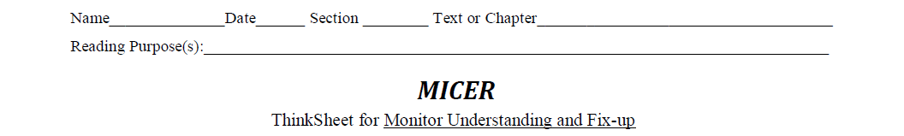
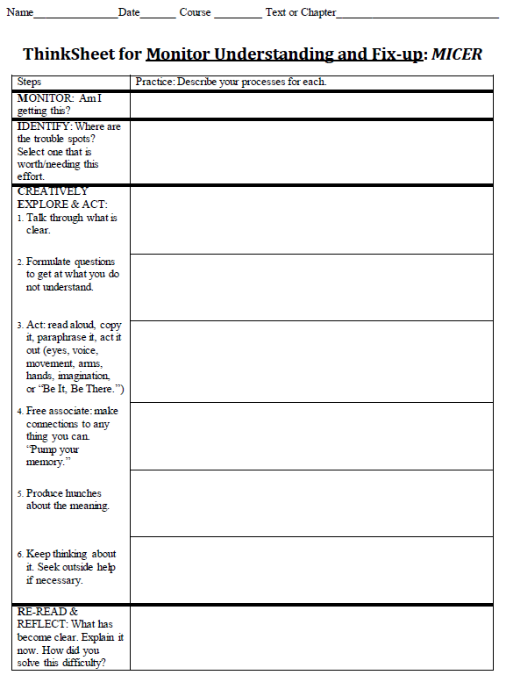

Slide 4
Here is the text I will be using to demonstrate this strategy.

Slide 5
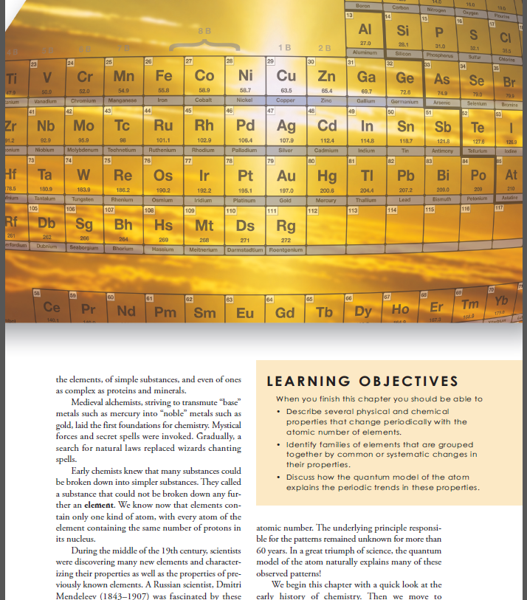
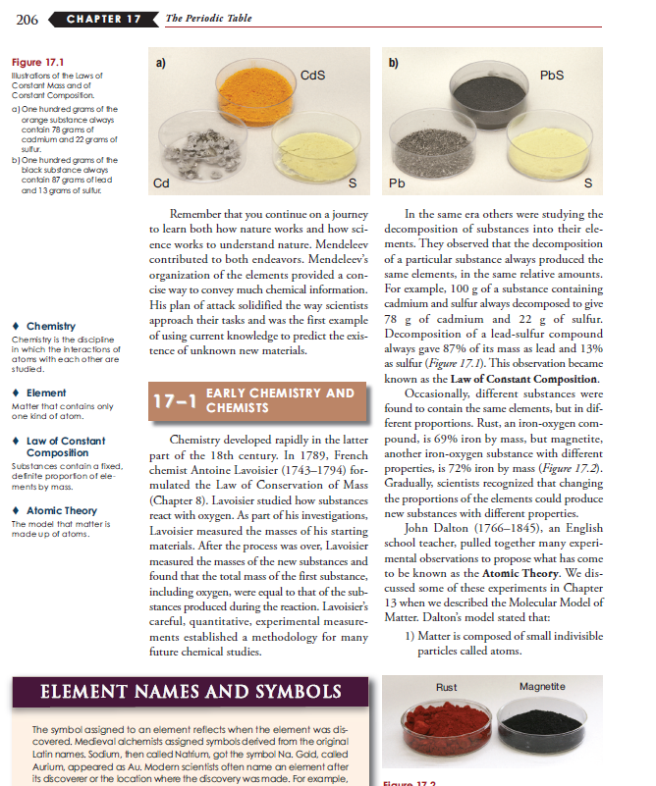
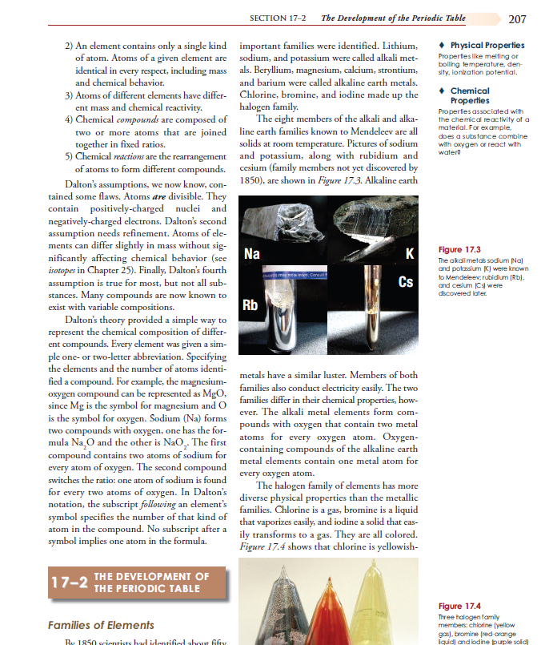
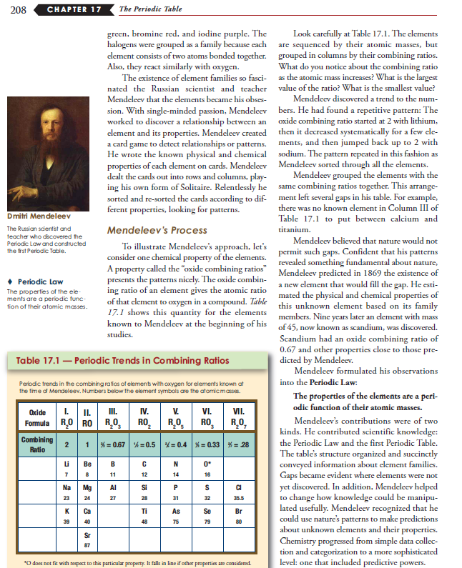
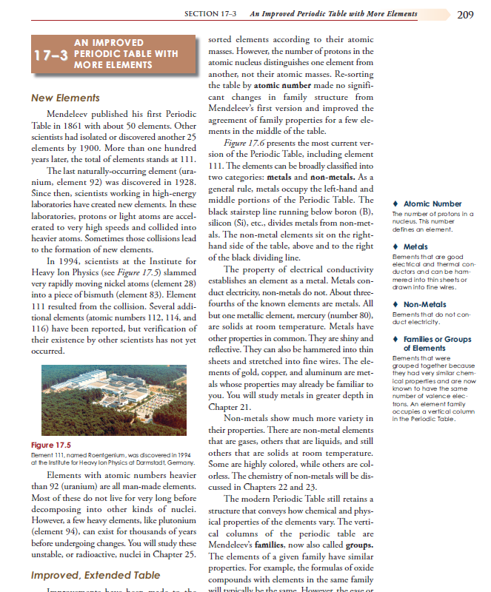
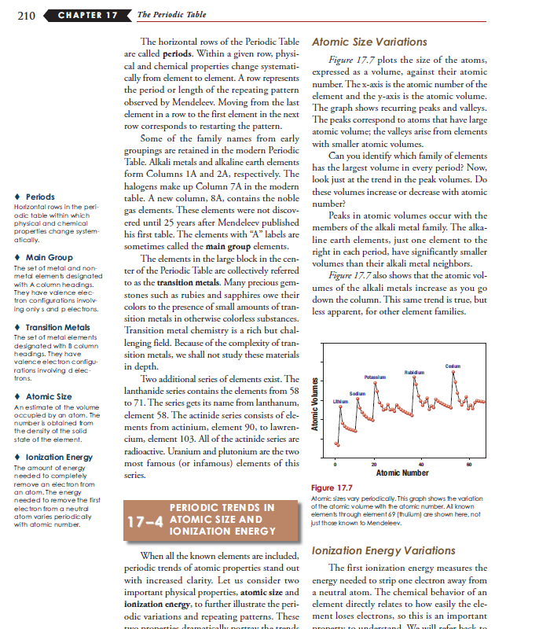
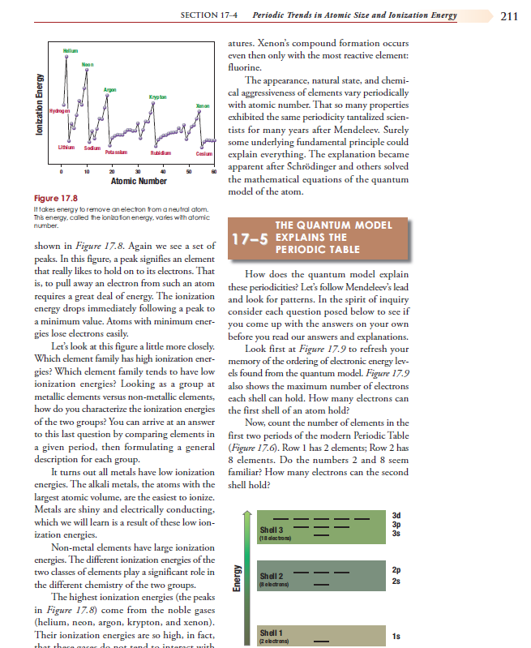
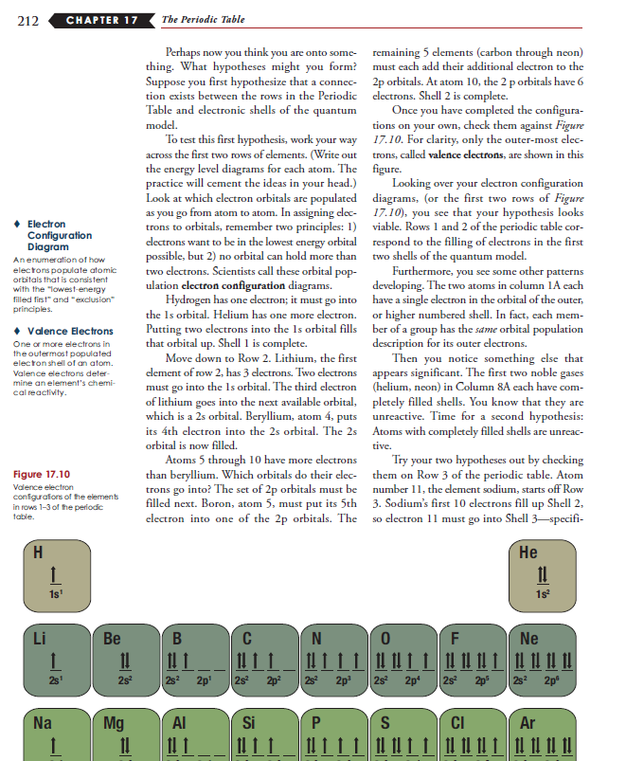
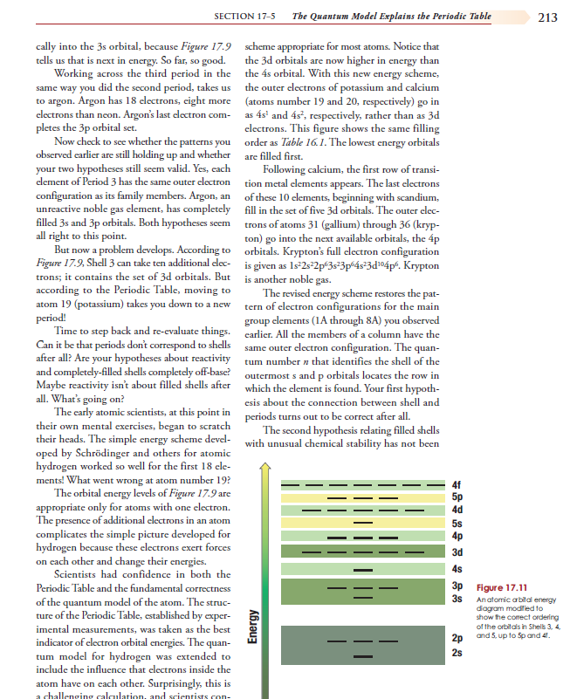
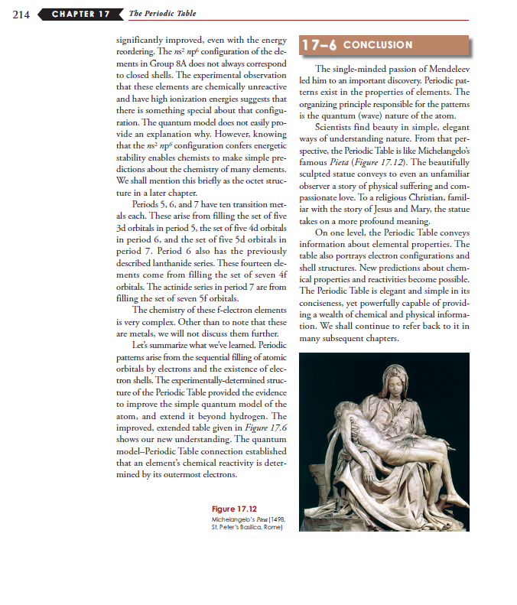
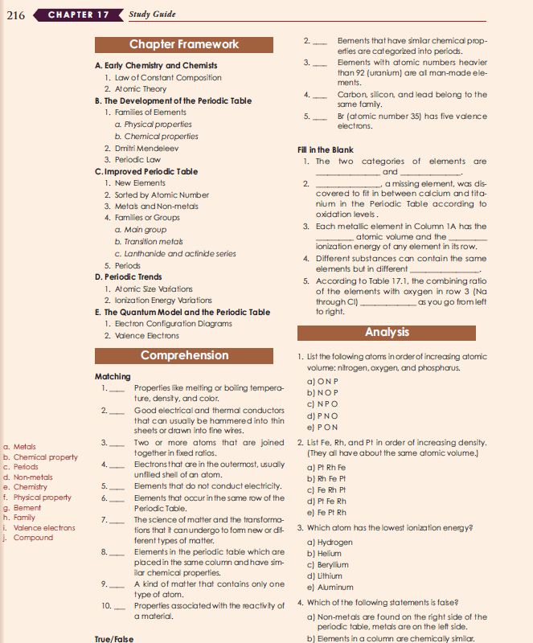
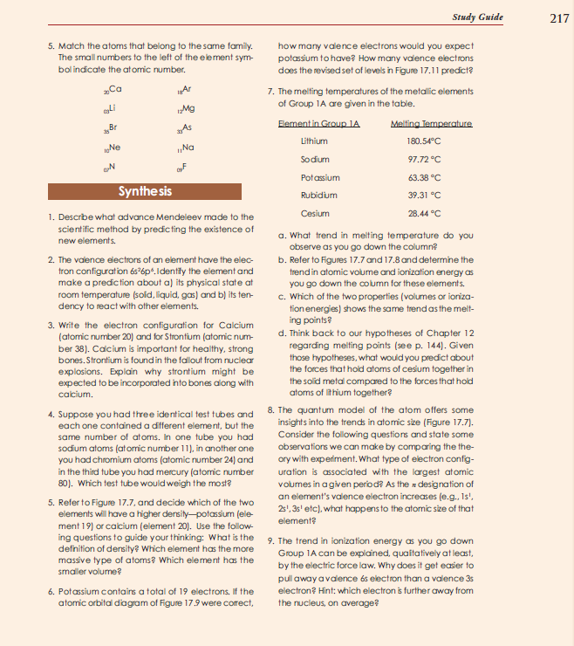
Once again our old friend - Chapter 17
“The Periodic Table”

Slide 6
Let’s start with Monitor.

Slide 7
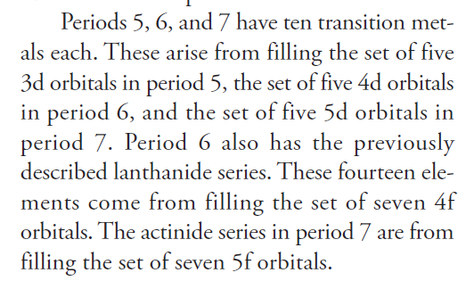
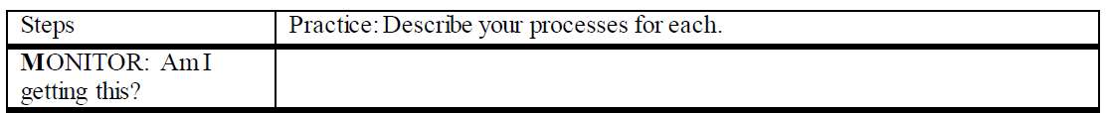
Then, my fragile understanding collapsed.
I actually thought I was getting this until p. 214 middle paragraph.
Read Here

Slide 8
I put my thoughts onto the ThinkSheet.
I thought so – until p. 214 middle paragraph; then my fragile understanding collapsed.

Slide 9
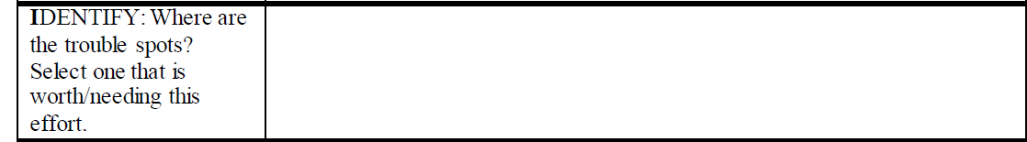
but feel if I can understand this one paragraph,
I have lots and lots of questions,
I’ll better understand the rest of the chapter.
This paragraph is a big trouble spot.
Read Here

Slide 10
That paragraph is the big trouble spot.
I have lots and lots of questions, but feel if I can understand this one paragraph, I’ll better understand the rest of the chapter.
Notes:
Add to dialog in previous slide

Slide 11
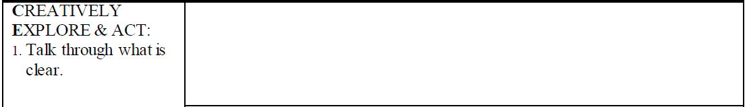
I read aloud multiple times,
and placed the periodic table in front of me.
Read Here
Notes:
I read aloud multiple times, and placed the periodic table in front of me.

Slide 12
I know Periods 5, 6, & 7 refer to the rows on the Periodic Table of elements.
Orbitals are standing waves that hold electrons,
but their place in the orbital can only be predicted by probabilities.

Slide 13
This is the core idea of the quantum model of the atom.

Slide 14
I read aloud multiple times, and placed the periodic table in front of me. I know Periods 5, 6, & 7 refer to the rows on the Periodic Table of elements. Orbitals are standing waves that hold electrons but their place in the orbital can only be predicted by probabilities.

Slide 15
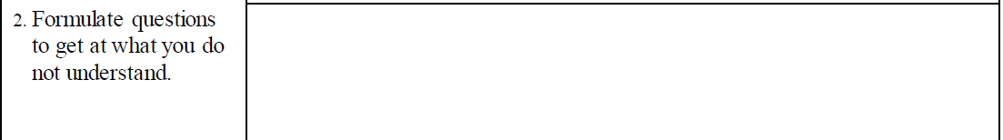
What are 3d & 4d orbitals?
What are the transition metals?
Read Here
Notes:
Bring in the paragraph and draw arrows.

Slide 16
What are 4f & 5f orbitals?
What are the distinguishing features of the lanthanide & actinide series?
Notes:
How do I identify the ten each in Periods 5, 6, & 7?
What are 3d & 4d orbitals?
What are 4f & 5f orbitals?
What are the distinguishing features of the lanthanide & actinide series?

Slide 17
How do I identify the ten each in Periods 5, 6, & 7? What are 3d & 4d orbitals? What are 4f & 5f orbitals? What are the distinguishing features of the lanthanide & actinide series?
Notes:
How do I identify the ten each in Periods 5, 6, & 7? What are 3d & 4d orbitals? What are 4f & 5f orbitals? What are the distinguishing features of the lanthanide & actinide series?

Slide 18
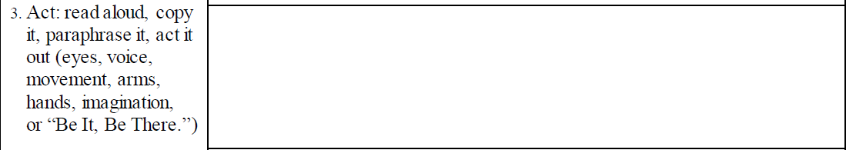
This step is the heart and fun of the MICER strategy. It is often where breakthroughs in understanding occur.
Before I can do this for my hard paragraph, I realize I must build more schema!
So I study parts of earlier chapters—10, 14, 15, and all of 16 using Mindful Reading,
and read Ch. 17 a third time—reading parts aloud & “talking to the Author.”
Read Here
Notes:
Put on everyone of these – READ THE SUGGESION (RED ARROW)

Slide 19
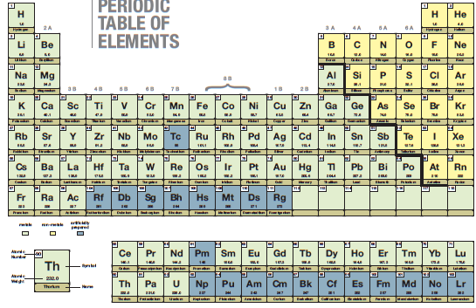


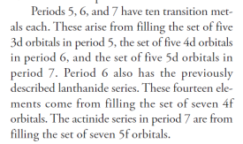
All this while constantly referring to my target paragraph.
Then, I looked at the Periodic Table and imagined that I cut it up –an act for Step 3.
A second action was imagining placing every element where it goes on the table and
explaining why it goes there.
Notes:
Before I can do this, I must build more schema!
So I studied parts of Ch. 10, 14, 15, all of 16 “Mindful Reading”
and read Ch. 17 a third time- read parts aloud & talked to the Author.
All this while constantly referring to my target paragraph.
Then, I made a copy of the Periodic Table and then cut it up,
placing every element where it goes and explaining why.

Slide 20
Before I can do this, I must build more schema! So I studied parts of Ch. 10, 14, 15, all of 16 “Mindful Reading” and read Ch. 17 a third time- read parts aloud & talked to the Author.
All this while constantly referring to my target paragraph. Then, I made a copy of the Periodic Table and then cut it up, placing every element where it goes and explaining why.
Notes:
IMAGINE CUTTING IT UP – BUBBLE IN HEAD – WITH PERIODIC TABLE AN D SISSORS - IMAGINE

Slide 21
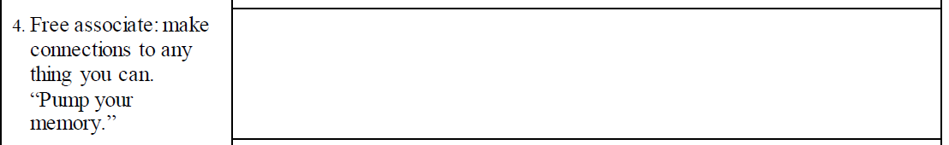

For example, Periodic is not “occasionally” but a repeated pattern—like class periods in high school schedules or like a magazine that comes out every month, a periodical.
The standing waves –like jumping ropes, like shaking ropes, or like leaves staying in place on a lake after a motor boat goes by, etc.
I made many connections as I was building schema.
Read Here

Slide 22
I made many connections as I was building schema; eg; Periodic (not “occasionally” but a repeated pattern - like class periods in high school schedules.) The standing waves –like jumping ropes, like shaking ropes, like leaves staying place on a lake after a motor boat goes by, etc.

Slide 23
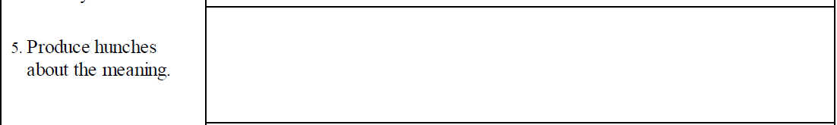
The number of electrons in the outer shell (valence electrons) determines if the shell is filled or not,
That is why the shells below the outer ones are stable.
and this shows “excitability” of the atom to connect or reject joining with other atoms.
All nature seeks equilibrium.
Read Here

Slide 24
because every element has natural characteristics that can be ordered.
The Periodic Table is totally systematic – not “created” but “discovered”
Notes:
The number of electrons in the outer shell (valence electrons) determines if the shell is filled or not – and this shows “excitability” of the atom to connect or reject joining with other atoms.
All nature seeks equilibrium. That is why the shells below the outer ones are stable.
The Periodic Table is totally systematic – not “created” but “discovered” because every element has natural characteristics that can be ordered.

Slide 25
The number of electrons in the outer shell (valence electrons) determines if the shell is filled or not – and this shows “excitability” of the atom to connect or reject joining with other atoms.
All nature seeks equilibrium. That is why the shells below the outer ones are stable.
The Periodic Table is totally systematic – not “created” but “discovered” because every element has natural characteristics that can be ordered.
Notes:
The number of electrons in the outer shell (valence electrons) determines if the shell is filled or not – and this shows “excitability” of the atom to connect or reject joining with other atoms.
All nature seeks equilibrium. That is why the shells below the outer ones are stable.
The Periodic Table is totally systematic – not “created” but “discovered” because every element has natural characteristics that can be ordered.

Slide 26
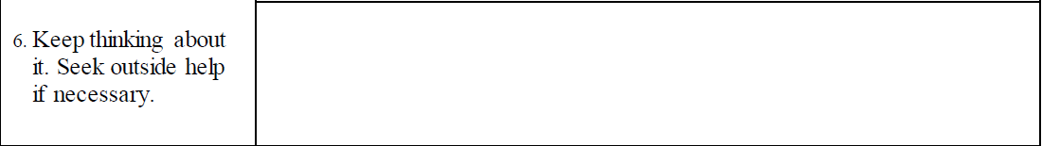
I asked the Tutor to listen to
my explanation and clarify any misconceptions about the periodic table and the target paragraph.
I thought through the whole table & then went to the chemistry tutoring lab.
Read Here

Slide 27
I was constantly using my new current knowledge about why every placement on the table made sense.
He clarified my misconceptions and deepened my observations by clarifying the patterns I was seeing.

Slide 28
I thought through the whole table & then went to the chemistry tutoring lab and I explained the periodic table and the target paragraph to the tutor. He clarified my misconceptions and deepened my observations by clarifying the patterns I was seeing –
pulling in my current knowledge about why every placement on the table made sense.

Slide 29
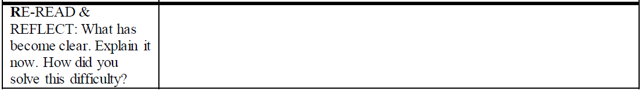
The periods, groups, standing waves, orbitals, shells, spin, valence shell, s, d, p, & f,
. . . what each atomic number and atomic weight mean as well as the history of the Periodic Table.
What has become clear?
Read Here

Slide 30
What has become clear: The periods, groups, standing waves, orbitals, shells, spin, valence shell, s, d, p, & f, what each atomic number and atomic weight means as well as the history of the Periodic Table.
Notes:
What has become clear (comes first)
Above is the explain
How did you solve it – my dogged pursuit
By doing all th e thinking of MICER – time consuming – tried to figure it out by myself – I have really studied this – I think im almost there – I want you to listen to me explain it an dyour job is to clarify my misconceptions.
You do the groundwork first for two reasons (take less time from the person your asking and you are ready to receive what they are saying – you are a pitcher not a plate)
What has become clear: The periods, groups, standing waves, orbitals, shells, spin, valence shell, s, d, p, & f, what each atomic number and atomic weight means as well as the history of the Periodic Table.

Slide 31
I thought so – until p. 214 middle paragraph; then my fragile understanding collapsed.
I have lots and lots of questions, but feel if I can understand this one paragraph, I’ll understand the rest of the chapter.
I read aloud multiple times, and placed the periodic table in front of me. I know Periods 5, 6, & 7 refer to the rows on the Periodic Table of elements. Orbitals are standing waves that hold electrons but their place in the orbital can only be predicted by probabilities.
How do I identify the ten each in Periods 5, 6, & 7? What are 3d & 4d orbitals? What are 4f & 5f orbitals? What are the distinguishing features of the lanthanide & actinide series?
Before I can do this, I must build more schema! So I studied parts of Ch. 10, 14, 15, all of 16 “Mindful Reading” and read Ch. 17 a third time- read parts aloud & talked to the Author.
All this while constantly referring to my target paragraph. Then, I made a copy of the Periodic Table and then cut it up, placing every element where it goes and explaining why.
I made many connections as I was building schema; eg; Periodic (not “occasionally” but a repeated pattern - like class periods in high school schedules.) The standing waves –like jumping ropes, like shaking ropes, like leaves staying place on a lake after a motor boat goes by, etc.
The number of electrons in the outer shell (valence electrons) determines if the shell is filled or not – and this shows “excitability” of the atom to connect or reject joining with other atoms. All nature seeks equilibrium. That is why the shells below the outer ones are stable. The Periodic Table is totally systematic – not “created” but “discovered” because every element has natural characteristics that can be ordered.
I thought through the whole table & then went to the chemistry tutoring lab and I explained the periodic table and the target paragraph to the tutor. He clarified my misconceptions and deepened my observations by clarifying the patterns I was seeing – pulling in my current knowledge about why every placement on the table made sense.
What has become clear: The periods, groups, standing waves, orbitals, shells, spin, valence shell, s, d, p, & f, what each atomic number and atomic weight means as well as the history of the Periodic Table.

Slide 32
I hope you see how nice it is to know a way to make difficult learning happen.
Now use this strategy on a part of a text where you need to monitor and fix up your understanding!
You may not spend as long as I did on your difficult part, but you might if it is hard enough and if you are determined to understand.
You saw me demand understanding and what it took to do so. Definitely MICER has taken far less time in other text situations.

